Slide 1


2022-2023
Golden Secondary School

Slide 2

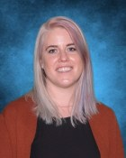
Kelsey Doolaar, Principal
Over the course of the 2021-2022 school year, we monitored the ongoing progress of student achievement in the areas of Numeracy and Literacy as well as teachers’ growth in inclusive practices and students’ sense of belonging. From this data we continue to be able to identify and target areas of need to focus our attention. This data told us a story and highlighted areas that we as a staff want to continue to focus on.
Our target areas continue to center around belonging, numeracy, literacy and inclusive assessment practices. These areas continue to be a focus of our Professional Learning Teams (PLTs). Each PLT has been tasked with becoming more knowledgeable in instructional practices that will continue to enhance student learning in these areas. Through collaboration and sharing of instructional strategies during our monthly learning staff meetings, PLTs will share their findings with staff to help enhance student learning.
As we embark on this journey, we look forward to supporting all students on their path to success.

Slide 3
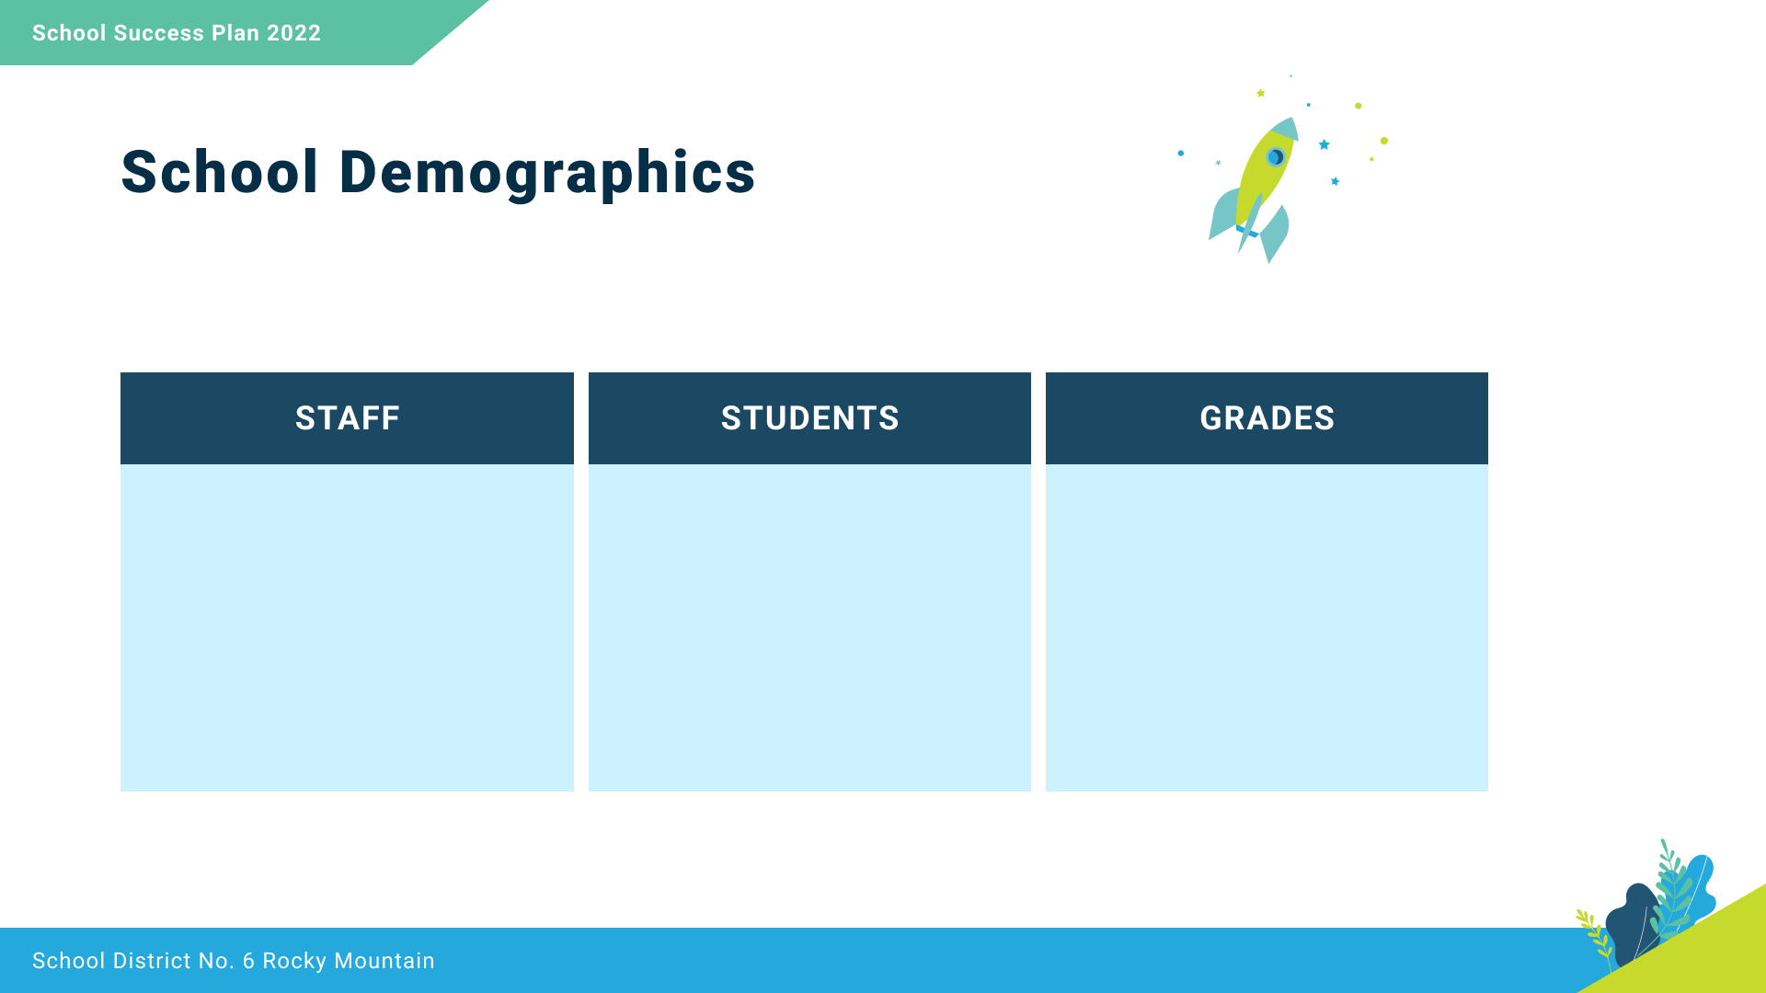
21 Teachers
15 Support Staff
All Learners
356
Indigenous Learners
72
Grades 8 to 12

Slide 4

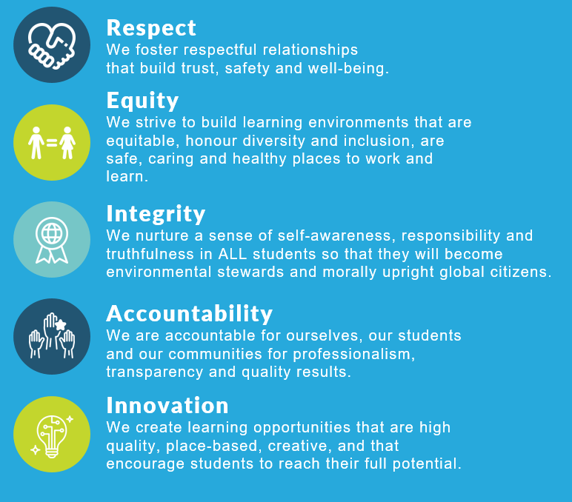
We collaborate in the pursuit of each student’s success as caring, resilient members of a global community.
Opportunity, equity, and success for all learners.

Slide 5

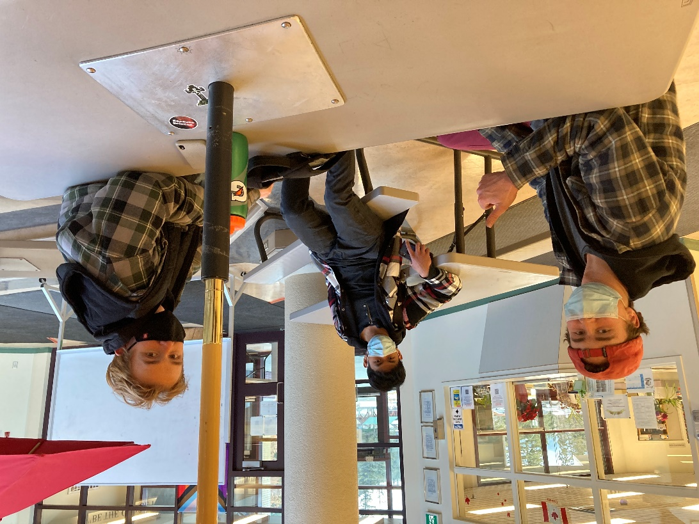
Equity and Inclusion
1
To increase students’ sense of belonging at school.

Slide 6

Is school a place where you feel like you belong?
 | 2020-2021 | 2021-2022
Belonging (Most and all of the time) | 30% | 53%

Slide 7
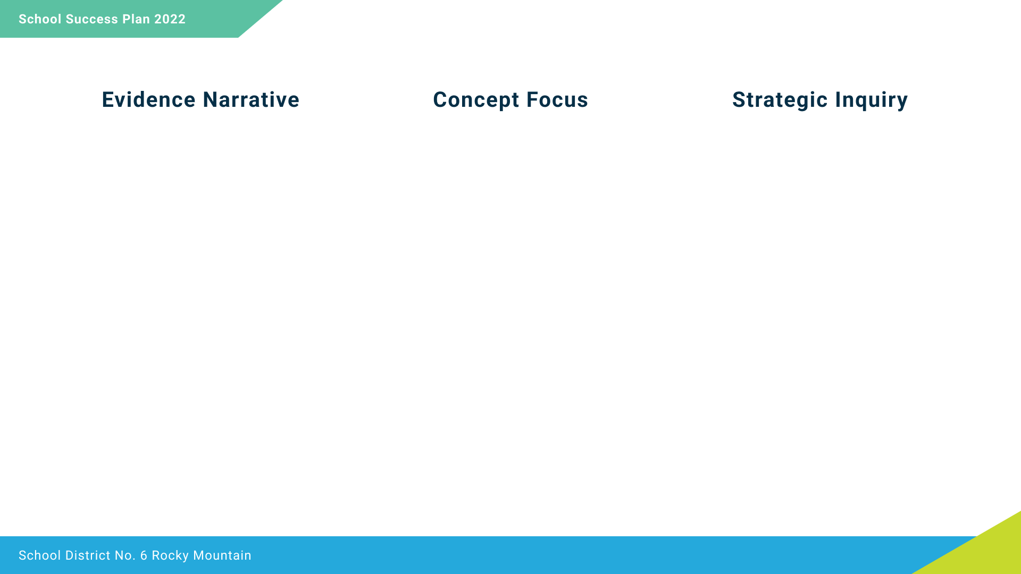
On the previous slide, Through the GSS Belonging Survey, students provided feedback about the importance of staff and student relationships. Though we noticed growth throughout the year, staff considered the responses and felt that relationships between students and adults at school were an area that requires ongoing focus.
Student Sense of Belonging
To what extent will teachers’ use of trauma informed strategies, and encouraging teacher-student relationships, help increase students’ sense of belonging at school?

Slide 8
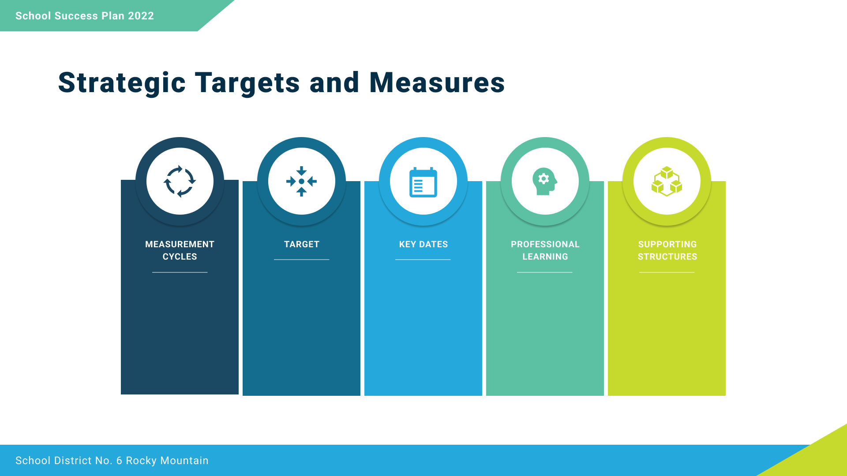
An increased sense of belonging from
50 % to 75% on the
GSS Belonging Survey
(All the time & Most times)
GSS Belonging Survey
September 29, January 27 & May 1
-
Student Connection Survey
December 6 & April 4
Ensouling Our School
by Jennifer Katz & Kevin Lamoureux
-
PLT Learning Focus
All Students Survey Data Reviewed at Staff
Oct./Feb./May
Professional Learning Teams Belonging Focus Monthly
Professional Learning Teams
(Monthly meeting to focus on strategic priority goal)
Learning Focused Staff Meetings
Student Advisory Council

Slide 9
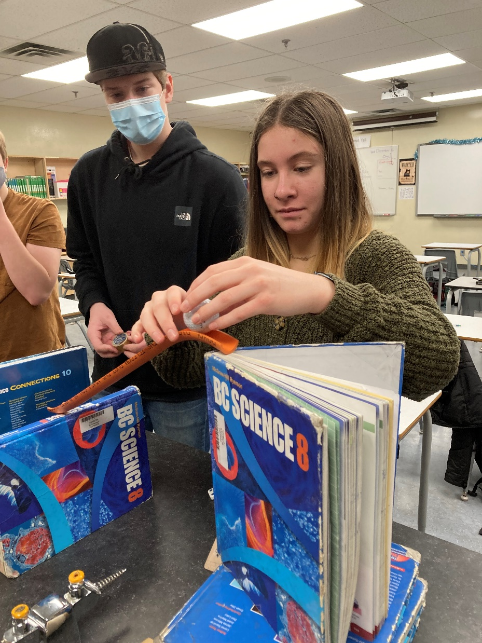
Success for each learner
2
- Numeracy
To increase students’ achievement in numeracy.

Slide 10
 | Grade 8 SNAP | Grade 9 SNAP | GNA 10 (June 2021)
% Proficient (Proficient or Extending) | 69% | 67% | 35%

Slide 11
In comparing our SNAP Data and Provincial Numeracy data, as well as what teachers have observed in the Numeracy Task of the week, students are capable of solving math equations, but lack the critical thinking strategies when it comes to applying math skills to real life problems.
Critical Thinking
If all staff focus on teaching interpretation and analysis to students across curriculum, will students improve their numeracy skills?

Slide 12
An increase student achievement in Numeracy assessments from
35 % Proficient to 50% Proficient or Extending
Junior District Numeracy Assessment
September & April (end)
-
Provincial Numeracy Assessment
January & June
Student Critical Thinking Tools Samples Reviewed
Nov. 1/Apr. 4
Professional Learning Teams Numeracy Focus
Monthly
Making Thinking Visible
by Ritchhart, Church & Morrison
-
PLT Learning Focus
Professional Learning Teams
(Monthly meeting to focus on strategic priority goal)
Learning Focused Staff Meetings
Instructional Rounds

Slide 13
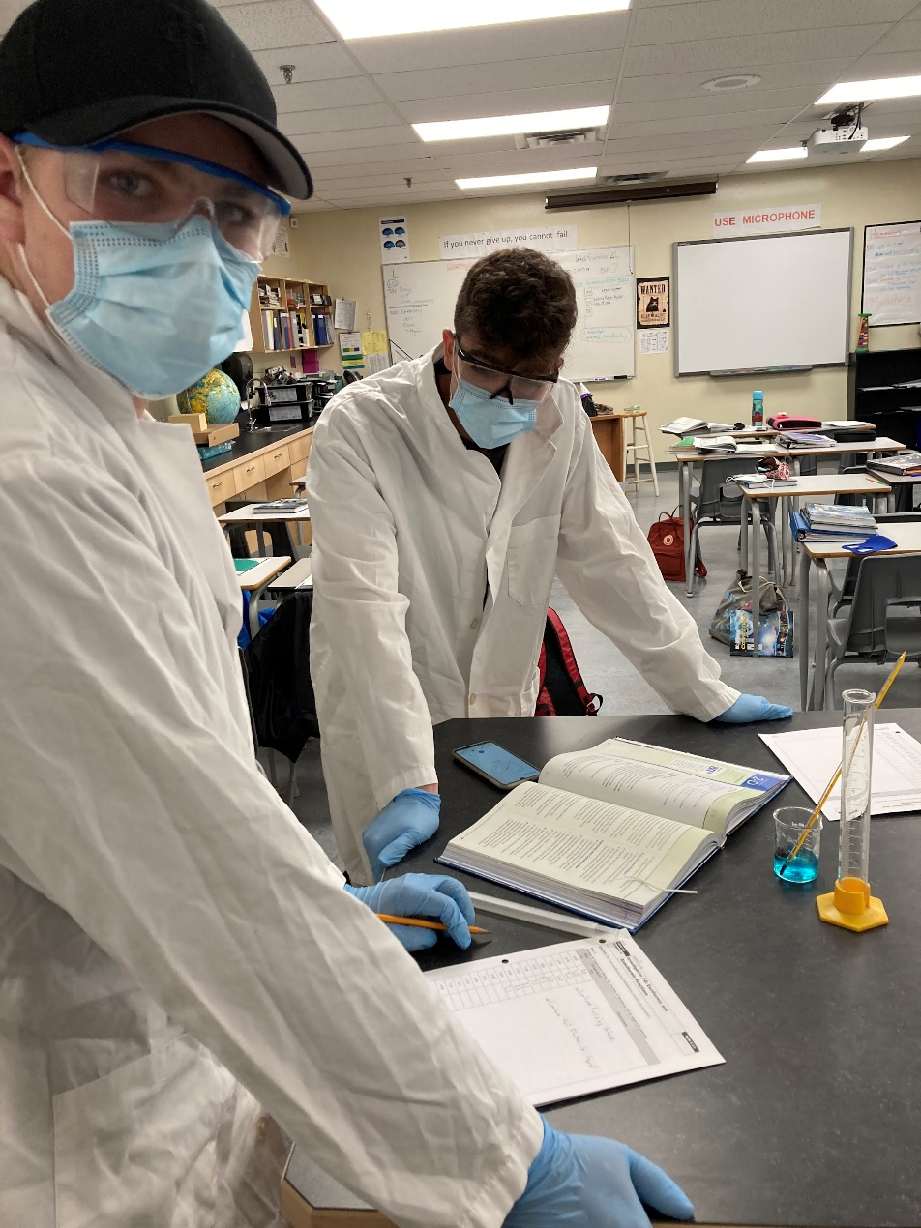
Success for each learner
2
- Literacy
To improve students’ achievement in reading.

Slide 14
Reading Comprehension Teacher Assessment
At the end of the 2021-2022 school year, teachers reported the following data related to students’ ability in Grade 8 and 9 to comprehend reading at Grade level.

Slide 15
As noted in the reading data, a large number of students are achieving below grade level in the area of reading, especially in Grade 8. As a result, incorporating reading comprehension strategies across all curriculums will be essential to improving students’ reading ability.
To make meaning of from a variety of texts
To what extent will students’ achievement in reading improve when all teachers intentionally model reading comprehension strategies daily in classroom instruction?

Slide 16
An increase in student achievement in reading comprehension of 25% of students reading below grade level to reading at grade level.
GSS 8/9 Reading Assessment
September 12-16, January 16-20 & May 15-19
-
Provincial Literacy Assessment
November & June
pro D
sessions with District VP & Literacy Teachers
ANCHOR MARKING of Reading Assessments Multidisciplinary
GSS Staff Review Reading Assessments
October 4, February, June
Professional Learning Teams Reading Comprehension Focus Monthly
Professional Learning Teams
(Monthly meeting to focus on strategic priority goal)
Learning Focused Staff Meetings
Instructional Rounds

Slide 17
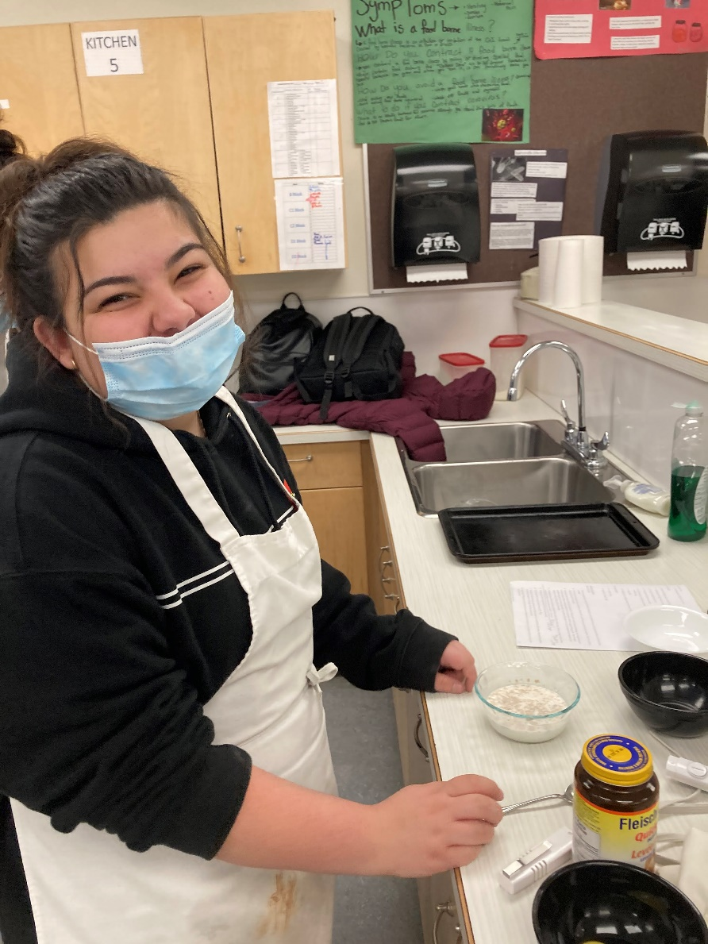
Excellence in Teaching and Leadership
3
To improve teaching practice in the area of inclusive assessment.

Slide 18
Do you feel that you have increased your capacity in incorporating inclusive instructional practices into your classes?
Teacher Reflections:
“Offering different means to express learning, such as, through speaking, writing or speech-to-text.”
“Providing students with multiple options and flexible outcomes for responding to text – visual representation, oral discussion, written output.”
“Assistive Technology – Worked to incorporate speech-to text and text-to speech tools.”
“Offering choice of assignments with different levels.”
“Low floor, high ceiling assignments that allow student to extend their learning.”

Slide 19
Teachers’ knowledge and understanding of inclusive practices increased during 2021-22 school year. Through self-reflections teachers wanted to continue to focus more specifically in the area of inclusive assessment in the coming year.
Inclusive Assessment
To what extent will teachers increase their confidence with inclusive practices if they participate in monthly learning about inclusive assessment?

Slide 20
“Assessment Design: Perspectives and Examples Informed by Universal Design for Learning”
pro D
sessions with District VP & Literacy Teachers
“Assessment Design: Perspectives and Examples Informed by Universal Design for Learning”
By the Justice Institute of BC
Teacher Self-Reflection
September 1, February 7 & May 2
Professional Learning Teams Universal Design for Learning Focus
Monthly
All teachers participate in two instructional rounds.
Teachers report 95% confidence level delivering inclusive assessments.
14-18th of each month to carry out one set of instructional rounds with 3-4 teachers participating
Professional Learning Teams
(Monthly meeting to focus on strategic priority goal)
Learning Focused Staff Meetings
Instructional Rounds

