Slide 1


2022-23
Eileen Madson Primary School

Slide 2

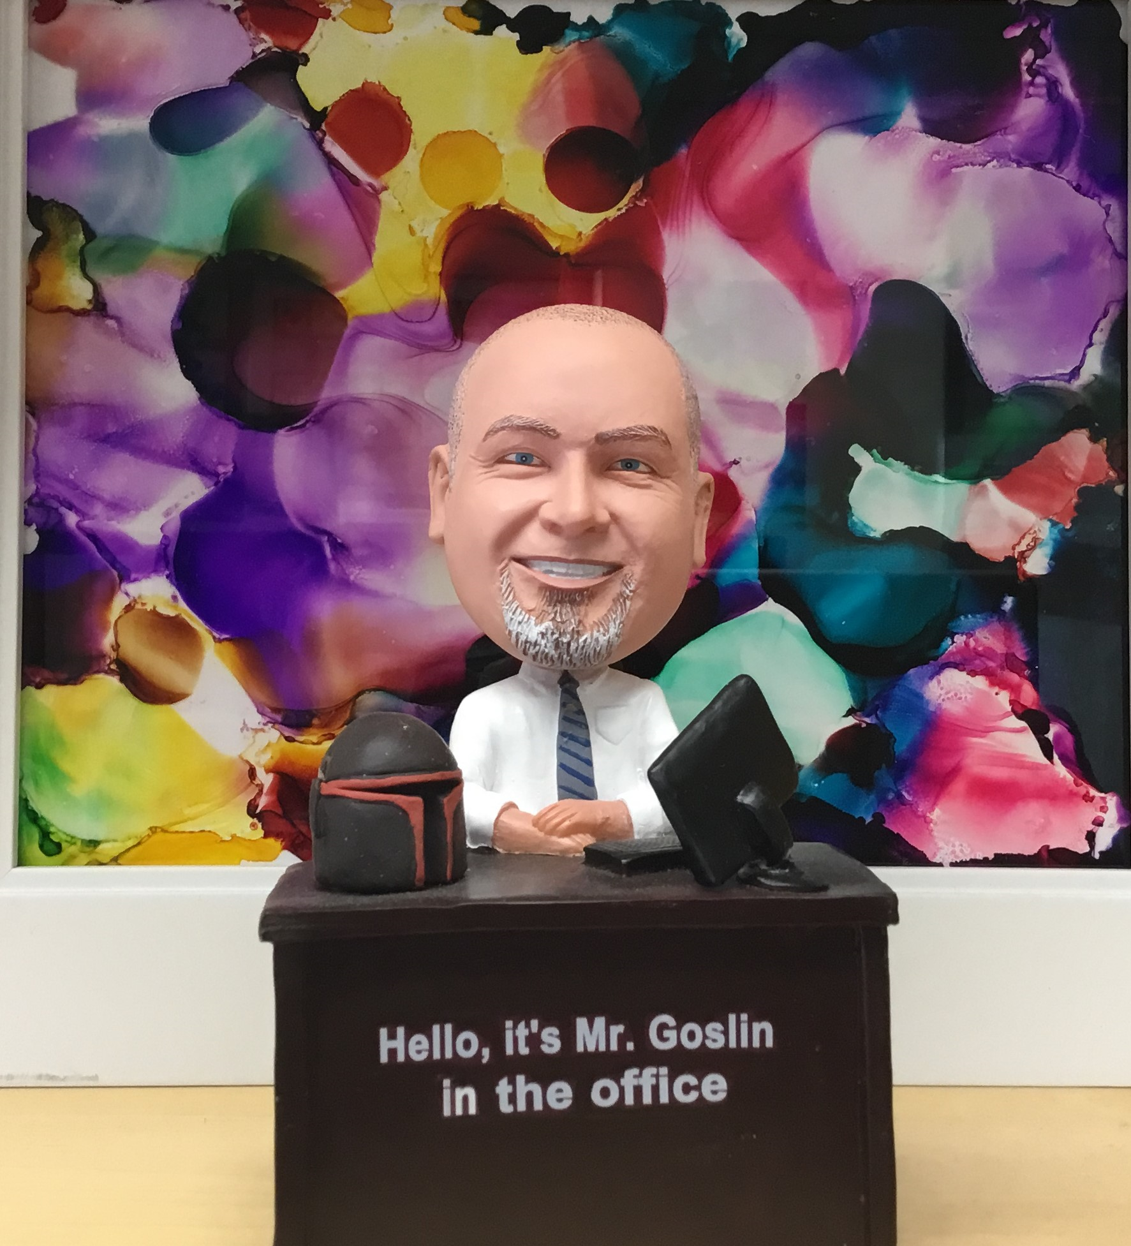
At Eileen Madson Primary school, students are provided many engaging and meaningful opportunities to become “mighty learners” by teachers who are devoted to teaching and building a solid foundation for literacy and numeracy. As a school, we place an emphasis on play-based experiences as part of a balanced curriculum. In addition, diverse outdoor learning opportunities stimulate creativity, curiosity, and a connection to our natural world. Our goal is to provide a rich, safe, nurturing, and friendly school environment for each child to flourish.
This plan has 3 main focal points for Eileen Madson
  Foundational Learning for ALL children
      Supporting Heath and well being of ALL of our diverse population of students
      A strong commitment to Professional development and growth
      The staff at Eileen Madson arrived at this plan by gathering and diving into the data collected from our students, such as
        SNAP math assessment
        PM Benchmarks for Reading
        District Wide Write for writing
        Report card Data
        Staff records, observations and anecdotal assessments
        This data, along with staff conversations brought us to the understanding of what our goals need to be.

Slide 3
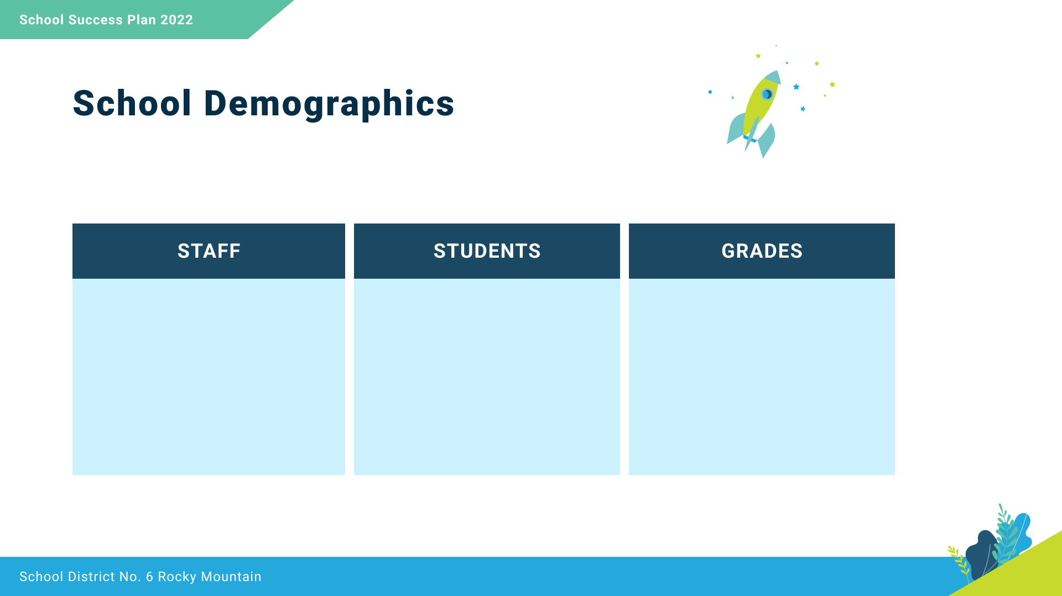
30
17 teachers
8 Education Assistants
1 Principal
1 Admin Secretary
1 AB Ed Worker
1 Lunchroom Supervisor
1 Facility Operator
231
StrongStart
K-3

Slide 4






Respect
We foster respectful relationships
that build trust, safety and well-being.
We collaborate in the pursuit of each student’s success as knowledgeable, caring, resilient, and contributing members of a global community.
Equity
We strive to build learning environments that are equitable, honour diversity and inclusion, are safe, caring and healthy places to work and learn.
Integrity
We nurture a sense of self-awareness, responsibility and honesty to become environmental stewards and morally upright global citizens.
Opportunity, equity,
and success for ALL learners
Accountability
We are accountable for ourselves, our students and our communities for professionalism, transparency and quality results.
Innovation
We create learning opportunities that are high quality, place-based, creative, and that encourage students to reach their full potential.
Page 05

Slide 5

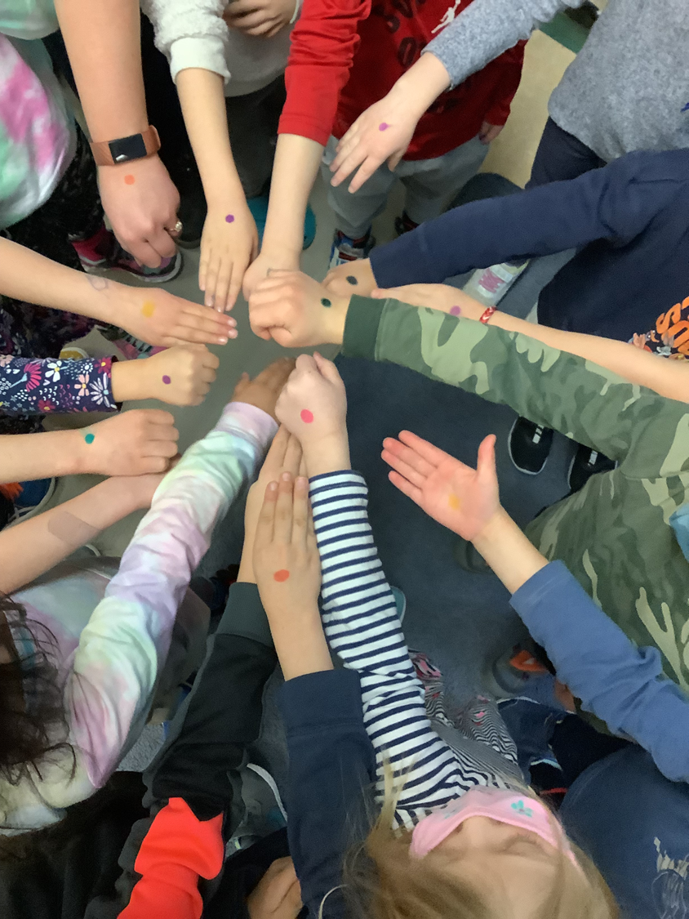
Equity and Inclusion
To improve student sense of connectedness at school

Slide 6

This data displays that the work we began this year has been successful. 92% of our students know they are learning about emotions, and 73% are able to identify some that they are learning about in themselves and others.

Slide 7
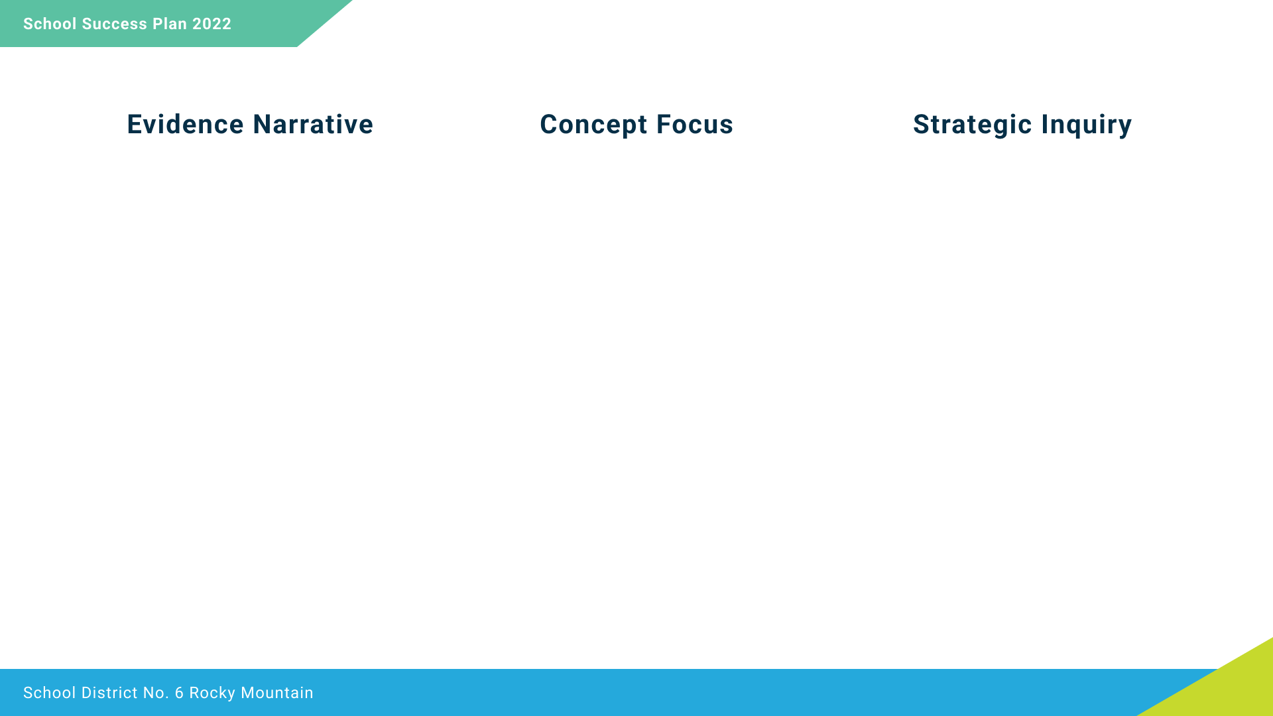

Social Emotional Regulation
Students have been learning about their Emotions at EMP. 92% of students know they have been learning about them, and most can identify when they are feeling certain emotions. Now that we have a basis in understanding our emotions, we need to focus on how to build on these, share them effectively and learn to understand how they impact ourselves, each other and the community through building Self-Regulation
If all staff focus on building strong understanding strategies for social emotional regulation, will students feel an increased sense of safety, belonging and self-esteem

Slide 8
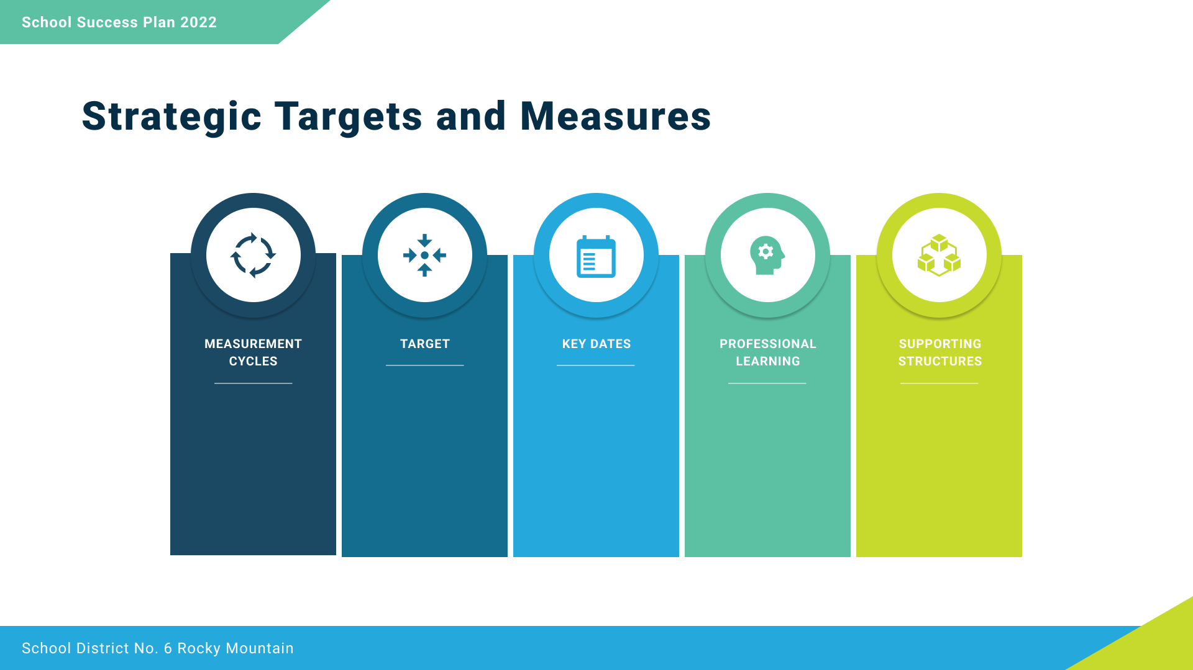
80% of students feel they belong at school
January – School Created Survey to ask students about these target questions
June – Reintroduce survey to see growth
Cultural understandings – ISW, Settlement workers
Trauma Informed and Compassionate Schools
Emotional Literacy
Staff Meetings with ProD focal points
Common PD Days
Building Trauma Informed School knowledge
Background information – CHEQ, EDI data
Utilization of Specialists in district
3 Measurement Cycles – October, February, May
90% of students feel safe at school
80% of students feel they have a safe adult at school that cares about them

Slide 9
To improve Reading Achievement

Slide 10
The tables below depict our current situation in Reading/English Language Art. The table on the left displays the student's performance on the PM Benchmark test. The report card data (right), considers other aspects of literacy, such as writing and representing.

Slide 11
The staff an EMP will work to focus on developmentally appropriate decoding strategies for all students.
Our focus the previous year was to improve in reading at EMP. Our main goal was to be able to have 58% of our students either extending or proficient on the PM Benchmarks. This was achieved. Currently our students that are emerging on the PM Benchmarks is sitting at 31% of our student. With many of our students that are emerging, they did progress at least a year, if not further in their reading growth.
If staff focus on developmentally appropriate decoding strategies, will student reading achievement improve?

Slide 12
PM Benchmarks Under 75% of students will be at a developing level or higher
75% of students at Emerging level will demonstrate a full year or more of growth in their reading levels
Staff Meetings with ProD focal points
Common PD Days
Sharing of expertise in reading recovery
Instructional Rounds work
Finding ways to share professional time
Sharing of student samples
Sept/Oct – Review of students that are at an Emerging PM Benchmark.
Oct./Nov. – create and review plan
Feb/March – Review and enhance plan
May/June – reflect and prepare transitions
Monthly review of staff strategies at staff meetings
Reading Formative Assessment strategies
Guided Reading strategies
What can the PM Benchmarks tell us?
Common Literacy Framework
3 Measures per year – Sept./Oct, Feb./March, May

Slide 13
To improve Student Numeracy Achievement

Slide 14
The tables below depict our current situation in Reading/English Language Art. The table on the left displays the student's performance on the PM Benchmark test. These display similar percentages of student achievement.

Slide 15
EMP Staff will work to build understanding of number sequencing daily to improve math number sense understanding
Over the past year, we saw an improvement of students at the lowest achievement level from 10% to 5% of on our SNAP Math Assessment. That decrease corresponded to a 5% increase (from 21% to 26%) of students at a developing level. Number sense continues to be a key area of growth that is needed at EMP
If staff plan and implement lessons and daily practice on number sequencing, then student achievement will improve

Slide 16
SNAP Score – 75% of students will be Proficient by year end.
Report Card marks will reflect growth in mathematics
Sept/Oct – Testing for SNAP and review of student performance in past SNAP
February/March – review of SNAP and report card marks. Change plan as needed
May/June – final SNAP, review and prepare for transitions
Work with Math VP
Staff Meetings with ProD focus
Common PD Days
Math manipulatives replenished and able to support learning at all times
Common Professional Time
3 Assessment cycles/year
Monthly Conversations to review
Common math language and resources for math numeracy
Sharing of expertise

Slide 17
To improve the quality of Trauma Supportive Practice

Slide 18
This data displays the work that the school counsellor did this term, and the support that was identified and needed for each student. Most students needed more than 1 support.
As well, a breakfast program was run, and over 15% of the school population took part. Most students indicated that they participated in the breakfast program for the social emotional learning opportunities.

Slide 19
Staff will collaboratively build a common understanding of Trauma and building a Trauma Compassionate School. Staff will also be continuing to build common understandings around Literacy and Mathematics.
EMP has built a very strong collaborative culture and this has supported both staff professional growth and student growth. During the 2021/22 school year, staff worked together to build literacy and emotional literacy understandings. Staff is looking to build further understanding together around these areas.
If staff build a language of practice around trauma and Trauma Informed Practice, will staff report enhanced capacity in their professional practice?

Slide 20
All staff will have documentation of how they are working to build a Trauma Compassionate School
All staff will report an increase in understanding of Trauma Informed Practice
End of School year 2021/22 staff will self-assess for understanding and knowledge of TIP
August Pro-D, beginning to build understanding
October – Pro-D
Feb – re-assess and rework
May – re-assess and rework
Staff Meetings with ProD focal points
Common PD Days
Building Trauma Informed School knowledge
School Based Learning Team Meetings
Background information – CHEQ, EDI data
Utilization of Specialists in district – Sue, Kari,
Work with Indigenous Support Worker to help develop plans
Work with Community Members that are informed on Trauma
Work with JA Laird to build common understanding and learning frameworks
3 Assessment cycles/year
Monthly Journal cycle after each session
Looking at Trauma informed Practice
Build professional network on Trauma Compassionate Schools

