Slide 1



Nicholson Elementary School
September 2022
Nicholson Elementary School

Slide 2

Nicholson Elementary School is a K-7 school located on the traditional territories of the Ktunaxa and Secwepemc peoples and the chosen home of the Metis People of B.C. Nicholson Elementary is a rural school of 100 students for the 2022-2023 school year. Learn, Love, Lead communicates the values that the Nicholson Community holds for ourselves and others.
At Nicholson Elementary, the educational staff review assessment practices on an ongoing basis by participating in School Based Team Meetings, Class Profile Meetings and Staff Meetings where we look at formal and informal assessments which guides us in determining our strengths and areas that require additional focus. This information supports us in developing the goals for the School Success Plan.
Through this process we have developed goals to increase students’ sense of belonging, improvement in students reading and numeracy achievement and in the area of teaching and leadership, an increase in the quality and frequency in collaborative opportunity. We have also developed a plan that specifically outlines the steps that we will use throughout the school year in order to reach the outlined goals.
Margo Reinders

Slide 3
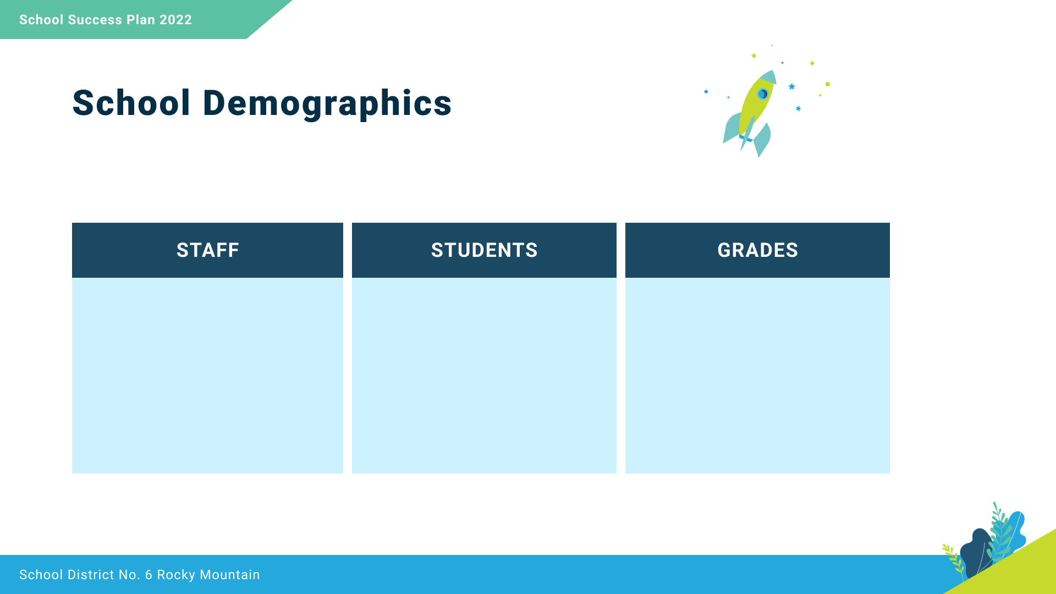
8 Teachers
5 Support Staff
2 Itinerant Staff
1 Administrator
100
K-7

Slide 4

Respect
We foster respectful relationships
that build trust, safety and well-being
Equity
We strive to build learning environments that are equitable, honor diversity and inclusion, are safe, caring and healthy places to work and learn.
well-being.
Integrity
We nurture a sense of self-awareness, responsibility and honesty to become environmental stewards and morally upright global citizens.
Accountability
We are accountable for ourselves, our students and our communities for professionalism, transparency and quality results.
Innovation
We create learning opportunities that are high quality, place-based, creative, and that encourage students to reach their full potential.
Learn, Love, Lead
Nicholson Elementary is a welcoming, happy place to be.
We are a community of life-long learners who connect, synergize, and positively influence each other and the world around us.
We strive for success today and prepare for success tomorrow.

Slide 5

Equity and Inclusion
Increase a Sense of Belonging for All Students

Slide 6


Slide 7
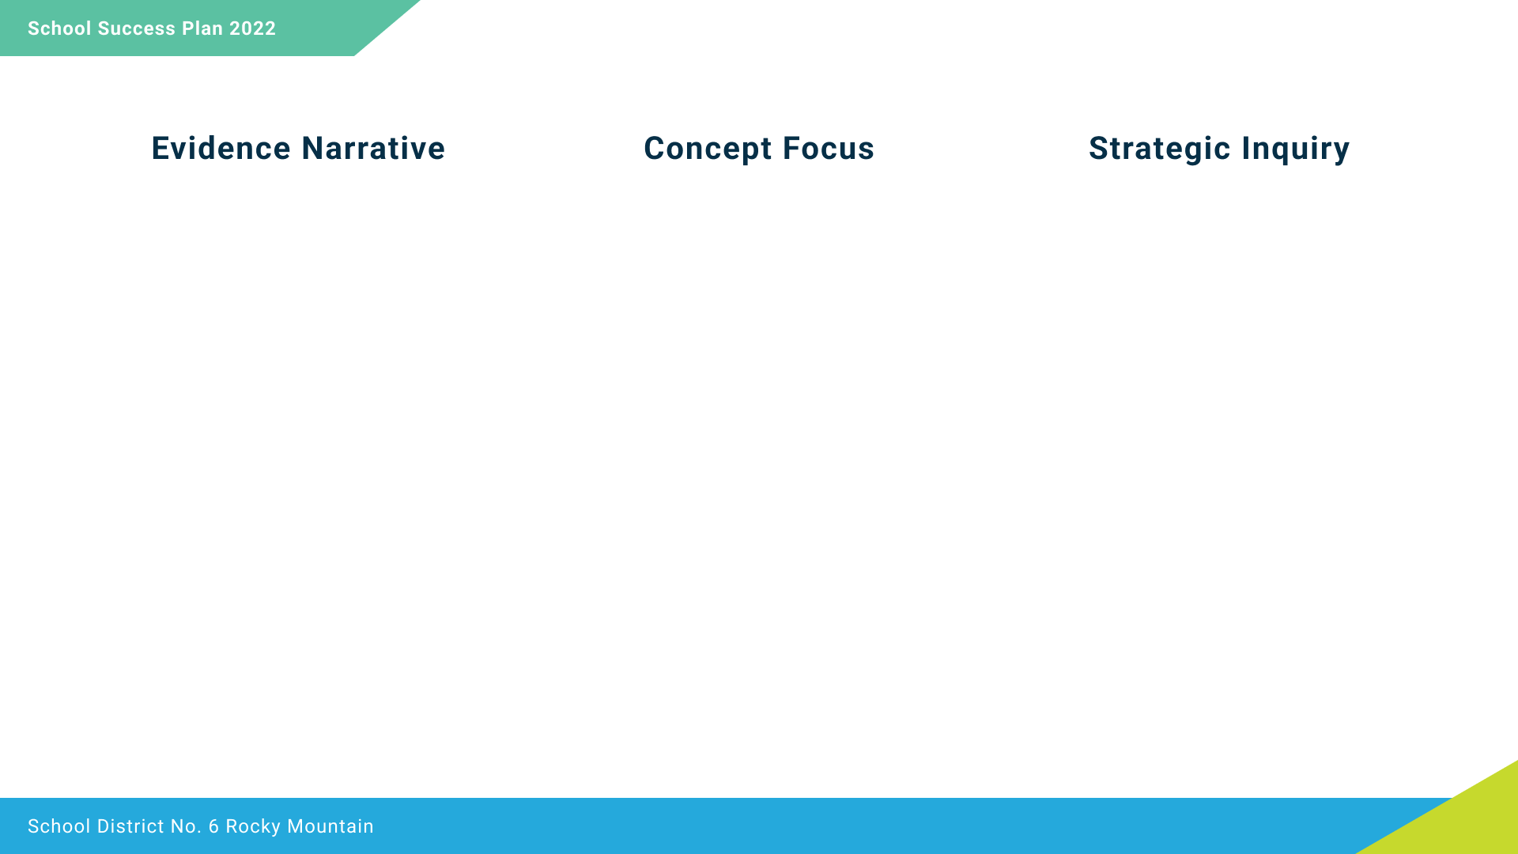
Student results on the Belonging Survey were discussed three times during the year with staff. We determined through this assessment that students feelings of belonging was the primary focus for the Equity and Inclusion goal.
Students identifying that they feel the school is a place where they belong is the area of focus for the school year.
To what extent will adults facilitating a classroom community circle practice, once a week, increase student’s sense of belonging according to the school developed Belonging Survey?

Slide 8
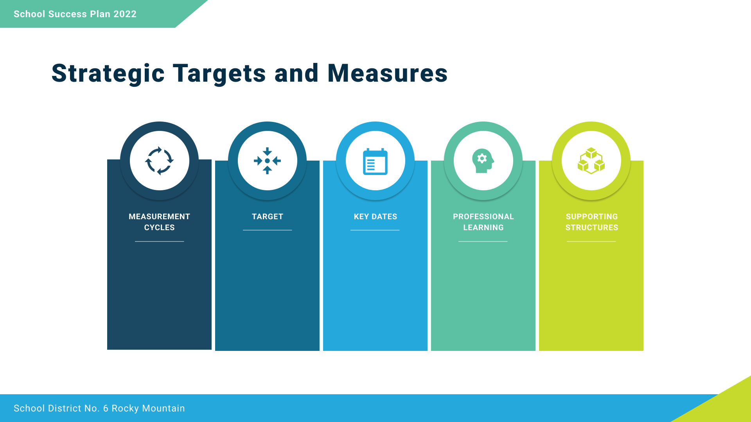
Belonging Survey
3 Times a Year
57% report a Sense of Belonging Most of the Time to 75% report a Sense of Belonging Most of the Time
Students complete Belonging Survey in October, February and May
Collaborative Conversations on the structure and use of Community Circles
Staff Meeting time used for creating and discussing the community circle practice, student survey revisions and monitoring the goal

Slide 9
Success for Each Student
Improving Reading Achievement for All Students

Slide 11
Student results on the Reading Benchmark Assessment were discussed three times during the year with staff. We determined through this assessment that reading was the primary focus for literacy in our school. Overall, students did 25% better on the District Wide Write than the Reading Benchmarking Assessment.
Decoding is the area of focus that will support the reading achievement for 45% of the students to grow from emerging or developing to proficient according to the Reading Benchmark Assessment.
To what extent will teaching specific reading strategies, focused on decoding, during small reading groups affect students’ overall achievement as measured by the Reading Benchmark Assessment?

Slide 12
Reading Benchmark Assessment
3 Times a Year
55% of students reading at a proficient level to 65% of students reading at a proficient level.
Reading Benchmark Assessment October, February and May
Collaborative Conversations on the topic of reading decoding skills, phonological awareness and orthographic knowledge
Staff Meeting time used for collaborative dialogue about reading decoding skills and monitoring the goal

Slide 13
Success for Each Student
Improve Numeracy Achievement for All Students

Slide 15
The results of the Foundational Skills Assessment in Numeracy for the Grade 4 and 7 students, showed 65% of students are On Track. The staff would like to focus on students being able to solve locally authentic math problems.
Solving locally authentic math problems is the area of focus which will be measured using school developed math problems.
To what extent will all teachers, teaching tools for solving locally authentic math problems, to be used weekly, affect students achievement on the math problem assessment?

Slide 16
Problem Solving Assessment
3 Times a Year
60% of students are proficient on the Problem Solving Assessment in May
Problem Solving Assessment in October, February and May
Collaborative time used to develop locally authentic math problems for classroom and assessment purposes
Staff Meeting time used for development of math problems and monitoring the goal

Slide 17
Teaching and Leadership Excellence
Increase Quality and Frequency of Collaborative Opportunities

Slide 18
Some staff had the opportunity to participate in Learning Rounds during the 2021-22 school year. They would like to continue to grow this practice so that all staff can participate in collaborative dialogue during the different phases of a Learning Round.
The staff would like to focus the priority on continuing to diversify our learning around the development of a collaborative culture.
Will educational staff report greater opportunity to diversify a collaborative culture by participating in Learning Rounds?

Slide 19
All Educational Staff participate in Learning Rounds
3 Times a Year
Staff Reflection Journal during Staff Meetings using collaborative culture criteria
All educational staff have participated in a Learning Round, 3 times during the year
Learning Rounds by November, March and June
Conversations on diversifying a Collaborative Culture
Staff Meeting time used to discuss and record progress about Learning Rounds and monitor the goal

