Slide 1
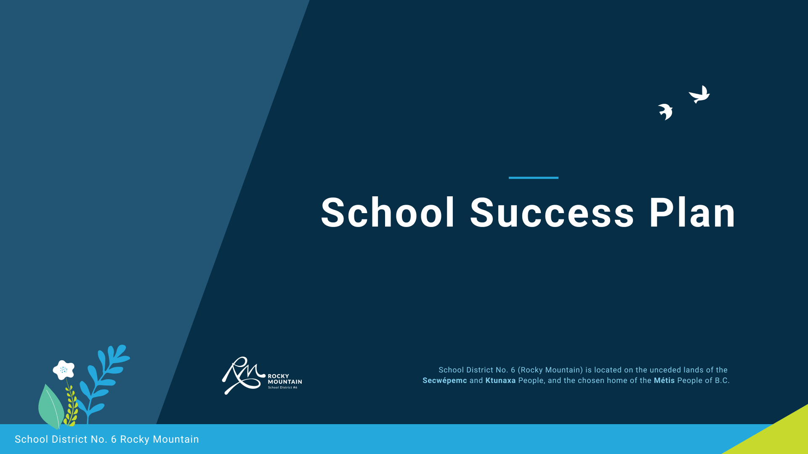


July 6, 2022
McKim Middle School

Slide 2
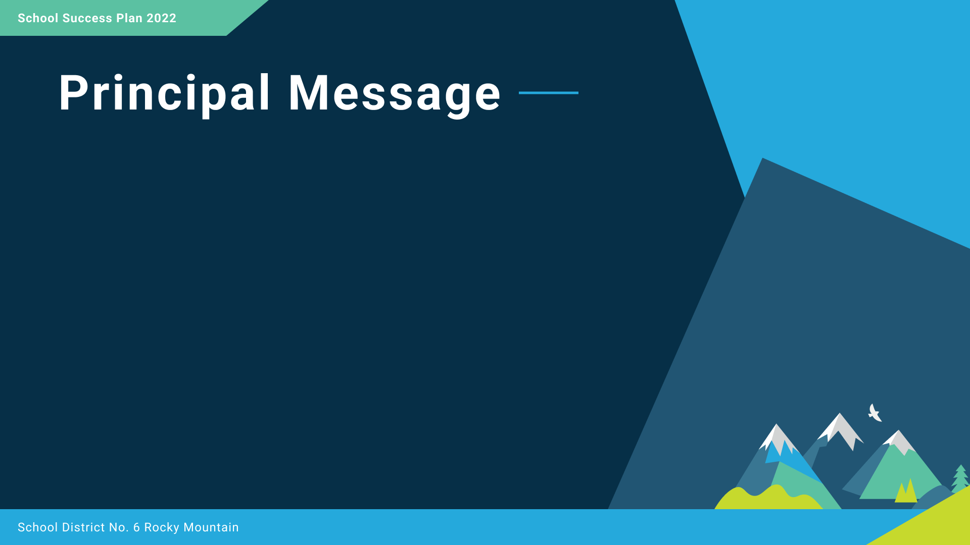


“We care for ourselves, each other and this place.”
McKim Middle School is located on the traditional unceded territory of the Ktunaxa peoples and the chosen home of the Metis.
In this strategic plan, our school staff have gathered data from provincial and district assessments to guide our thinking. Together we have developed goals using this data and consulted with our school community at meetings of the Parent Advisory Committee, staff, and Indigenous Education Workers. Improving our practices in equity and inclusion, striving for success for all learners, and developing excellence in teaching and leadership will provide a balanced and rigorous program for the students at McKim.
As you make your way through our strategic plan, you will see the foundational data, goals, strategic focus, and specific targets that will help our school community bring this plan to fruition.
Brad Carrier

Slide 3
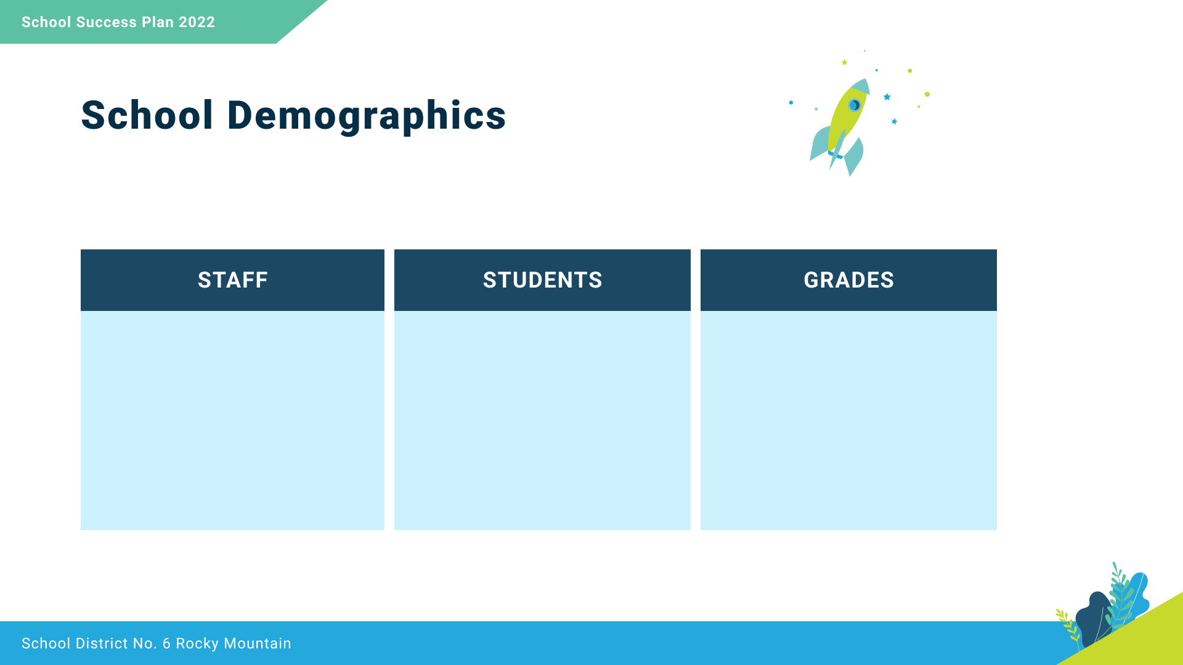
Teachers: 22
Support Staff: 20
Total: 414
Indigenous: 81
Grade 4: 98 (inc. 16 Indigenous)
Grade 5: 110 (inc. 14 Indigenous)
Grade 6: 91 (inc. 28 Indigenous)
Grade 7: 115 (inc. 23 Indigenous)

Slide 4

Take care of yourself, each other, and this place.
Respect
We foster respectful relationships that build trust, safety and well-being.
Equity
We strive to build learning environments that are equitable, honour diversity and inclusion, are safe, caring and healthy places to work and learn.
Integrity
We nurture a sense of self-awareness, responsibility and truthfulness in ALL students so that they will become environmental stewards and morally upright global citizens.
Accountability
We are accountable for ourselves, our students and our communities for professionalism, transparency and quality results.
Innovation
We create learning opportunities that are high quality, place-based,
creative, and that encourage students to reach their full potential.
Opportunity, equity, and success for ALL learners

Slide 5
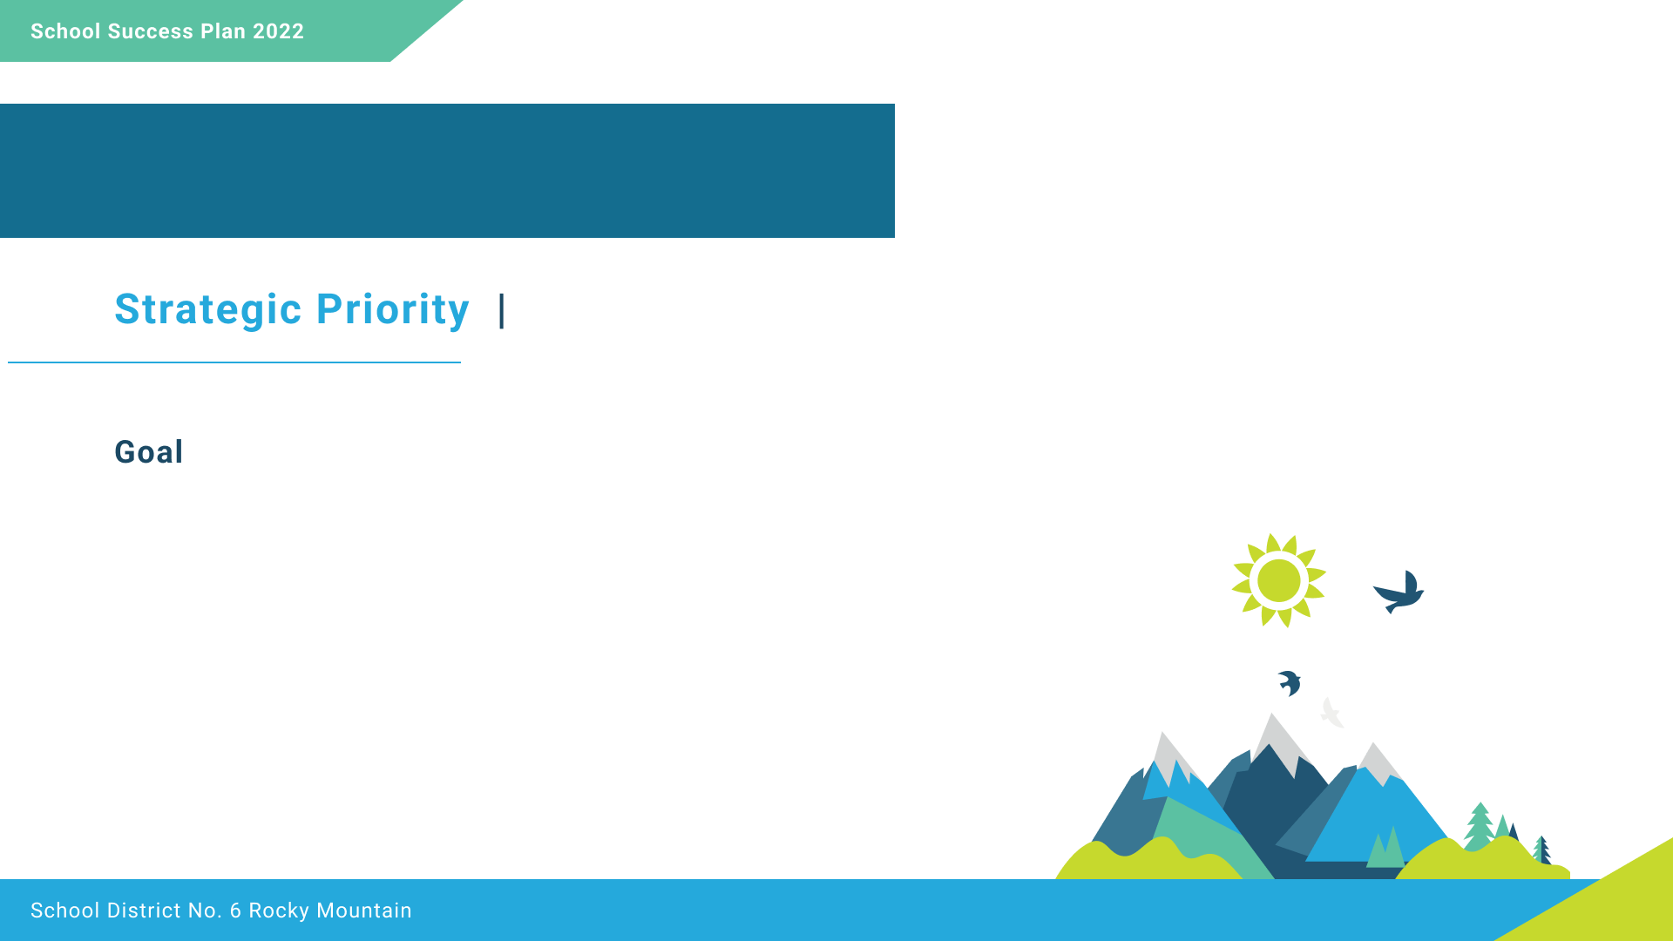
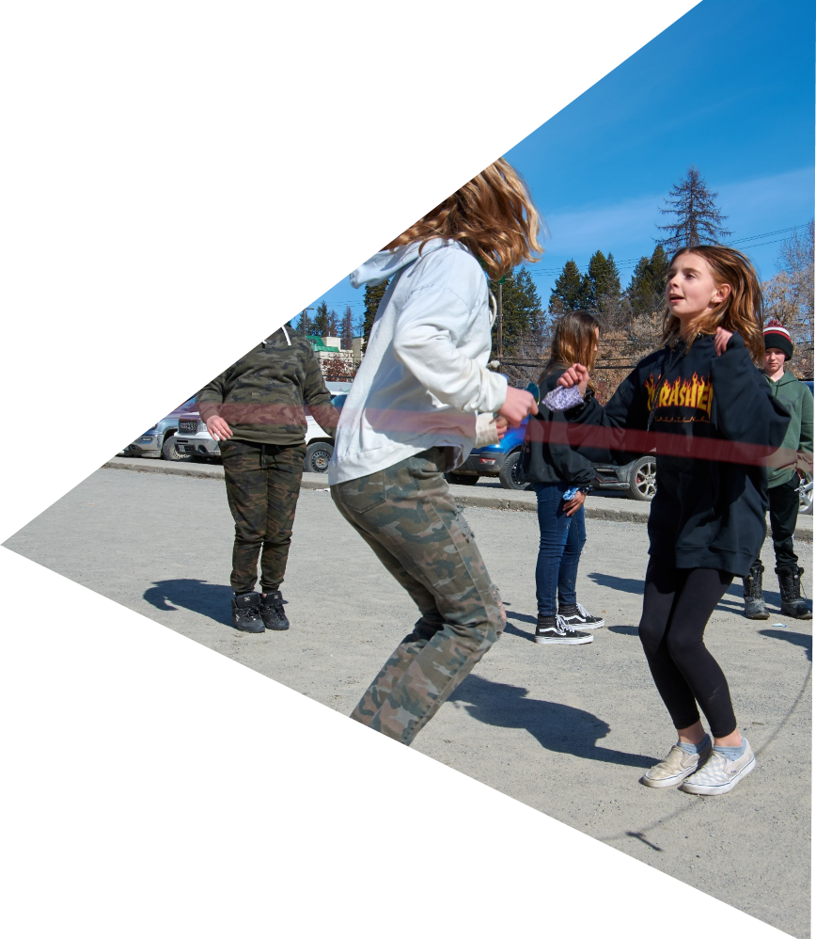
<Insert Image>
Students at McKim will increase their sense of belonging.

Slide 6

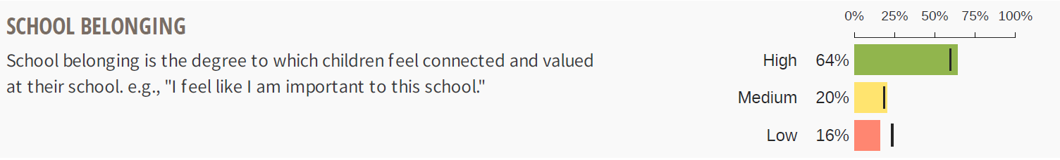
The black bar in this provincial Middle-Years Development Index survey show the provincial averages for school sense of belonging. This coloured bars show the high level of school belonging (64%) at McKim school. However, there are still 36% of students who may benefit from increased sense of belonging.

Slide 7
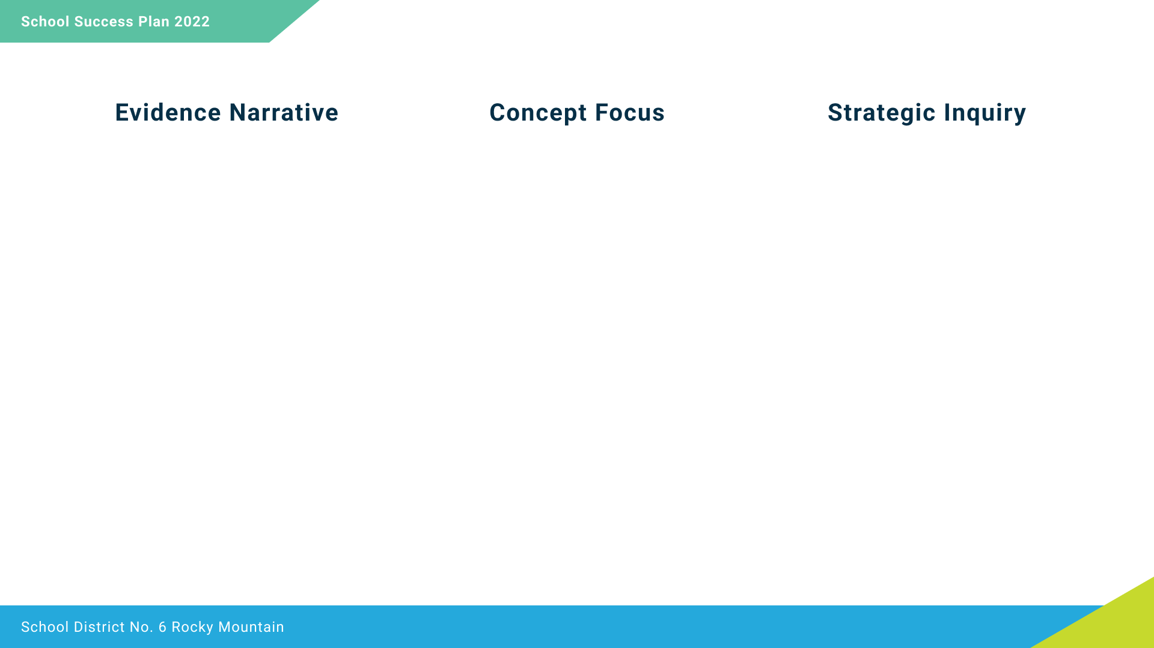
Children's sense of belonging at school has been shown to foster their school success in many ways. When children have positive experiences at school, they are more likely to feel they belong within their school, feel more motivated and engaged, and have higher academic achievement.
According to a provincial survey, 64% of students feel a sense of belonging at McKim.
We will focus on increasing students' sense of belonging.
To what extent will the creation of an Exploratory Program on Friday afternoons improve our students' sense of belonging?

Slide 8
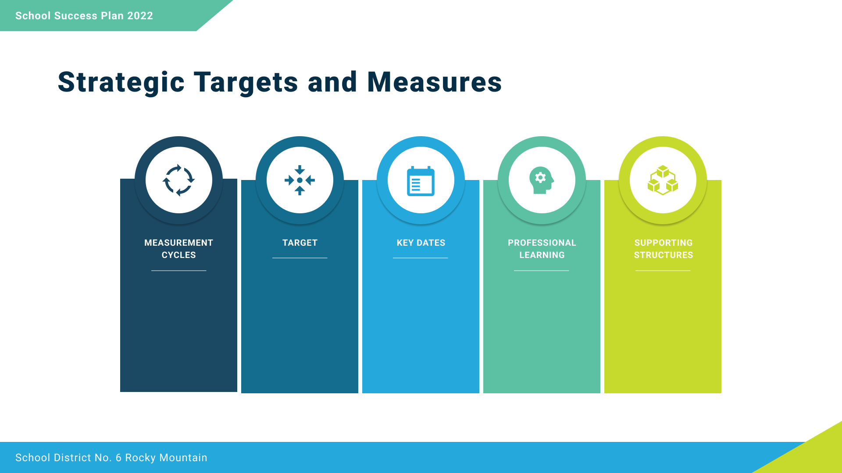
Student participation in survey 3 times a year regarding their sense of belonging
Indigenous student check-ins with IESW
Fall Survey: September 2022
Winter Survey: February 2023
Spring Survey: May 2023
Staff discuss successes and stretches every five weeks
Increase students with High sense of belonging on MDI survey from 64% to 75%
Staff meetings for monitoring objectives and adjusting strategy
Collaborative time between IESW and teachers
Student survey
School wide scheduled time
IESW teaming up with teachers to offer indigenous activities as a part of teacher's learning sequence

Slide 9
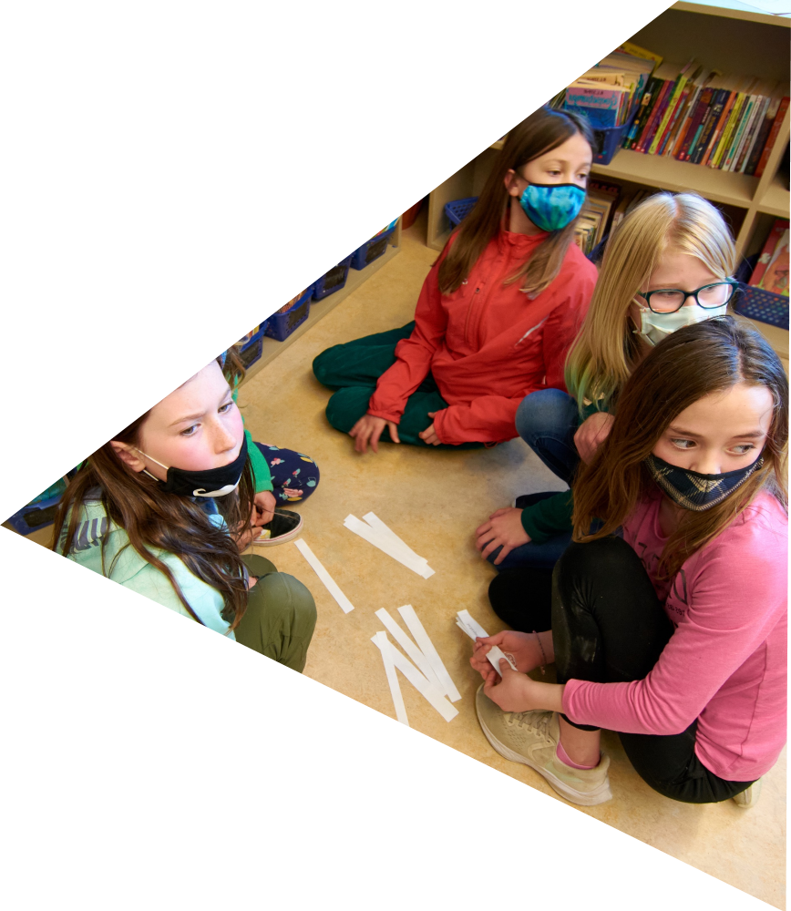
<Insert Image>
To improve reading outcomes for all students.

Slide 10
The data from the Fountas and Pinnell assessment is collected twice a year and provide details about students' achievement in reading. The fall data shows 59% of Indigenous students on track in comparison to 73% of non-Indigenous students. There are improvements in the spring data with 69% of Indigenous students on track in comparison to 80% of non-Indigenous students.

Slide 11
Reading assessments and other sources of data indicate that within the area of literacy, students are most challenged with reading. Specifically, there is a gap between Indigenous and non-Indigenous student achievement in the Fountas and Pinnell reading assessment.
Focus on teaching comprehension strategies during guided reading groups
If we use guided reading groups to teach specific tools to identify key ideas, will student achievement improve on Fountas and Pinnell assessments?

Slide 12
Fountas and Pinnell assessments 4 times a year
Foundational Skills Assessment
To have more than 90% of all students on track on the Fountas and Pinnell assessment
September 2022
December 2022
March 2023
May 2023
EMBEDDED PRO D sessions with LITERACY SPECIALIST LEARNING FOCUS STAFF MEETING for monitoring objectives & adjusting strategies
School Based team meeting for specific higher tier intervention
Read Naturally Literacy Block
Additional Literacy block with librarian, EA, and IESW

Slide 13
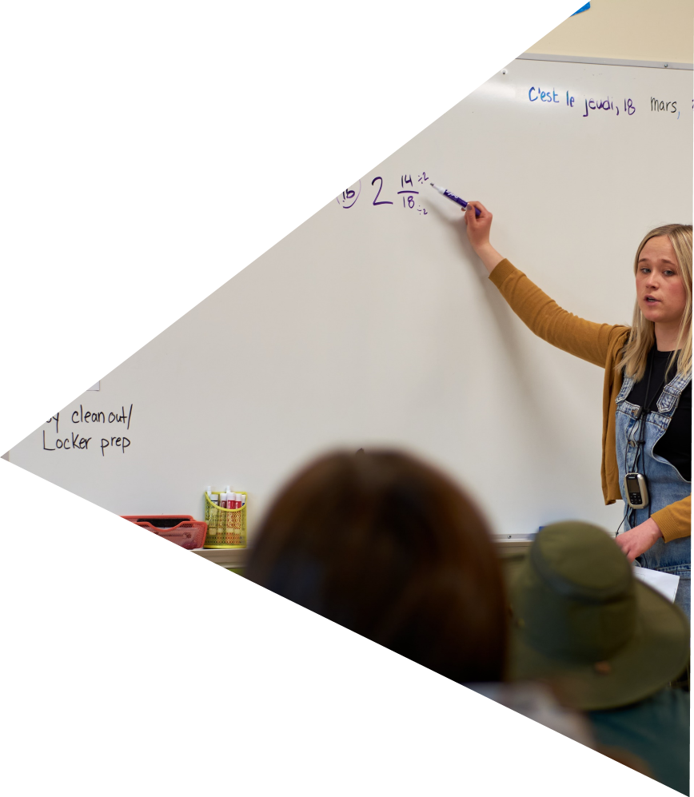
<Insert Image>
Improve numeracy success for all students.

Slide 14
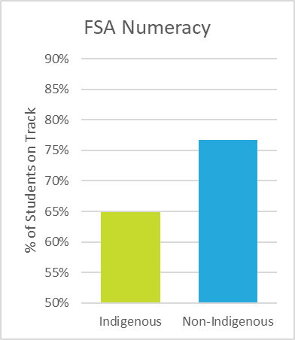
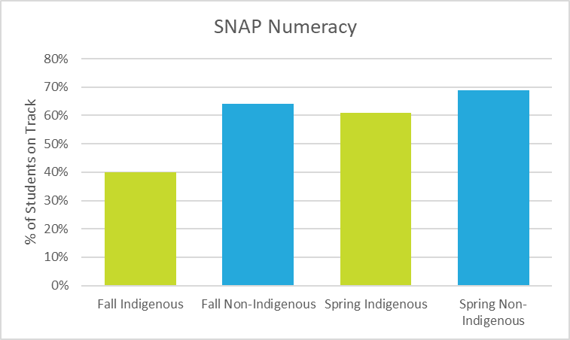
There are two significant data sources to support our focus on numeracy. The first is the Foundation Skills Assessment for grade 4 and 7 students. This shows 65% of Indigenous students on track in comparison to 77% of non-Indigenous students. The second is the SNAP Numeracy Assessment which is a 3-point scale assessment completed twice a year, with a score of 3 considered as on track. The fall data from this assessment shows 40% of Indigenous students on track in comparison to 64% of non-Indigenous students. The spring data from this assessment shows 61% of Indigenous students on track in comparison to 69% of non-Indigenous students.

Slide 15
We have noticed that according to the Foundational Skills assessment that less students are on track when it comes to solving real world numeracy problems. Additionally, we see an achievement gap between indigenous and non-indigenous students.
Establishing relevance and connection to real-world problems with number sense. Authentic representation of numbers in a real-world context
To what extent will teachers teaching connecting strategies weekly for numeracy tasks improve numeracy achievement?

Slide 16
Every 2 months teachers will review numeracy activities with grade group
Review FSA results
Review report card marks
To improve indigenous students on track from 61% to 75%
To improve non-indigenous students on track from 69% to 75%
Fall, Winter, and Spring SNAP assessments
FSA data review January 2023
Report card review January, March, and June
Learning focused staff meetings with numeracy instruction and assessment sessions for all staff.
Professional Learning Team meetings on Peter Liljedahl’s book .
SNAP Number Sense data will help plan numeracy lessons.
Indigenous Education Workers to support Indigenous learners.
Grade group meetings with numeracy focus.

Slide 17
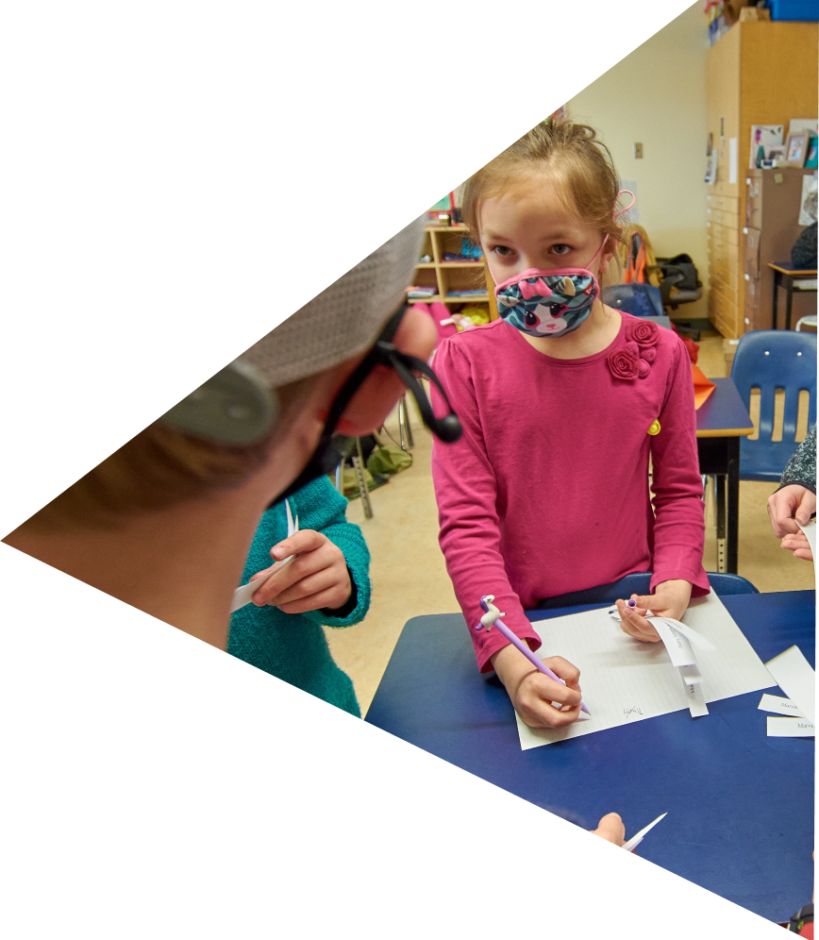
<Insert Image>
To increase opportunities for meaningful collaboration

Slide 18
Fall and spring staff survey – comfort of peer observation, reflection of learning and professional growth.
80% of staff indicate growth in practice and strategies due to collaboration and observation of peers
Fall and spring surveys
Quarterly staff meeting reflection and celebration time
“Instructional rounds in education” book for framework for norms, questions, observations
Collaboration blocks in like grade groups, Instructional rounds
Monthly reflection and sharing at staff meetings

Slide 19
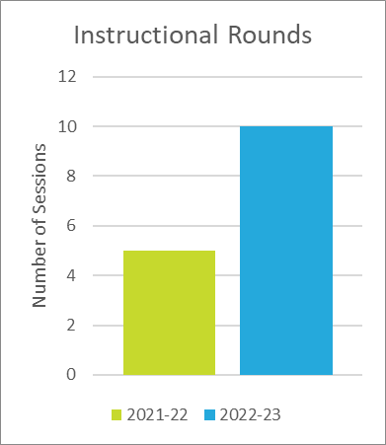
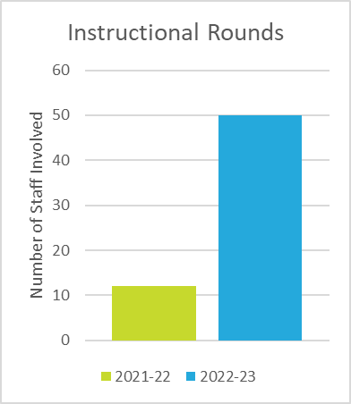
During the 2021-22 school year, not everyone got to take part in instructional rounds. There were five instructional rounds completed with a total of 12 staff involved. For the 2022-23 school year, it is our goal to increase this to 10 instructional rounds including 50 staff in total.

