Slide 1

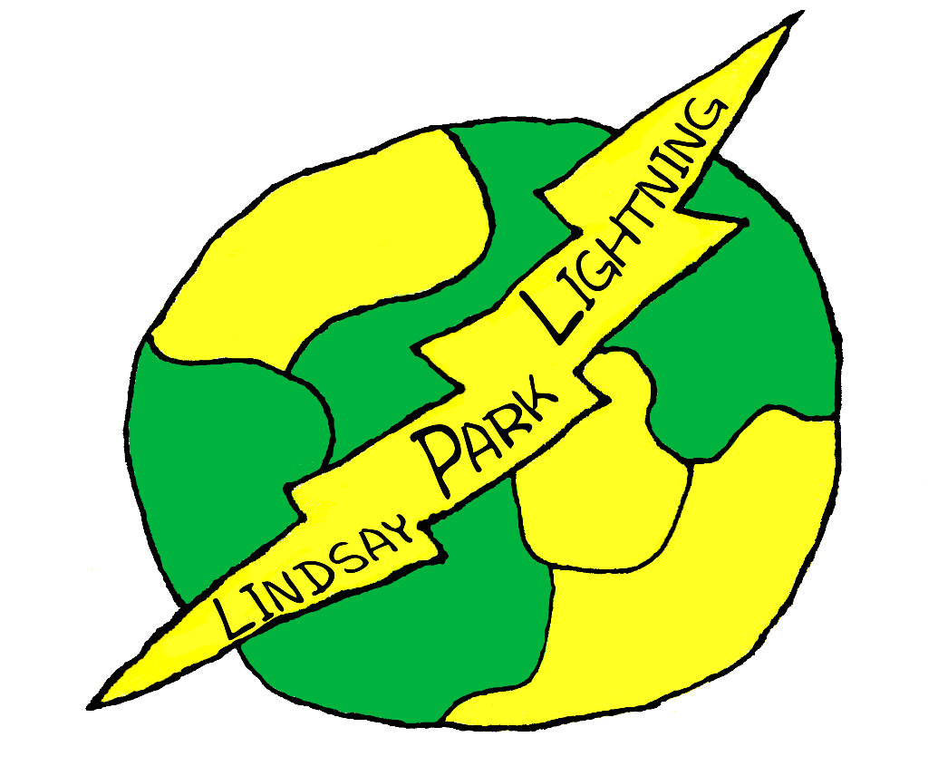
September 2022
Lindsay Park Elementary School

Slide 2

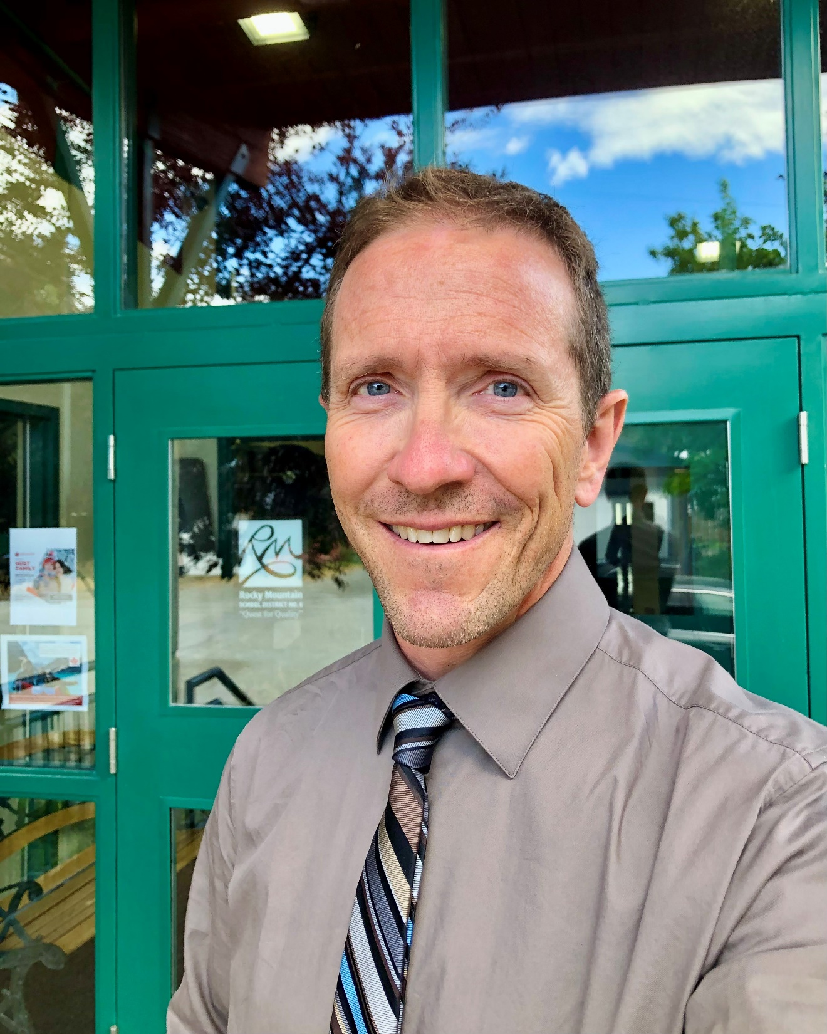
At Lindsay Park Elementary School, we acknowledge that we learn and play on the unceded territory of the Ktunaxa First Peoples. Lindsay Park is a K-3 primary school that prides itself on having a learning community that strives to create an inclusive, caring environment where our students and families feel safe, valued, and respected. We are committed to paddling together in one direction towards truth and reconciliation, and equity for all.
To develop an inclusive learning environment, it is our goal to support students in making good choices and developing positive behaviors through social/emotional lessons. This work should help create a strong sense of belonging for all students in our school.
Our academic goal is success for all learners in literacy and numeracy. With literacy, intentional guided reading and small group work will help students understand how sound functions in words. This focus may improve reading and writing for all learners, in particular Indigenous students. In numeracy, our goal is to develop and implement rich tasks that are real-life, experiential and meaningful to children ages 5-8.
Our last goal is focused on creating opportunities for staff to collaborate and engage in rich discussions about teaching and learning in lessons related to school goals.
We are excited about continuing the journey of school success with equity, literacy, numeracy, and collaboration as key focus areas for our work during 2022-2023.
Dan Clark

Slide 3
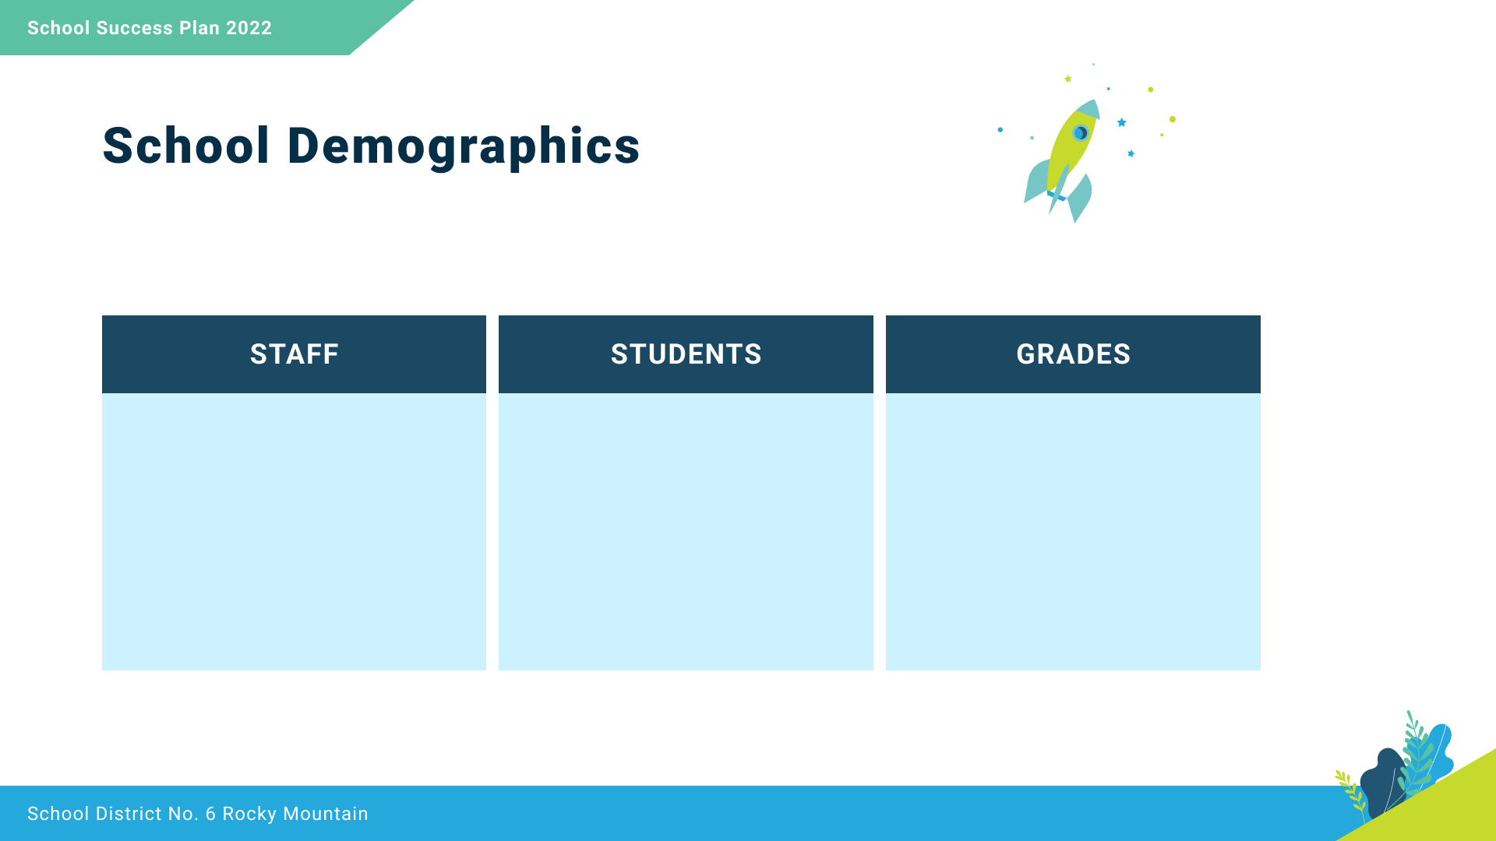
11 Classroom teachers
1 Learning Services Teacher
1 Teacher-librarian
3 Education Assistants
1 Indigenous Education Student Support Worker
1 Admin Assistant
1 Principal
176 students
22 Indigenous students
Kindergarten - 43
Grade 1 - 39
Grade 2 - 45
Grade 3 - 49

Slide 4

We take care of ourselves,
Each other,
This place, and
This land.
Relationships
Kindness
Wellbeing
Creativity
Communication
Trust
Everyone belongs and learns here.

Slide 5
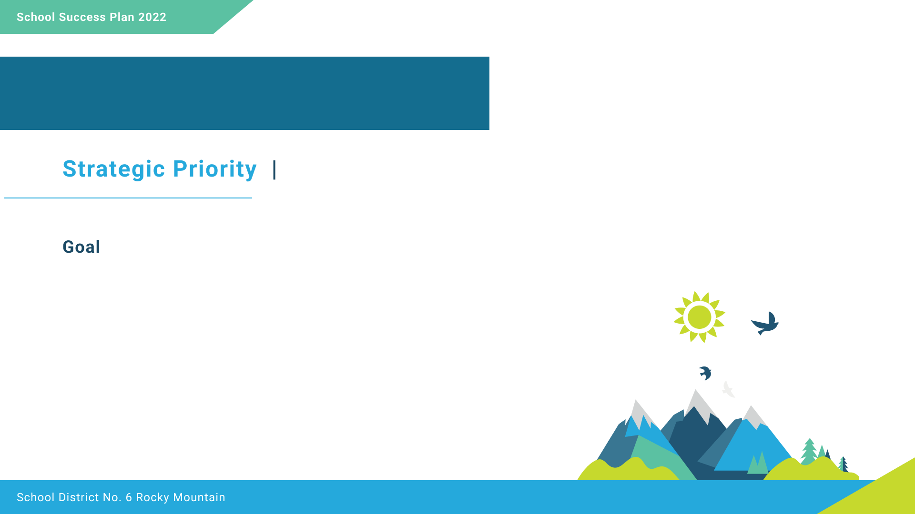
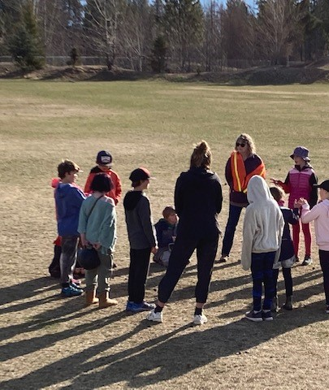
Equity and Inclusion
Increase positive behaviors around the school.

Slide 6

During the spring of 2022, staff noticed an increase in office referrals and behavior interventions. We surveyed staff and students with the finding that behavior incidents were increasing within the washrooms and on unstructured times in the field.

Slide 7
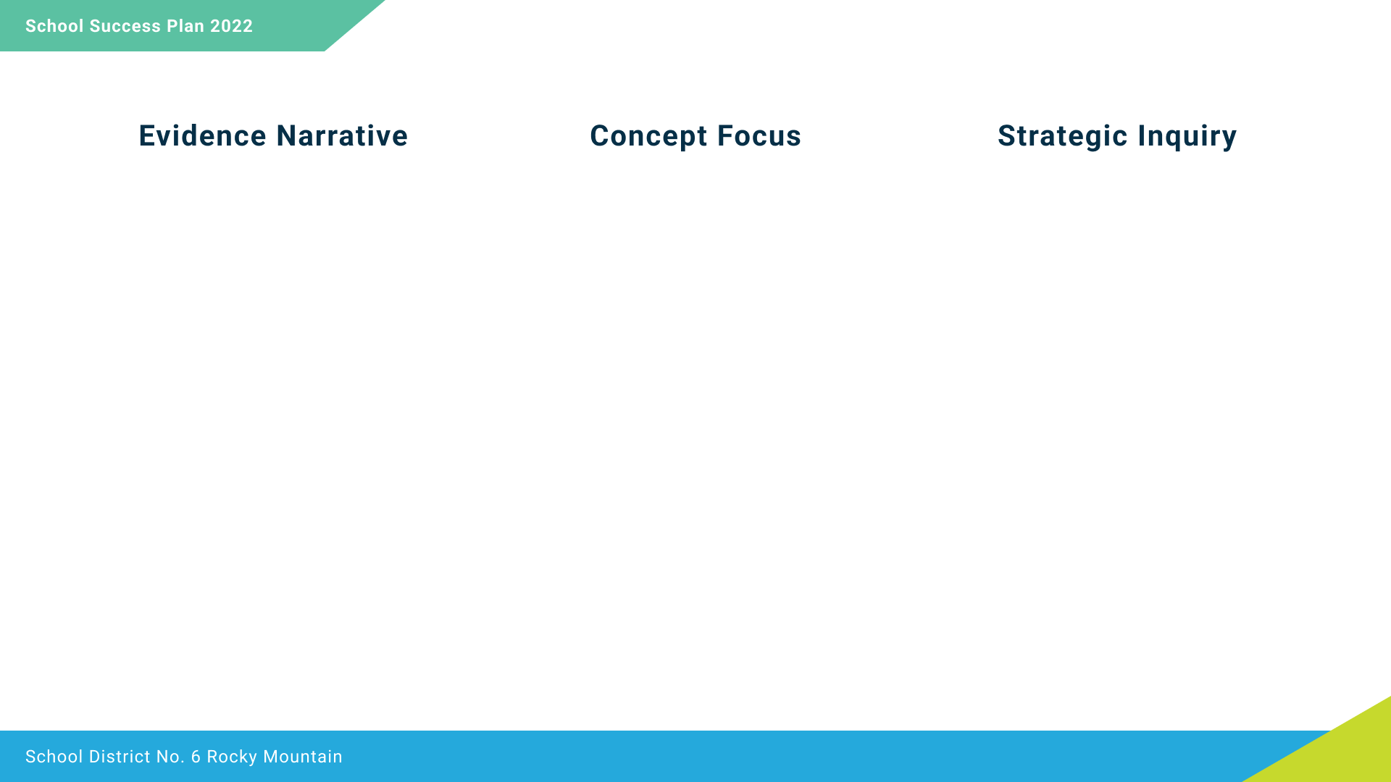
To improve equity and inclusion, we want to know more about how student behavior issues during unstructured times impact student feelings of inclusion. Data shows that in some school situations, students are having a hard time making good decisions.
We will focus on improved conduct and positive behavior supports, which includes teaching about making good decisions.
To what extent will we see more positive behaviors around the school, if teachers intentionally teach social/emotional
learning lessons with a focus on making good decisions?

Slide 8
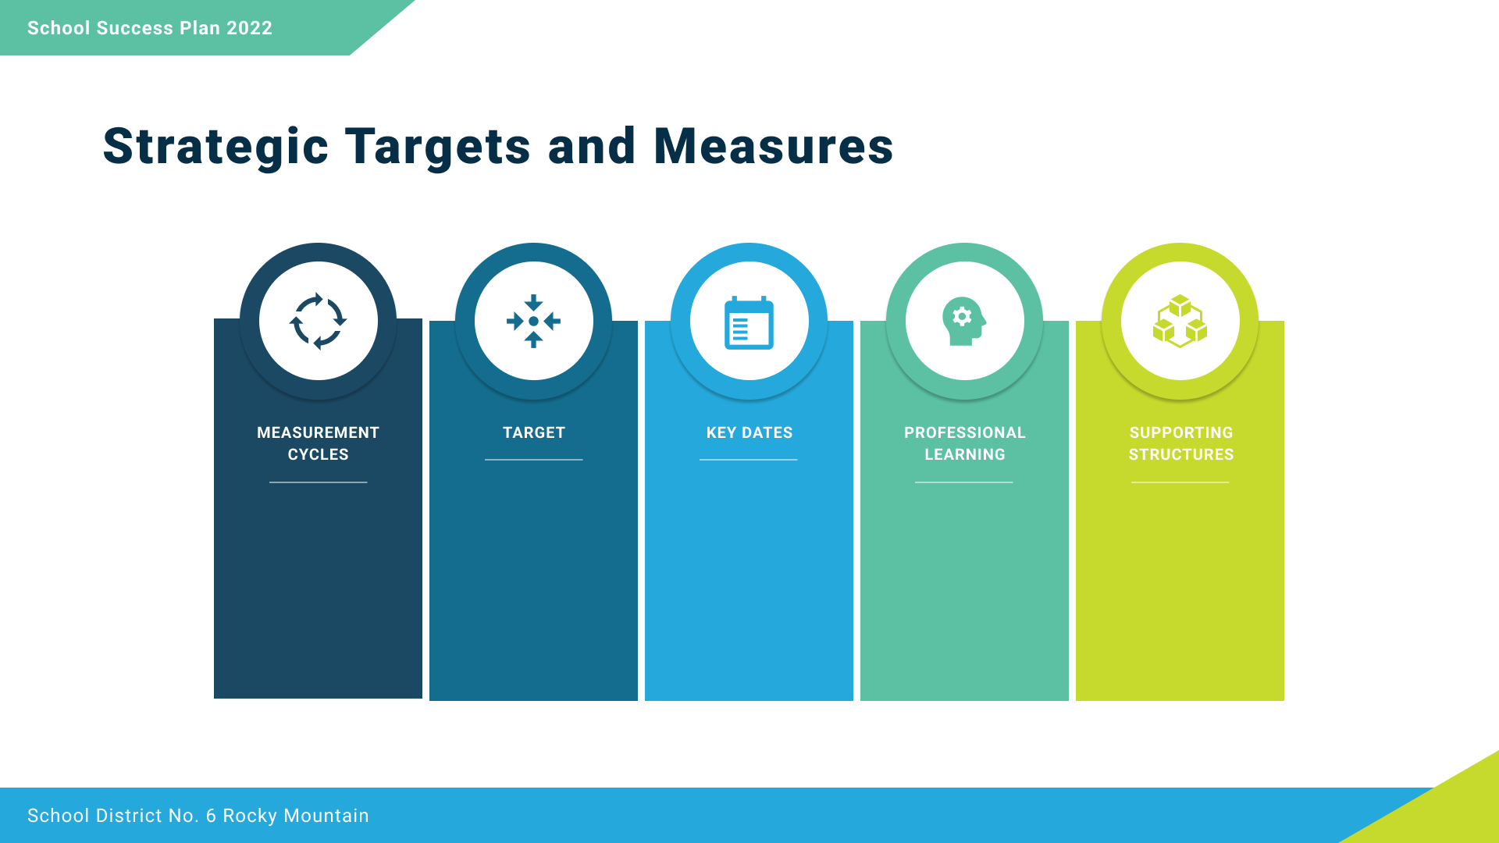
3 times/year review at staff meetings
Monthly review of office referrals
10% decrease of behavior referrals in washrooms and playground
November
February
May
We Thinkers and Zones of Regulation training.
Presence of visual supports for Zones of Regulation

Slide 9
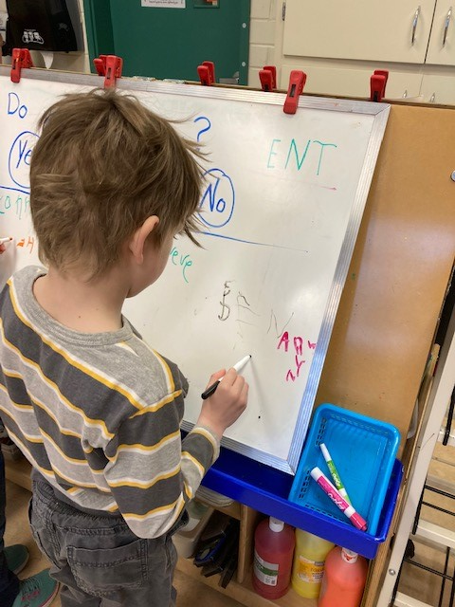
Success for all Learners
Literacy: Improve literacy achievement for all students.

Slide 10
For the 2021-22 school year, the data indicates that 71% of Indigenous learners are on-track in reading (scoring 2 or 3 on the reading assessment), while 85% of non-Indigenous learners are on-track.

Slide 11
For the 2021-22 school year, the data indicates that 93% of Indigenous learners are meeting expectations in writing (by achieving a 2.5, 3, or 4), while there are 84% of non-Indigenous learners meeting expectations.

Slide 12
Students are growing in their reading and writing, but there is still a significant percentage of students who are not yet meeting expectations in reading and writing.
The concept we are focusing on will be phonological and phonemic instruction in each class, every day. This instruction may improve reading, and also help students express themselves in writing easily and articulately.
To what extent will reading and writing results improve, if teachers intentionally focus on instruction in phonemic and phonological awareness in each class on a daily basis?

Slide 13
Literacy assessments October 2022 and May 2023
Mid-year scan as needed.
15% increase in Indigenous students on-track in reading.
October
February
May
Science of Reading
Words Their Way/Heggerty
Sound Connections
August Pro-D
Class Reviews
Staff Meetings
Instructional Rounds

Slide 14
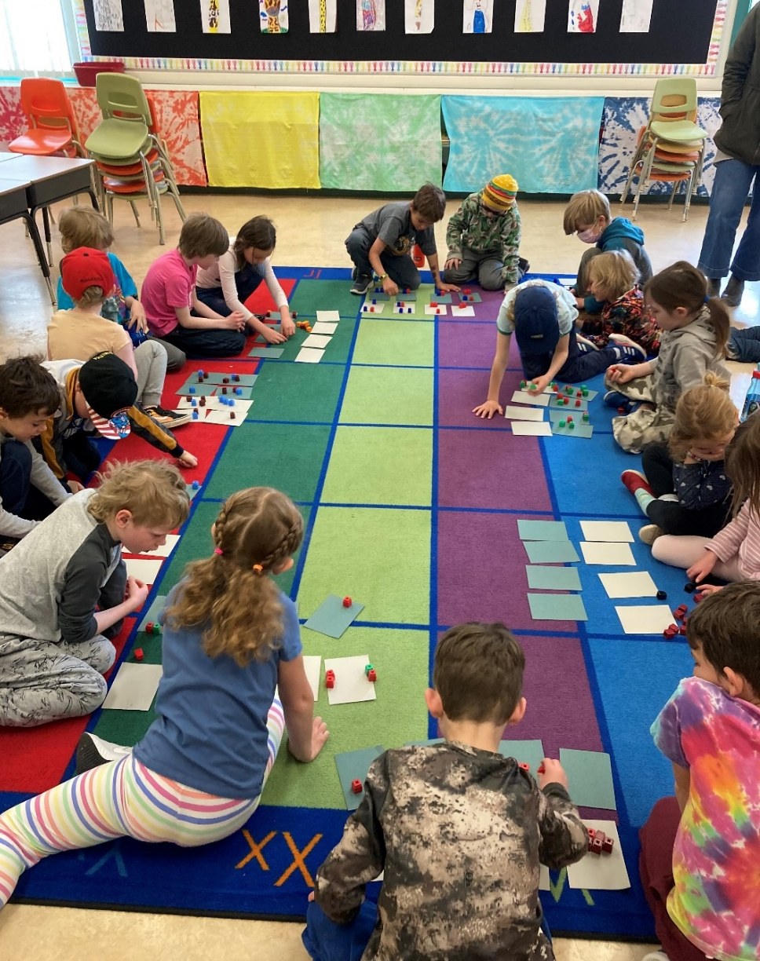
Success for all Learners
Numeracy: Increase understanding of and relationship with numbers in real-life.

Slide 15
For the 2021-22 school year, the data indicates that 79% of Indigenous learners are meeting expectations in numeracy (by achieving a 3), while there are 78% of non-Indigenous learners meeting expectations.

Slide 16
The SNAP numeracy assessment data tells us that 78-79% of all students are on track in numeracy. To deepen student understanding, we wonder if they need support seeing numbers in the real world using authentic numeracy tasks.
The concept we are focusing on is to increase students understanding of numbers in real-life, so they have a relevant and personal connection to numbers.
To what extent will numeracy results improve if teachers instruct numeracy lessons with real-life tasks on a weekly basis?

Slide 17
SNAP numeracy assessments October 2022 and May 2023
Mid-year scan as needed.
10% increase in students on-track, which would raise proficiency to 85%.
October
February
May
Mindset Mathematics
Thinking Classrooms
Number Talks
August Pro-D
Class Reviews
Staff Meetings
Instructional Rounds

Slide 18
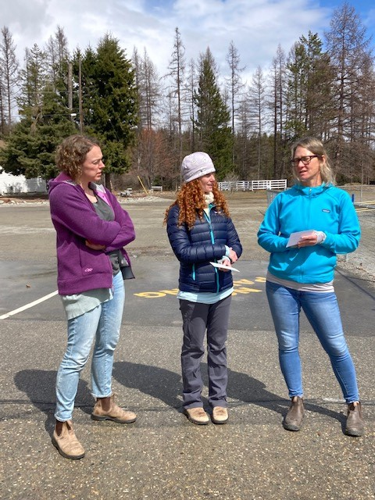
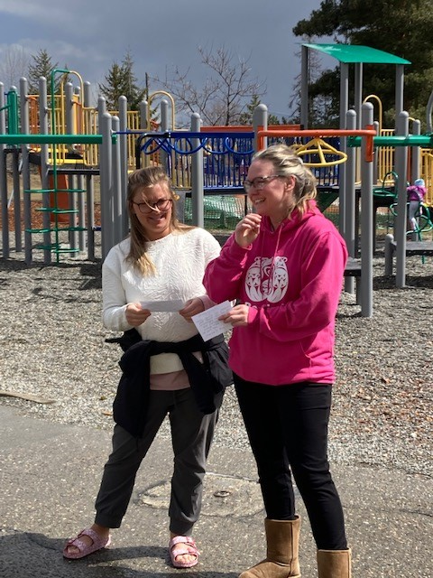
Leadership and Excellence
Increase quality and frequency of staff collaboration.

Slide 19
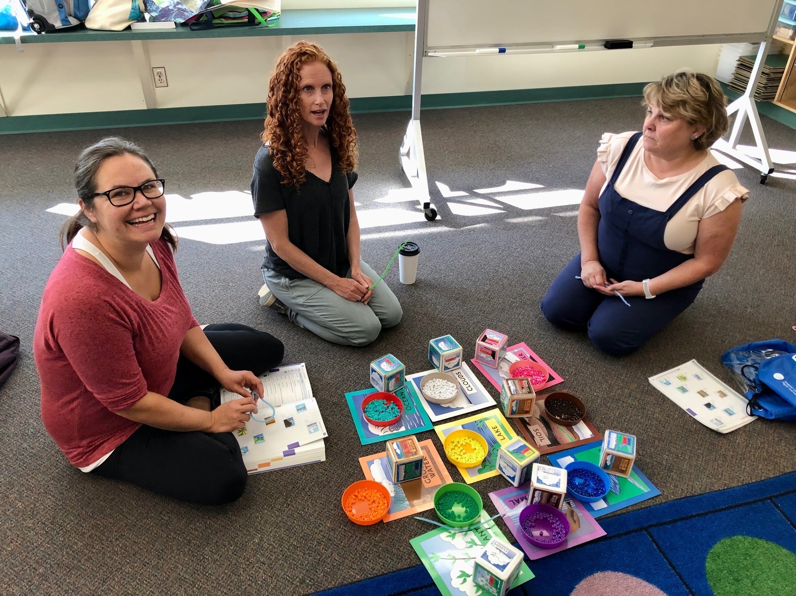
10/10 teachers participated in 2 collaborations in 2019-2020.
0/10 in 2020-2021
6/10 teachers participated in co-teach lessons in 2021-2022.
Goal for 2022-2023 – 100% of teachers participate in co-plan and co-teach lessons around school goals.

Slide 20
Learning is a lifelong process and LPES staff have had few collaborative opportunities with two years of interrupted collaboration. Staff have expressed an interest to meet with more frequency in small teams to collaborate by co-planning, co-teaching, and reflecting on their learning.
The concept we are focusing are groups of teachers co-planning, co-teaching, and reflecting on lessons related to school goals.
To what extent will teacher collaboration increase with structured opportunities to co-plan, co-teach and debrief lessons on literacy, numeracy and inclusion goals?

Slide 21
October & May survey of staff.
Monthly debrief of Instructional Rounds.
100% of teachers participate in four Instructional Rounds.
Oct., Nov., Dec., Jan., Feb., Mar., Apr., May, June
Science of Reading
Thinking Classrooms
We Thinkers
Staff meetings
Instructional Rounds
Collaboration release time

