Slide 1
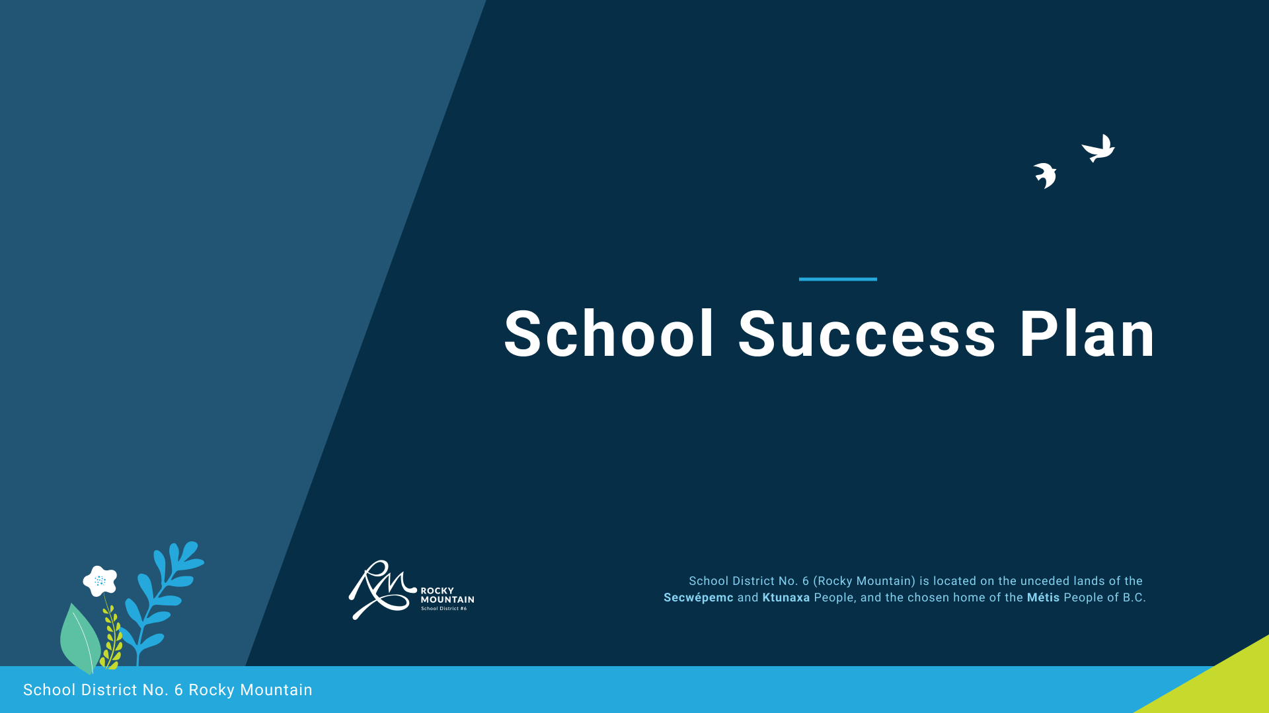

2022-2023
Rocky Mountain Online Learning
Learn at Home

Slide 2
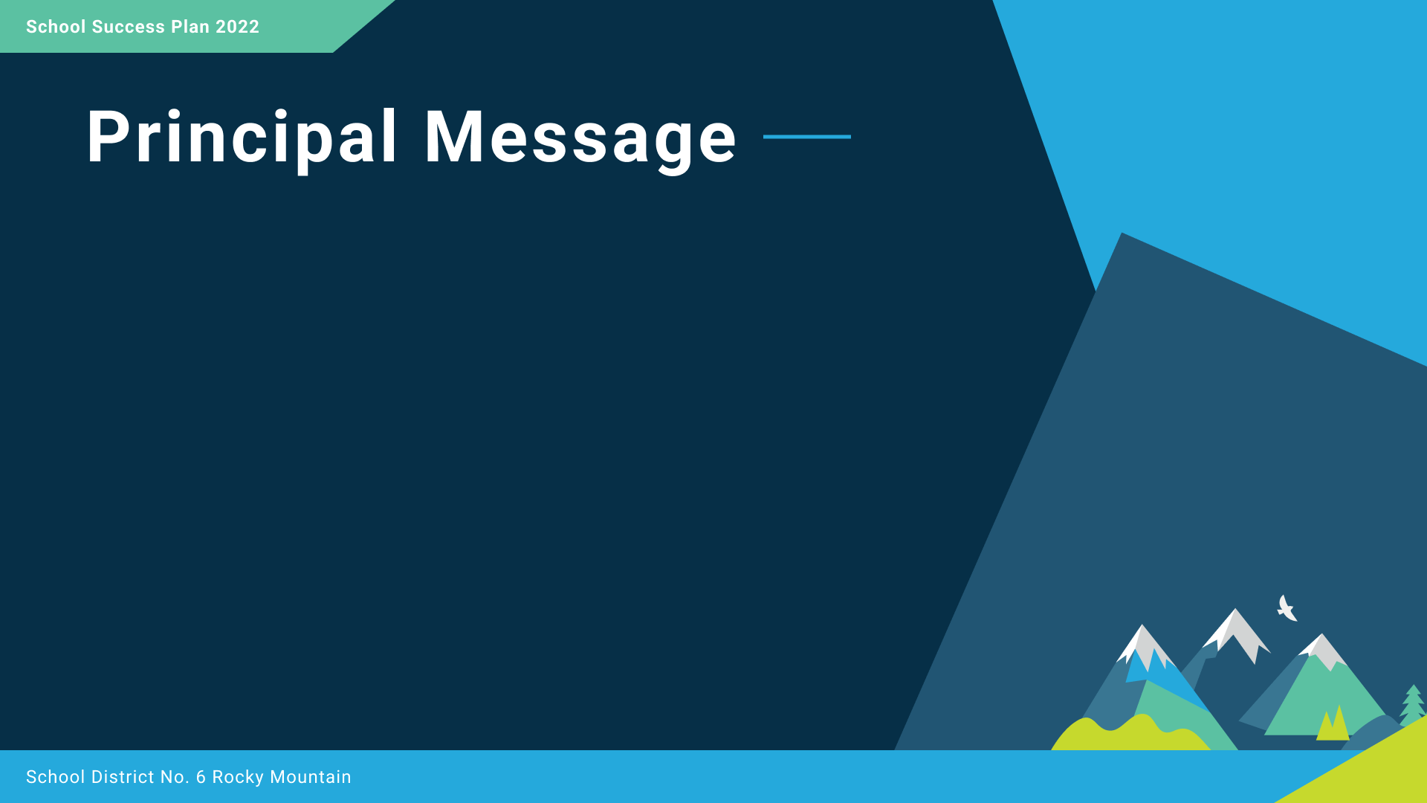

Personalization – Engagement – Connection
Rocky Mountain Online Learning acknowledges that this place where we live, work and play is the traditional, unceded, territories of the Ktunaxa and Secwépemc peoples and the chosen home of the Métis.
Our goal at Rocky Mountain Online Learning is to provide students and families in SD6 with a personalized approach to learning while continuing to be engaged, supported and connected. RMDL offers online courses to support students in grades 10 – 12, a Learn at Home program (K – 9) and Continuing Education studies to support adult learners.
Over the past year , our dedicated staff have worked with 43 families in our K-9 Learn at Home Program and connected with over 200 students in Grades 10-12, along with Adult Learners. Our staff have been responsive to the needs of families and students by providing flexible curricular options, an online learn at home program and secondary course options.
We work collaboratively with all the schools in SD6; these relationships have helped to create a better understanding of the programs and supports that RMOL provides to meet the needs of the learners and families in Rocky Mountain SD6

Slide 3
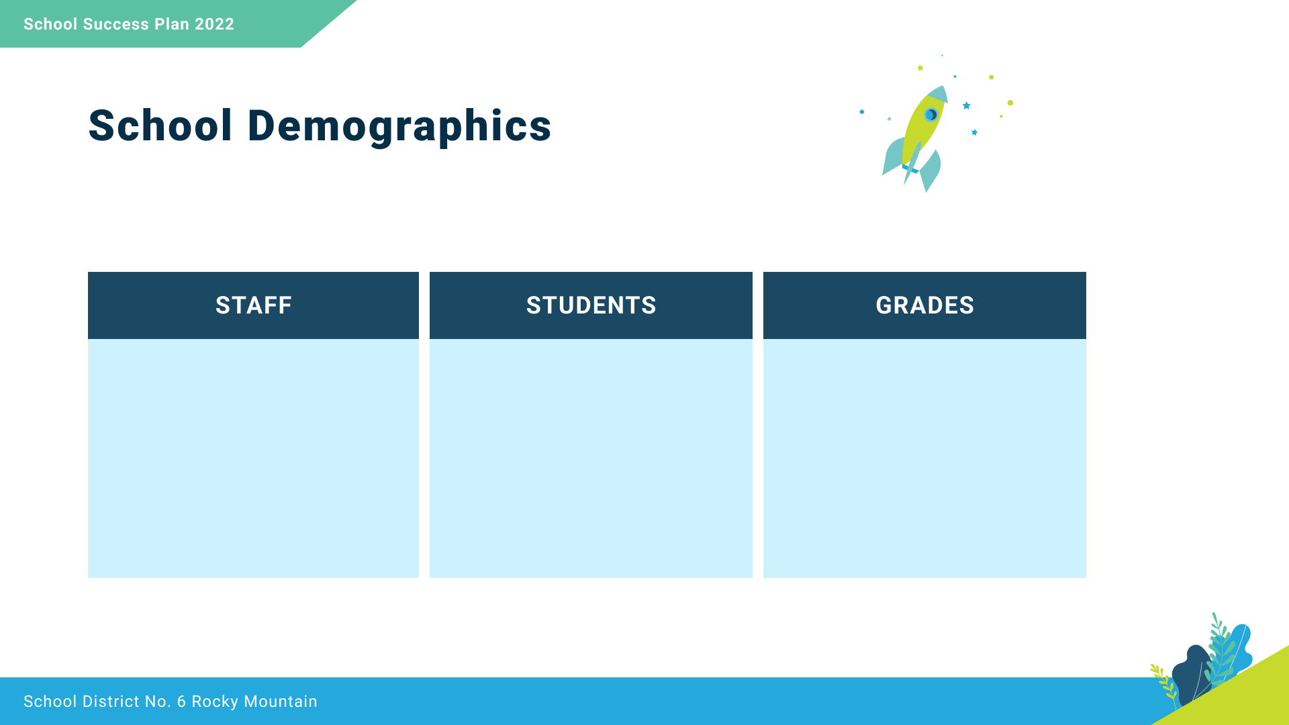
Kindergarten to Grade 12
Adult Education
3 Teachers
Admin Assistant
Principal
K-9: 14 Students
10-12 ~200 students
& Continuing Ed

Slide 4

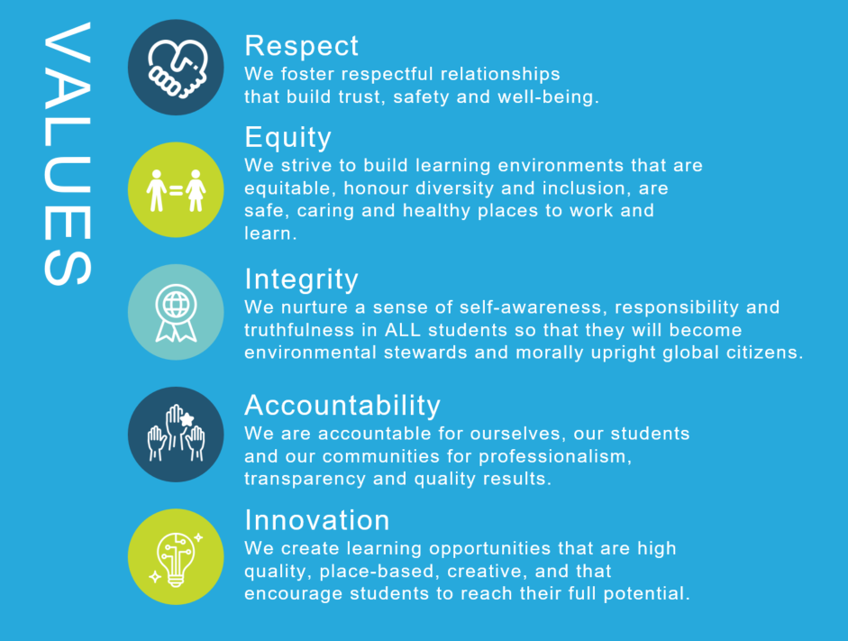
We collaborate in the pursuit of each student’s success as caring, resilient members of a global community.
Opportunity, equity, and success for ALL learners

Slide 5
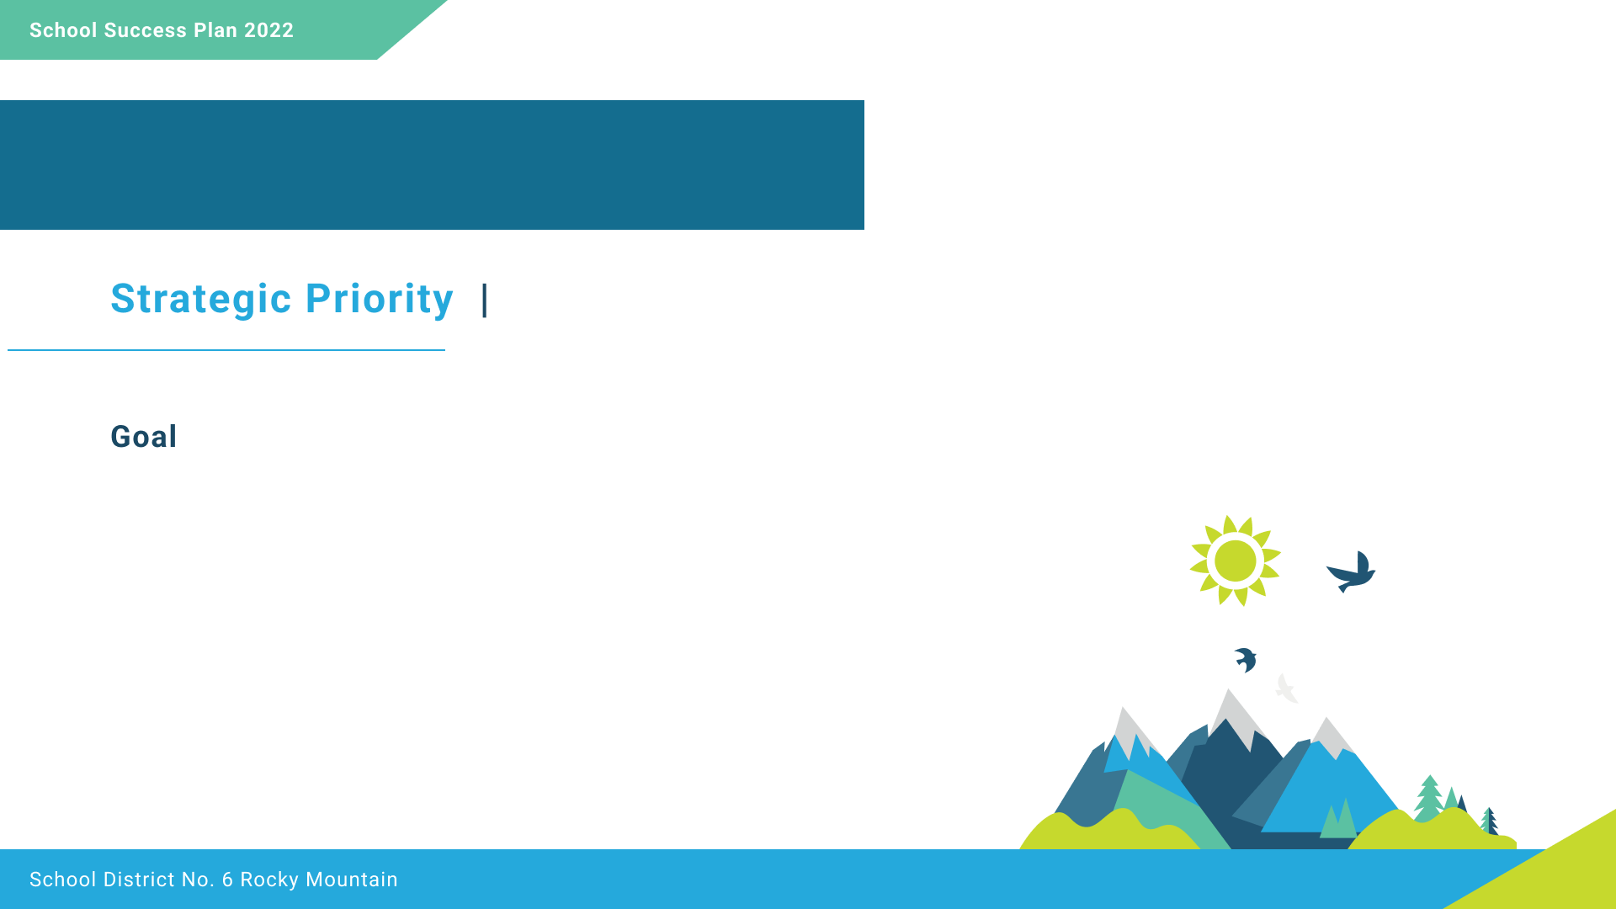

Equity and Inclusion
To provide effective programming and supports for all learners
“Learning ultimately supports the well-being of the self, the family, the community, the land, the spirits, and the ancestors.”
(First Peoples Principles of Learning)

Slide 6

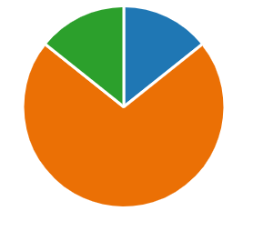
K – 9 Learn at Home
2021 - 2022 Parent Survey Results
Preference for a blended program (online and paper based)
Keep the resources as is. Do not change anything
Other option
Qualitative Data:
End of the year communication with parents indicates a need for increased flexibility in programming. Students and families expressed want more opportunities to explore areas of interest in specific curricular areas

Slide 7
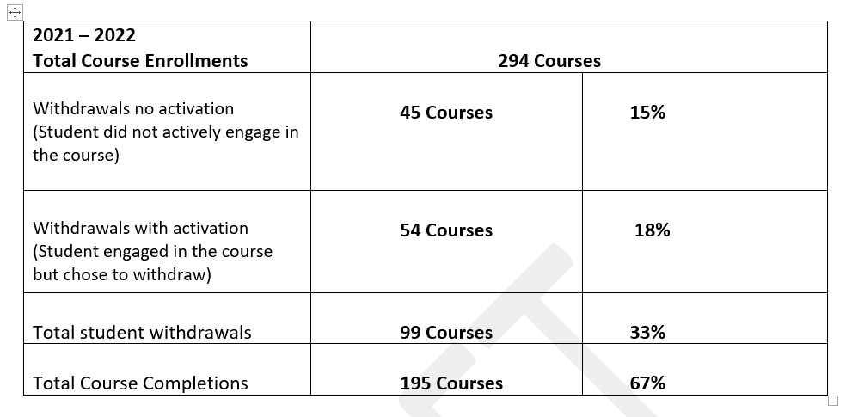
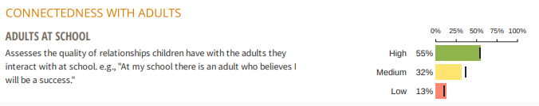
Grades 10 – 12 and Continuing Education
SD 6 Middle Years Development Instrument Survey Results

Slide 8
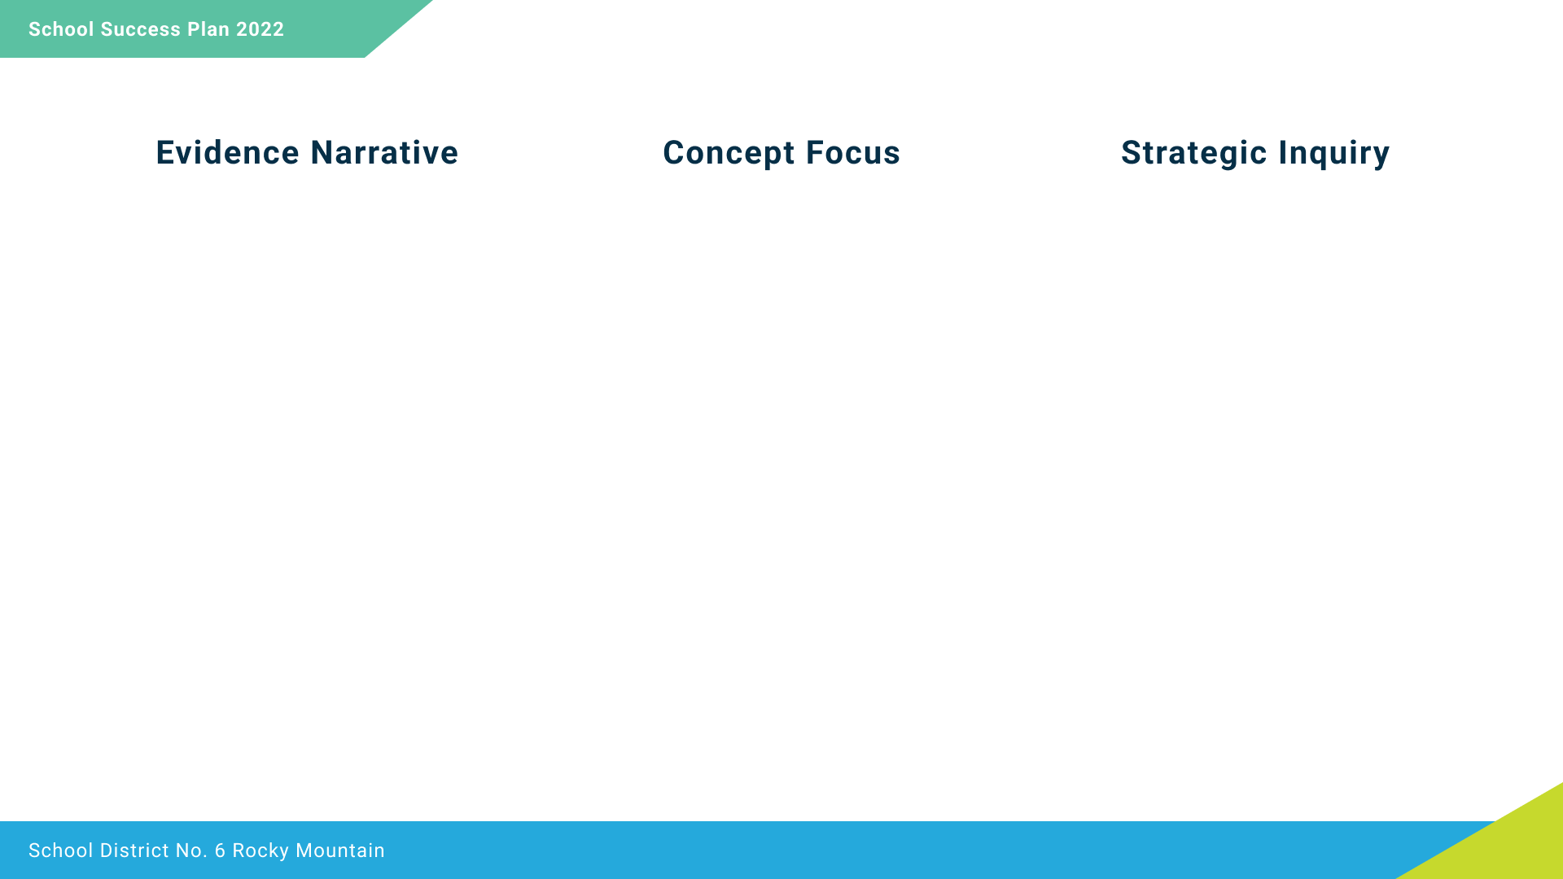
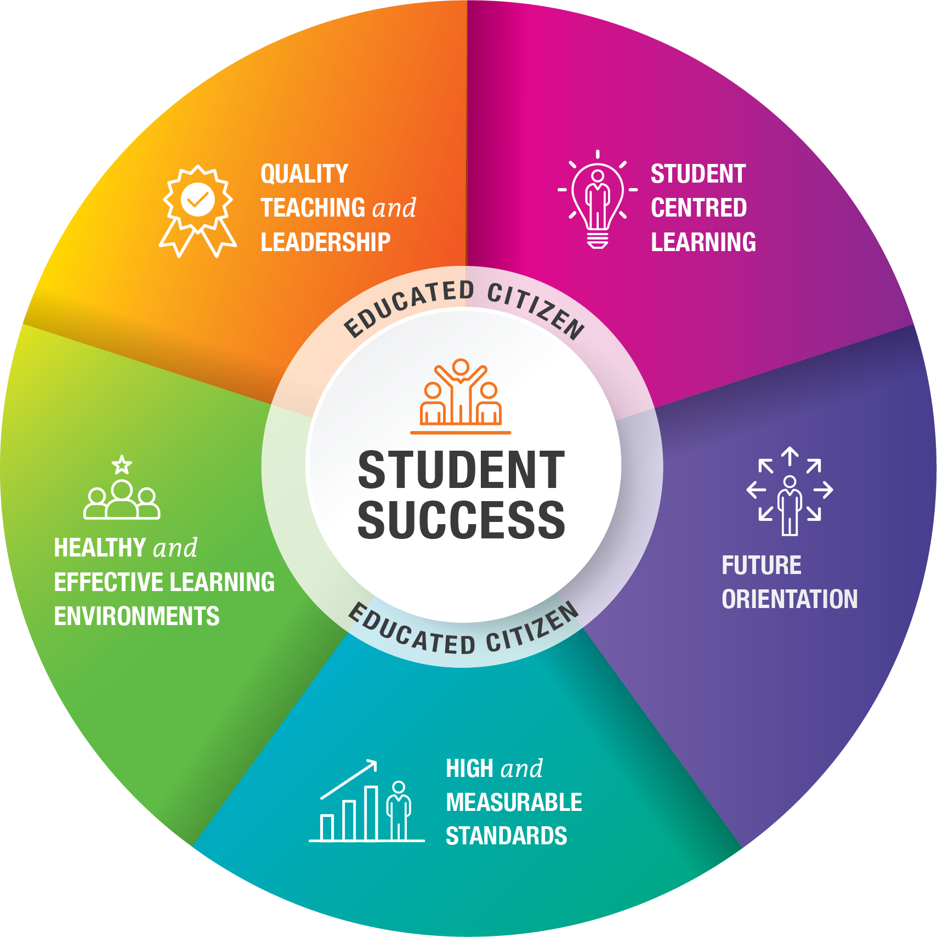
Feedback from our Learn at Home families indicates a need to provide more individualized program options. In order to provide the best supports and programming options for our K- 9 learners, it is vital that prior to registration , teachers meet with each family, in order to understand and best plan for the individual needs and interests of each learner. RMOL staff see the need to refine our onboarding process and revise the Student Learning Plan.
RMOL staff will also take a similar approach to address the 67% course completion rate. Secondary school students will also engage in a consultation process and commit to a course completion plan.
All learners and families will engage in a consultation process, whereby, learning plans will be co-created with teachers parents and students.
To what extent will a refined consultation/onboarding process involving student/parent and teacher improve student achievement?

Slide 9
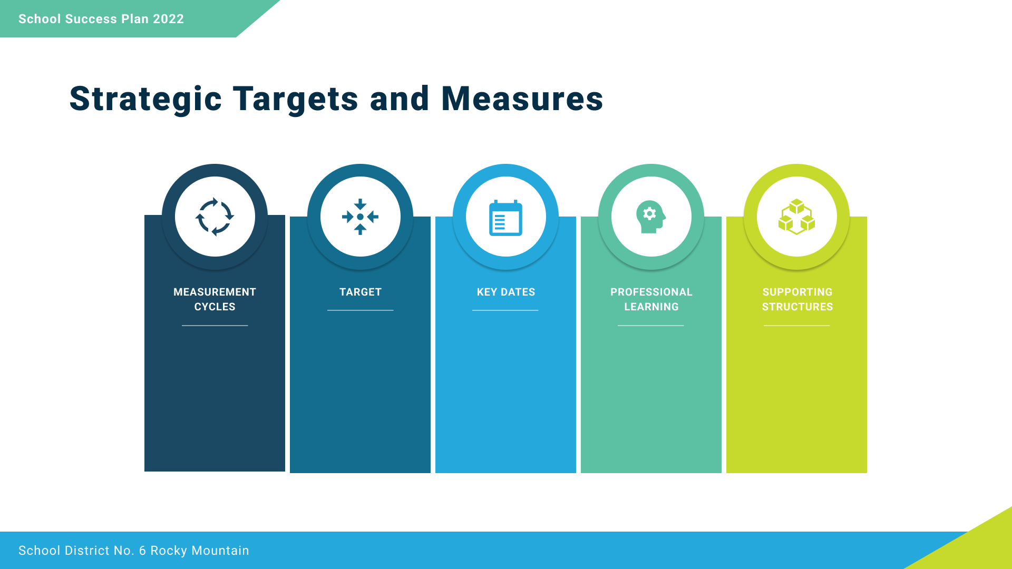
Research SLP templates and effective questioning
Connect with other online schools
Learn at Home: Onboarding Consultation
Revised Student Learning Plans
Gr. 10-12 Student Course Commitment Plan
Parent/Student Survey
Access to TTOC during onboarding
Staff review Student Learning Plans
3/year
Parent Survey 2/year
Formal Report Review (3/year)
80% Completion Rates Gr. 10-12
100% Learn at Home Learners are on track
November 2022
February 2023
May 2023
(Reporting Cycle)

Slide 10

Success for all learners
To improve student outcomes in literacy
To improve student outcomes in numeracy
“Learning involves patience and time”
(First Peoples Principles of Learning)

Slide 11
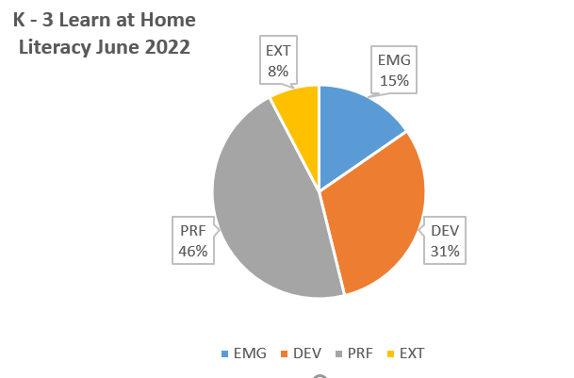
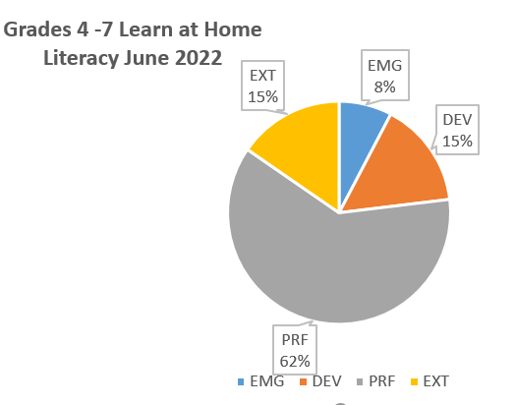
K – 9 Learn at Home: Literacy
June 2022 Report Cards

Slide 12
Literacy
Year end performance scores indicate that 46% of our K- 3 learners are emerging or developing in Literacy, 23% of Grade 4-7 are emerging or developing in Literacy. This data is supported by District and school based writing reading assessments.
Learn at Home parents are tasked with being a learning coach and provide daily Literacy instruction to their child. Resources that provide parents with comprehensive, step by step instructions are key to strengthening instruction at home and building literacy skills.
Provide comprehensive, age appropriate decoding strategies and resources to parents. Along with structured supports and workshops for parents and students.
To what extent will providing decoding materials at developmentally appropriate levels, and support for parents, impact student achievement in Literacy?

Slide 13
Decrease the number of students who are emerging/developing in Literacy on June report cards by 50%
RMOL Teachers join Pro-D sessions offered at Bricks and Mortar Schools
Instructional Rounds
Provide Literacy Workshops
for parents
WTW Assessment 4/year
Reading Assessments
3 x year
Report Cards
WTW: Sept, Nov, Feb, May
Report card cycle
Heggerty Literacy
Sound Connections
Words Their Way

Slide 14
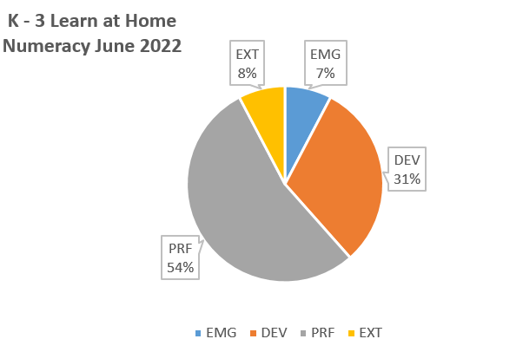
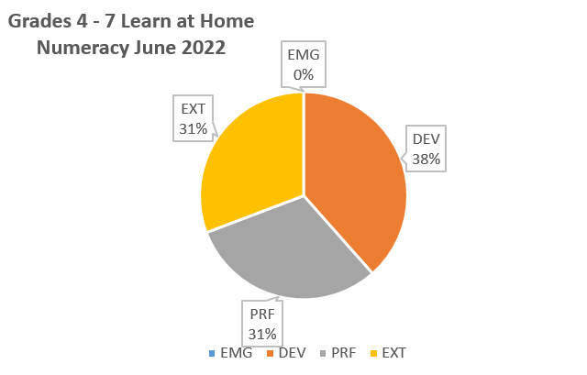
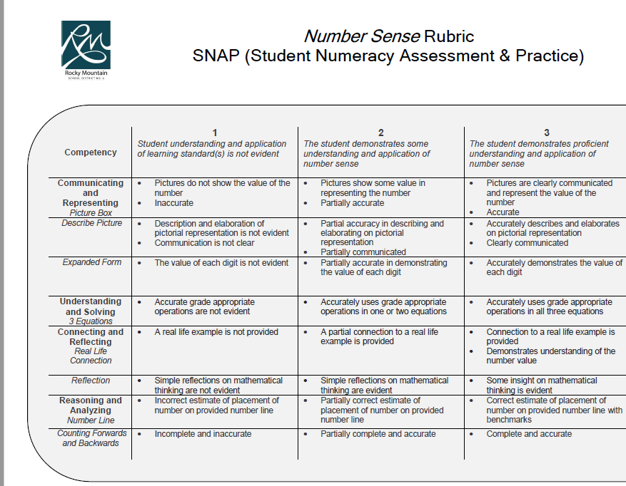
K – 7 Learn at Home: Numeracy
June 2022 Report Cards
June 2022 SNAP ASSESSMENT
Grade K – 3 Learners: SNAP Assessment
33% approaching in connecting and reflecting
42 % approaching in reasoning and analyzing
Grade 4-7 Learners: SNAP Assessment
45% approaching in connecting and reflecting
36 % approaching in reasoning and analyzing

Slide 15
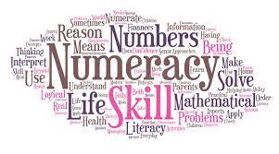
Numeracy
Year end Numeracy performance scores indicate that 46% of our K- 7 learners are emerging or developing. The SNAP assessment data highlights that Number Sense represents our greatest opportunity for growth, as ~40% of students are developing in this area.
Intentional focus/instruction on Task Analysis with all K – 7 students.
Example: Provide Weekly Word Problems and implement the - What’s important and Why strategy.
To what extent will providing our students with focused instruction and strategies to analysis and interpret Numeracy Tasks impact their achievement in Numeracy?

Slide 16
SNAP Assessments 3/year
Report Cards
Decrease the number of students who are approaching in reasoning and analyzing
by 50%
October, February & May
Report card cycle
RMOL staff join district Numeracy Team
RMOL staff participate in Instructional Rounds
Numeracy Workshops
for parents
U of W Word Problems K- 7

Slide 17

Excellence in Teaching
To improve staff collaboration
“Learning is holistic, reflexive, reflective, experiential, and relational. (First Peoples Principles of Learning)

Slide 18
The RMOL teachers are commitment to ongoing learning, the opportunity to work amongst collaborative team is limited by the size of our team.
We want to expand our opportunities to learn, collaborate and build professional relationships, while creating a culture of continuous improvement and tangible success for our students.
RMOL teachers will engage in collaborative learning opportunities with Primary/Elementary/Secondary Standard Schools.
RMOL teachers will participate in instructional rounds Primary/Elementary/Secondary school teams.
To what extent will active participation in instructional rounds with bricks and mortar school teams increase teacher collaboration and impact student success?

Slide 19
Fall and spring staff survey – comfort of peer observation, reflection of learning and professional growth.
100% of teachers report growth in practice due to collaboration and observations made during instructional rounds
Fall and spring surveys
Monthly staff meeting reflection and celebration time
Instructional Rounds in Education
(Professional Reading)
Provide time for collaboration
Monthly reflection and sharing at staff meetings

