Slide 1
<School Logo>
Sept 29, 2022
Edgewater Elementary

Slide 2
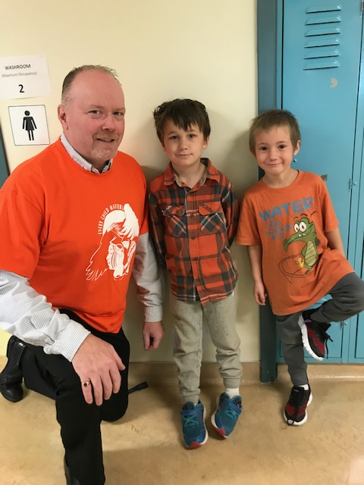
<Principal Photo>
Welcome to Edgewater Elementary School!
Edgewater Elementary School, a small rural K-7 school, priding ourselves on being visible and involved in the community. Our student population is growing bringing continuous change. We promotes active, lifelong, holistic learning. Our staff puts an emphasis on developing students intellectually, emotionally, physically and socially.
Yearly, our School Success Plan, is developed by our staff, through extensive planning, collaboration and teamwork, to meet the individual needs of all students. Our plan is regularly reviewed and adapted as needed to ensure each child continues to reach their potential in all areas of personal development.
This year our staff has recognized a few areas to address and a few areas we need to remain focused on. We will continue to concentrate on the core foundations of numeracy and literacy with an emphasis on numerate thinking and reading development. We also understand the importance of social emotional learning and its impact on academic learning. Our staff will work collaboratively to increase continuity of instruction of social emotional learning and student connections across all divisions. Staff will continue to develop and foster student social emotional growth while challenging entrenched values and beliefs. This holistic growth, and collaborative approach to learning, will further benefit student academic learning.
Success is never guaranteed. However, by supporting each other, & demonstrating continued growth, our students will be better prepared for future challenges.

Slide 3
9 Teachers
6 Educ Assistants
1 Community LINK
1 Indigenous Ed Support
1 Learning Services
124
K-7

Slide 4
Respect We foster respectful relationships that build trust, safety and well-being
Equity We strive to build learning environments that are equitable, honor diversity and inclusion, are safe, caring and healthy places to work and learn.
well-being.
Integrity We nurture a sense of self-awareness, responsibility and honesty to become environmental stewards and morally upright global citizens.
Accountability We are accountable for ourselves, our students and our communities for professionalism, transparency and quality results.
Innovation We create learning opportunities that are high quality, place-based, creative, and that encourage students to reach their full potential.
We collaborate in the pursuit of each student’s success as knowledgeable, caring, resilient, and contributing members of a global community.
Opportunity, equity, and success for ALL learners

Slide 5
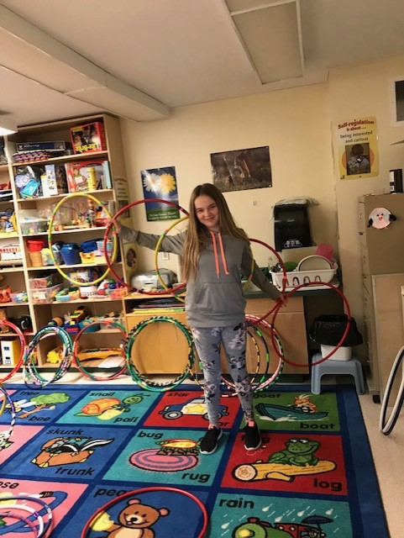
Equity & Inclusion
To increase student connectedness at school.
<Insert Image>

Slide 6
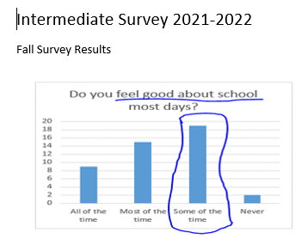
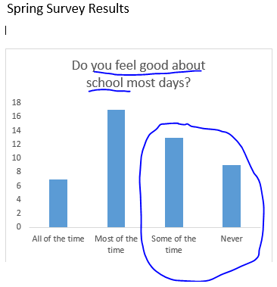
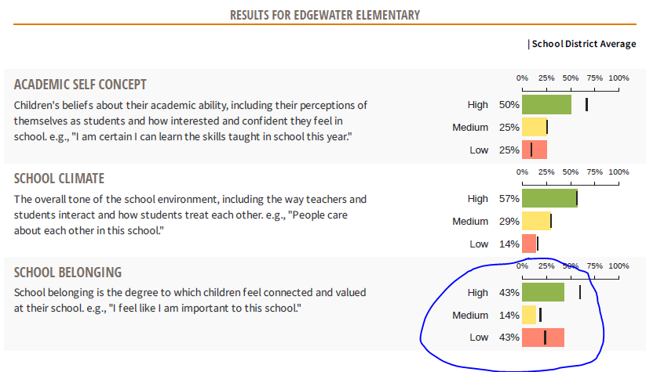
Early in 2021-22 we discussed what engagement may means and look like to students. Attendance is a way to track/measure but isn’t always an accurate reflection of engagement. We will continue to monitor attendance, however, after extensive collaborative discussion we identified questions for surveying students that reflect engagement and attitude/feelings towards school.
Our students, according to the survey, seem to feel welcome and accepted but there is some concern about ‘students feeling good’ when at EES. The staff are feeling like we need more extensive questioning and feedback to accurately assess growth.
Our staff will continue to look at ways to further connect and support students. We will determine a more extensive student survey by using questions from an evidence-based ‘school belonging scale’ to gather our information. We also plan to track office referrals & student participation in programs supporting social-emotional development and student belonging.
With Truth & reconciliation being a focus we will be conscious of Indigenous student responses and identify trends that require additional support.

Slide 7
Edgewater Elementary has had a growing population over the last number of years. Roughly 122 K-7 students projected for 2022-23 with 28 of them being self-identified Indigenous students (23%). We have witnessed varying levels of student engagement and understanding towards inclusion and a sense of belonging. Through survey data collected in 2021-22, we identified that students only ‘sometimes feel good’ about being at school. We now plan to drill deeper into this feedback and support students where necessary.
Increase a sense of belonging for all students with a specific focus on Indigenous students as a group.
To what extent will all staff providing programs to support student social and emotional needs (ie - 7 Indigenous teachings, Zones of Regulation, WITS – Walk away- Ignore-Talk it out-Seek Help, Afterschool primary program, Mentor program, extracurricular) improve students sense of belonging?

Slide 8
75% of students score increases in School Belonging Scale (SBS)
Decrease Office Referrals
Baseline for participation (80% of students participate extra-curr)- matching increase on provincial measures
Aug Days Pro-D
Social-emotional Learning
Trauma-Informed practice (refresh/remind)
Social Resp quick scales (review)
Review data collected
Continued Staff Decolonization & Reconciliation Growth
School Belonging / Engagement Scale 3X (connection - teachers, peers, oneself, learning)
Monthly review at SSP mtgs
MDI, SLS – once per year
Sept – baseline SBS data
May – SBS final data
Office Referrals tally – each reporting period (3X year)
August Days – SEL support, school belonging connections
Monthly SSP mtgs
Collaborative release time for staff
School Belonging Scale
MyEd – Office Referrals
Weekly EA Mtgs

Slide 9
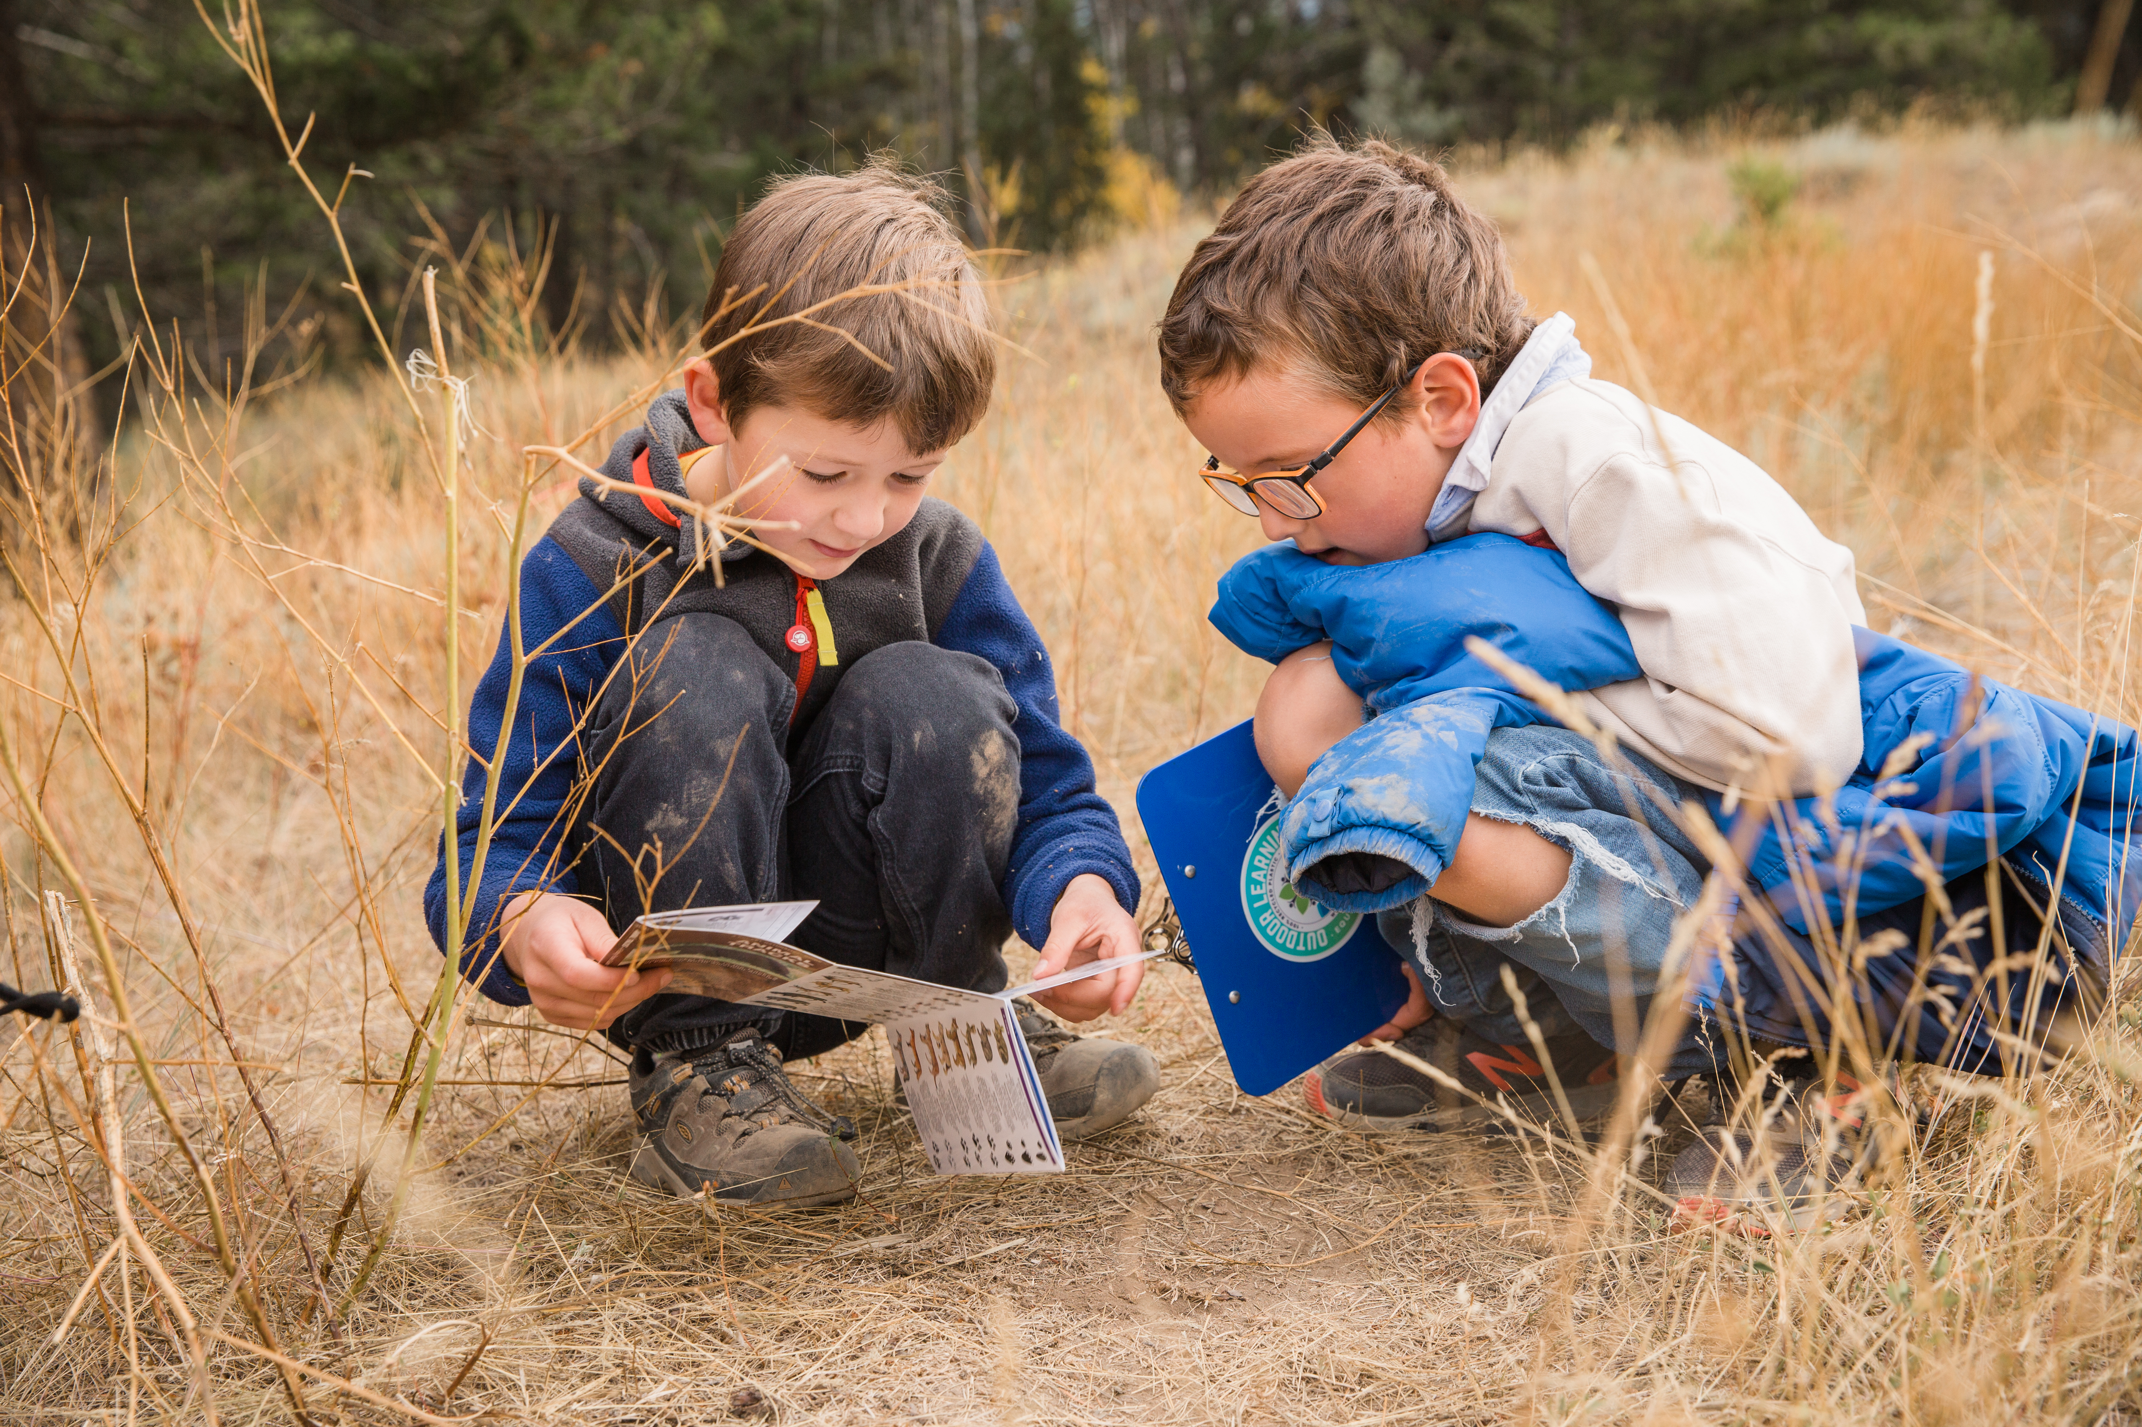
Success for All Learners (Literacy)
To increase student achievement in learning to read.
<Insert Image>

Slide 10
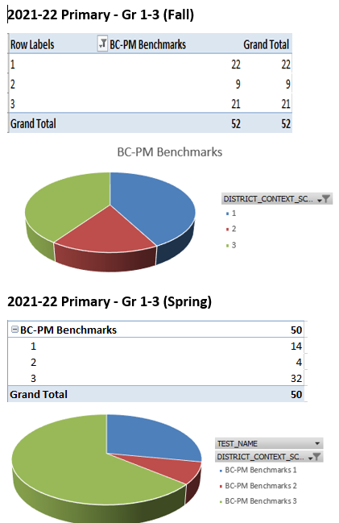
Fall 2020 PM benchmark scores we noticed concerning results for students entering Gr 2 (11 of 19 not meeting expectations). When we dug a little deeper, reviewing EES data and in early December 2021, we noticed 51% of all our primary students had a context score of 1 (Emerging). This was an issue that we needed to address.
(Graphs scale) 1- Emerging 2-Developing 3- Proficient/Extending
Primary Reading Scores – Gr 1-3
Fall 2021 – 42% emerging, 18% developing, 40% Proficient/Extending
Spring 2022 –28% emerging, 8% developing, 64% Proficient/Extending
36% (8/22) of our emerging students in ‘Fall’ moved up to developing or higher.
72% (36/50) of students in ‘Spring’ scored in proficient/extending up from 58% in ‘Fall’.

Slide 11
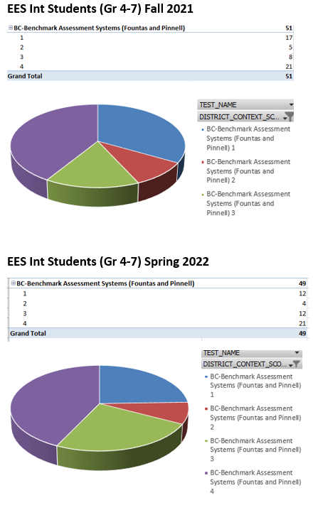
Once we noticed an issue with Primary Reading scores in 2020 we also looked closely at our Intermediate (Gr 4-7) results. Intermediate scale uses F&P benchmark scores, we again noticed concerning results. Roughly 50% of our Intermediate students scored ’emerging’ on our Fountes & Pinnel reading assessment in 2020. Again, two years later, after a targeted focus on reading we are seeing noticeable growth.
(Graph scale - Fall 2021/Spring 2022)
1- Emerging 2-Developing 3- Proficient 4- Extending
Intermediate Reading Scores – Gr 4-7
Fall 2021 – 33% emerging, 10% developing, 16% Proficient, 41% Extending
Spring 2022 –24% emerging, 8% developing, 24% Proficient, 43% Extending
1 of 3 students in the Fall were emerging (17/41 = 33%) and in the Spring we had 1 of 4 students score ‘emerging’ (12/49 = 24%).
10% increase in students in ‘Spring’ that scored ‘proficient/extending’.

Slide 12
We noticed a significant decline in primary reading scores (mainly Gr 2 in 2020-21 with some outliers). At the time we attributed this to likely being interruptions in learning due to COVID. After further analysis of collected data, we realized reading needed to be a priority for all K-7. EES provided various targeted strategies in 2021-22 to specific identified student groupings. The growth was significant with these students (refer to data on next page). In 2022-23 we plan to further implement targeted reading strategies in every classroom.
Improving reading fluency levels at each grade level.
To what extent will a staff wide focus on daily fluency strategies, with students, impact achievement in reading?

Slide 13
-Literacy VP – sessions on supporting reading interventions
-Time to collaborate - Primary F&P programming and resources, common language, practices for independent reading - Observation/planning/discussion on targeted reading practices
- Increase % of students meeting grade level expectations for reading
(be aware of small population influence)
-October / May - formal assessments
- Jan informal assessment
-Report Card dates – informal assessments
-Monthly classroom assessments on students with 1 as a context score
- 3 formal PM/F&P assessments
-5 times a year reviewing classroom evidence – SSP mtgs
- Monthly tracking of targeted students
-Monthly SSP mtgs
-Collaborative opportunities
-LA/1-to-1/targeted support plan
-weekly EA mtgs to support needy students(monitoring obj, adj strategies)

Slide 14
Success for All Learners (Numeracy)
To increase student achievement in numeracy.
<Insert Image>

Slide 15
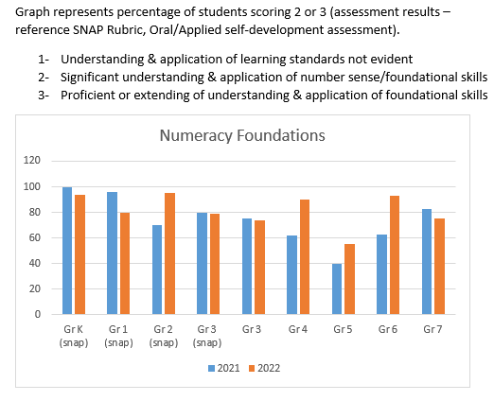
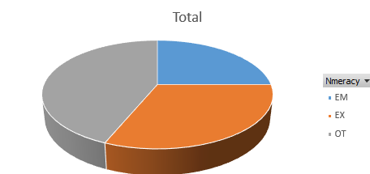
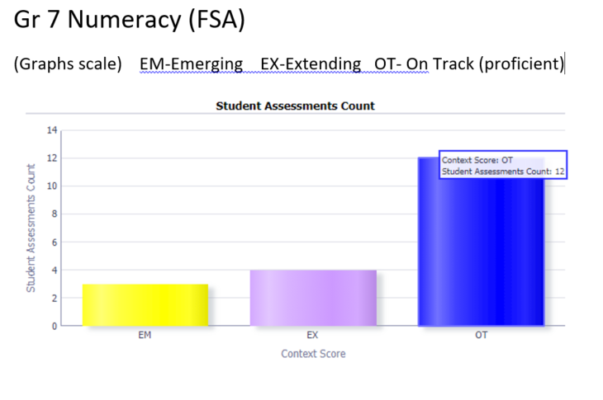
Numeracy Foundational Skills
Our continued effort to develop basic number skills this past year has resulted in noticeable growth (Gr 5 cohort to Gr 6 – biggest gain). The data shows that we are almost at 80% proficient for most grades. We are seeing an alignment of 80% proficiency between foundational skills & results on district assessments & provincial measures. However, growth has levelled off. How do we continue to increase scores? We have a plan to support students by maintaining work on foundational skills and shifting focus to include numerate problem solving.
Gr 7 - FSA Results NUMERACY
These graphs compare 2020 & 2021. Reveals strong scores on Foundations Skills Assessment (FSA) in numeracy for 2020 Gr 7 (84% - 16/19 On Track or Extending). We noticed a % drop 12/16 (75% in 2021). Our foundational skill development focus, with continued improvement of scores over 80%, may further support growth on assessments like FSA’s. However, a shift of focus to more numerate work, along with the growth witnessed in foundational skill development, should additionally support student success on FSA, classroom & real-life problem-solving ability.

Slide 16
School numeracy data demonstrated areas of opportunity for growth. We are also noticing an increase in numerate reasoning and an emphasis on the process of problem solving in assessments. Our students are having difficulty with solving problems and often the process of being able to show an ability to solve multi-step equations. A focus on numerate thinking will improve students’ ability to deeper understand, make connections, and solve grade level problems in numeracy.
Interpreting & Analyzing multi-step problems.
If teachers practice weekly interpreting and analyzing authentic math problems will students’ achievement improve?

Slide 17
-Aug Days Pro-D – Numerate thinking implementation / guidance (VP numeracy)
-EA training - how to support numerate thinking
-SD6 Learning Rounds???
FSA results – once year
SNAP – 3 x per year
Classroom assessment
Reviewing students’ samples at SSP mtgs
Improved FSA scores
(Gr 4&7)
Increase in % of students with context scores of 2&3
Oct / Jan / May - SNAP assessments
Oct – FSA tracking (compare to previous year)
Report Card classroom assessments
-SSP monthly mtgs
-Collaborative opps for teachers
-Numerate resources for all grade levels
-SD6 Intermediate numeracy assess
-weekly EA mtgs to support needy students(monitoring obj, adj strategies)

Slide 18
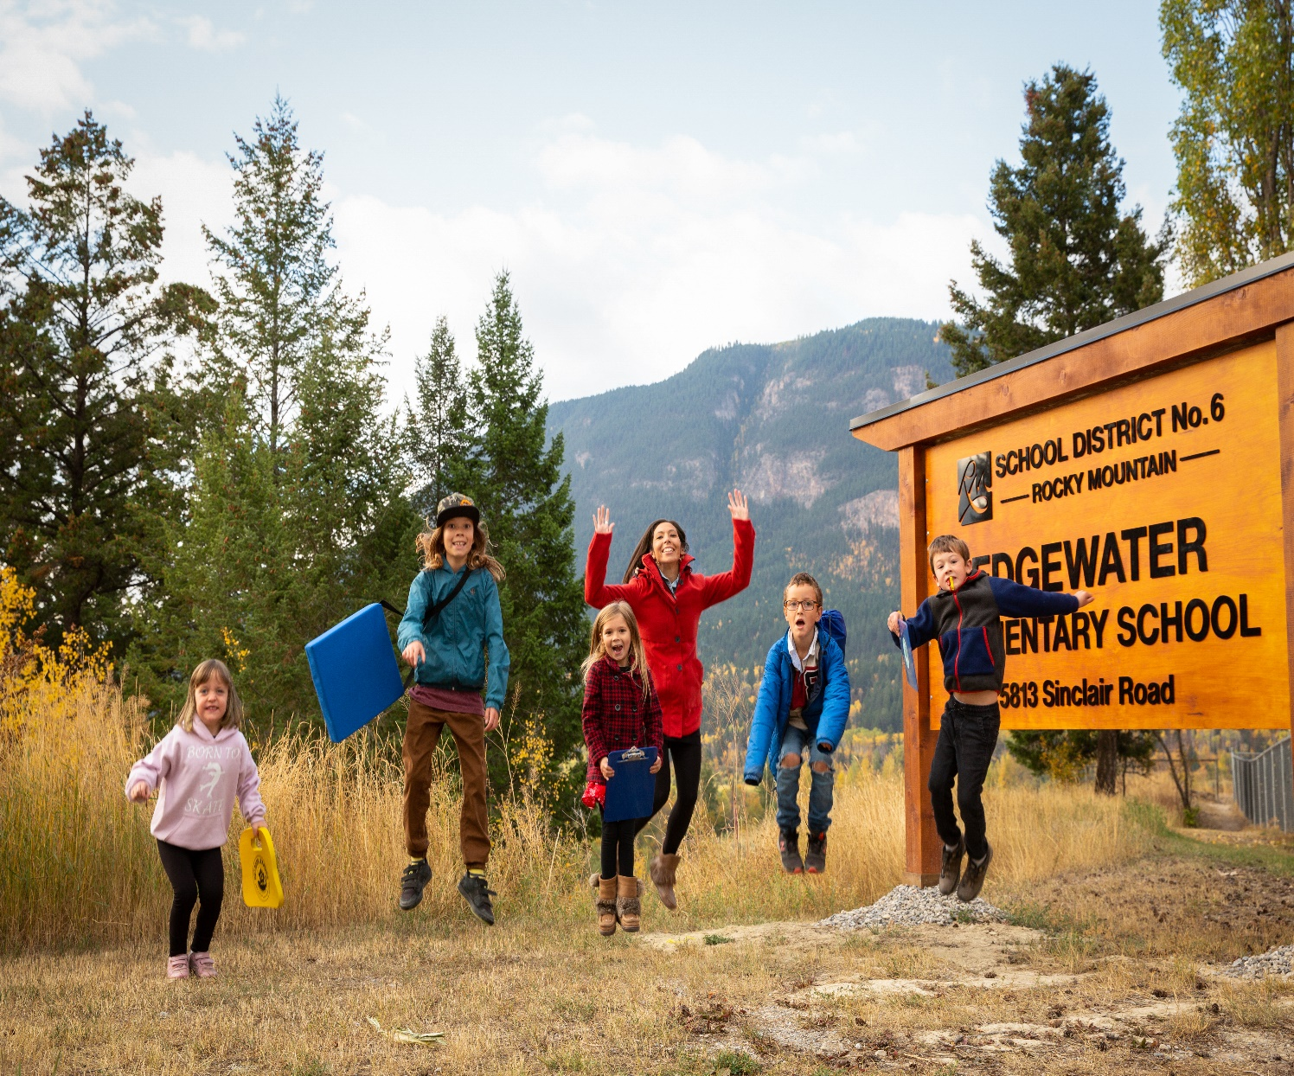
Excellence in
Teaching &
Leadership
To improve instructional practice in Social Emotional Learning.
<Insert Image>

Slide 19
Current Research supports strong social emotional development and a sense of belonging as foundational to learning. Through scheduled collaboration opportunities teachers will share best practice and work to develop ways to improve social emotional student support within their classroom. The enemy of improvement is isolation (Fullen).
Use scheduled collaborative release time and learning focused staff meetings (SSP monthly meetings) to promote staff reflecting and improving social emotional student learning in their classrooms.
Will providing monthly SSP meetings and teacher collaboration, with a focus on SEL, will teachers report an improved ability to teach SEL (Social Emotional Learning)?

Slide 20
Aug Days Pro-D – (guidance VP SPED)
Social-emotional Learning
Trauma-Informed practice (refresh/remind)
Social Resp quick scales (review)
Review data collected
Continued Staff Decolonization & Reconciliation Growth
- Increased SEL instruction within classroom (embed)
-Decrease in classroom mgmt. issues
-alignment of SEL language, delivery, programming within EES to support students
-Oct/Jan/June – SEL self-assessment
-Monthly reflections – growth within classroom
-teachers outline SEL instruction in yearly overviews
-SEL teacher self-assessment (3X)
-monthly reflections at SSP mtgs or collaborative groups (how is something in your practice aligning with SSP?)
-Monthly SSP mtgs
-Collaborative release time for staff
-BC quick scales on SR
-SEL – Classroom/teacher Self-assessment tool

Slide 21
Every success story is a tale of constant adaptation, revision & change.
– Richard Branson

