Slide 1
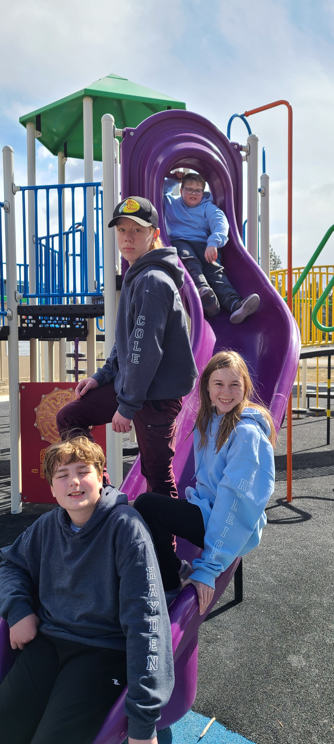
MMES: Curiosity, Community, Character
September 2022
Martin Morigeau Elementary

Slide 2
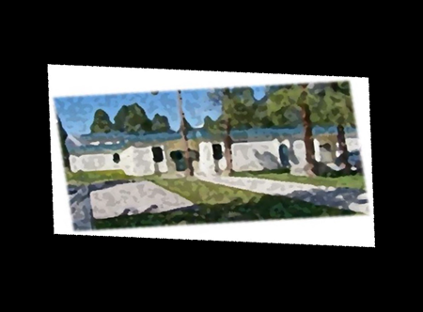
<Principal Photo>
Martin Morigeau Elementary School is a K-7 school located on the traditional, unceded territories of the Ktunaxa and Secwépemc peoples and on the territory chosen by the BC Métis Nation as home. MMES is a rural school with 74 students expected for the 2022-2023 school year. There is a diversity of students at MMES which includes First Nation and Métis students.
Curiousity, Community and Character communicates the values MMES holds for students. The school community revolves around Three Pillars of Care: We take care of Ourselves, we take care of Others, and we take care of This Place. MMES staff are committed to real world, experiential education connected to the area and bring their passion for teaching and learning to support students in reaching their full potential. MMES incorporates the First Nations Principles of Learning.
Teresa Vancise
Principal & Lifelong Learner

Slide 3
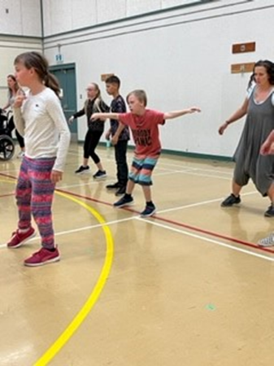
2022-2023
Students – 74
Indigenous Students– 34
Admin – 1
Support Staff – 9
Teachers - 5
Kindergarten – Grade 7

Slide 4
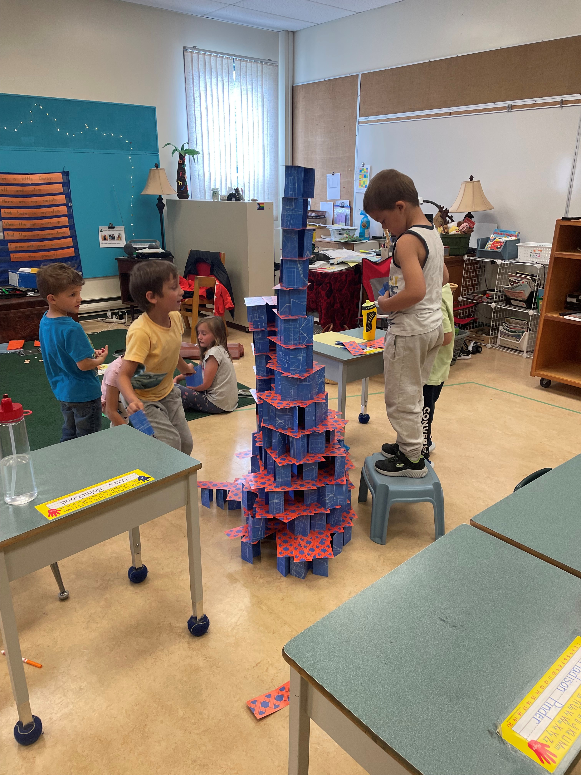
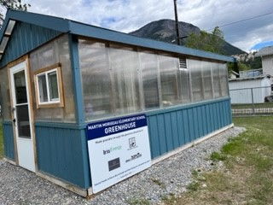
Respect
We foster respectful relationships that build trust, safety and well-being.
Equity
We strive to build learning environments that are equitable, honour diversity and inclusion, are safe, caring and healthy places to work and learn.
Integrity
We nurture a sense of self-awareness, responsibility and honesty to become environmental stewards and morally upright global citizens.
Accountability
We are accountable for ourselves, our students and our communities for professionalism, transparency and quality results.
Innovation
We create learning opportunities that are high quality, place-based, creative, and that encourage students to reach their full potential.
We collaborate in the pursuit of each student's success as knowledgeable, caring, resilient, and contributing members of a global community.
Opportunity, equity, and success for ALL learners

Slide 5
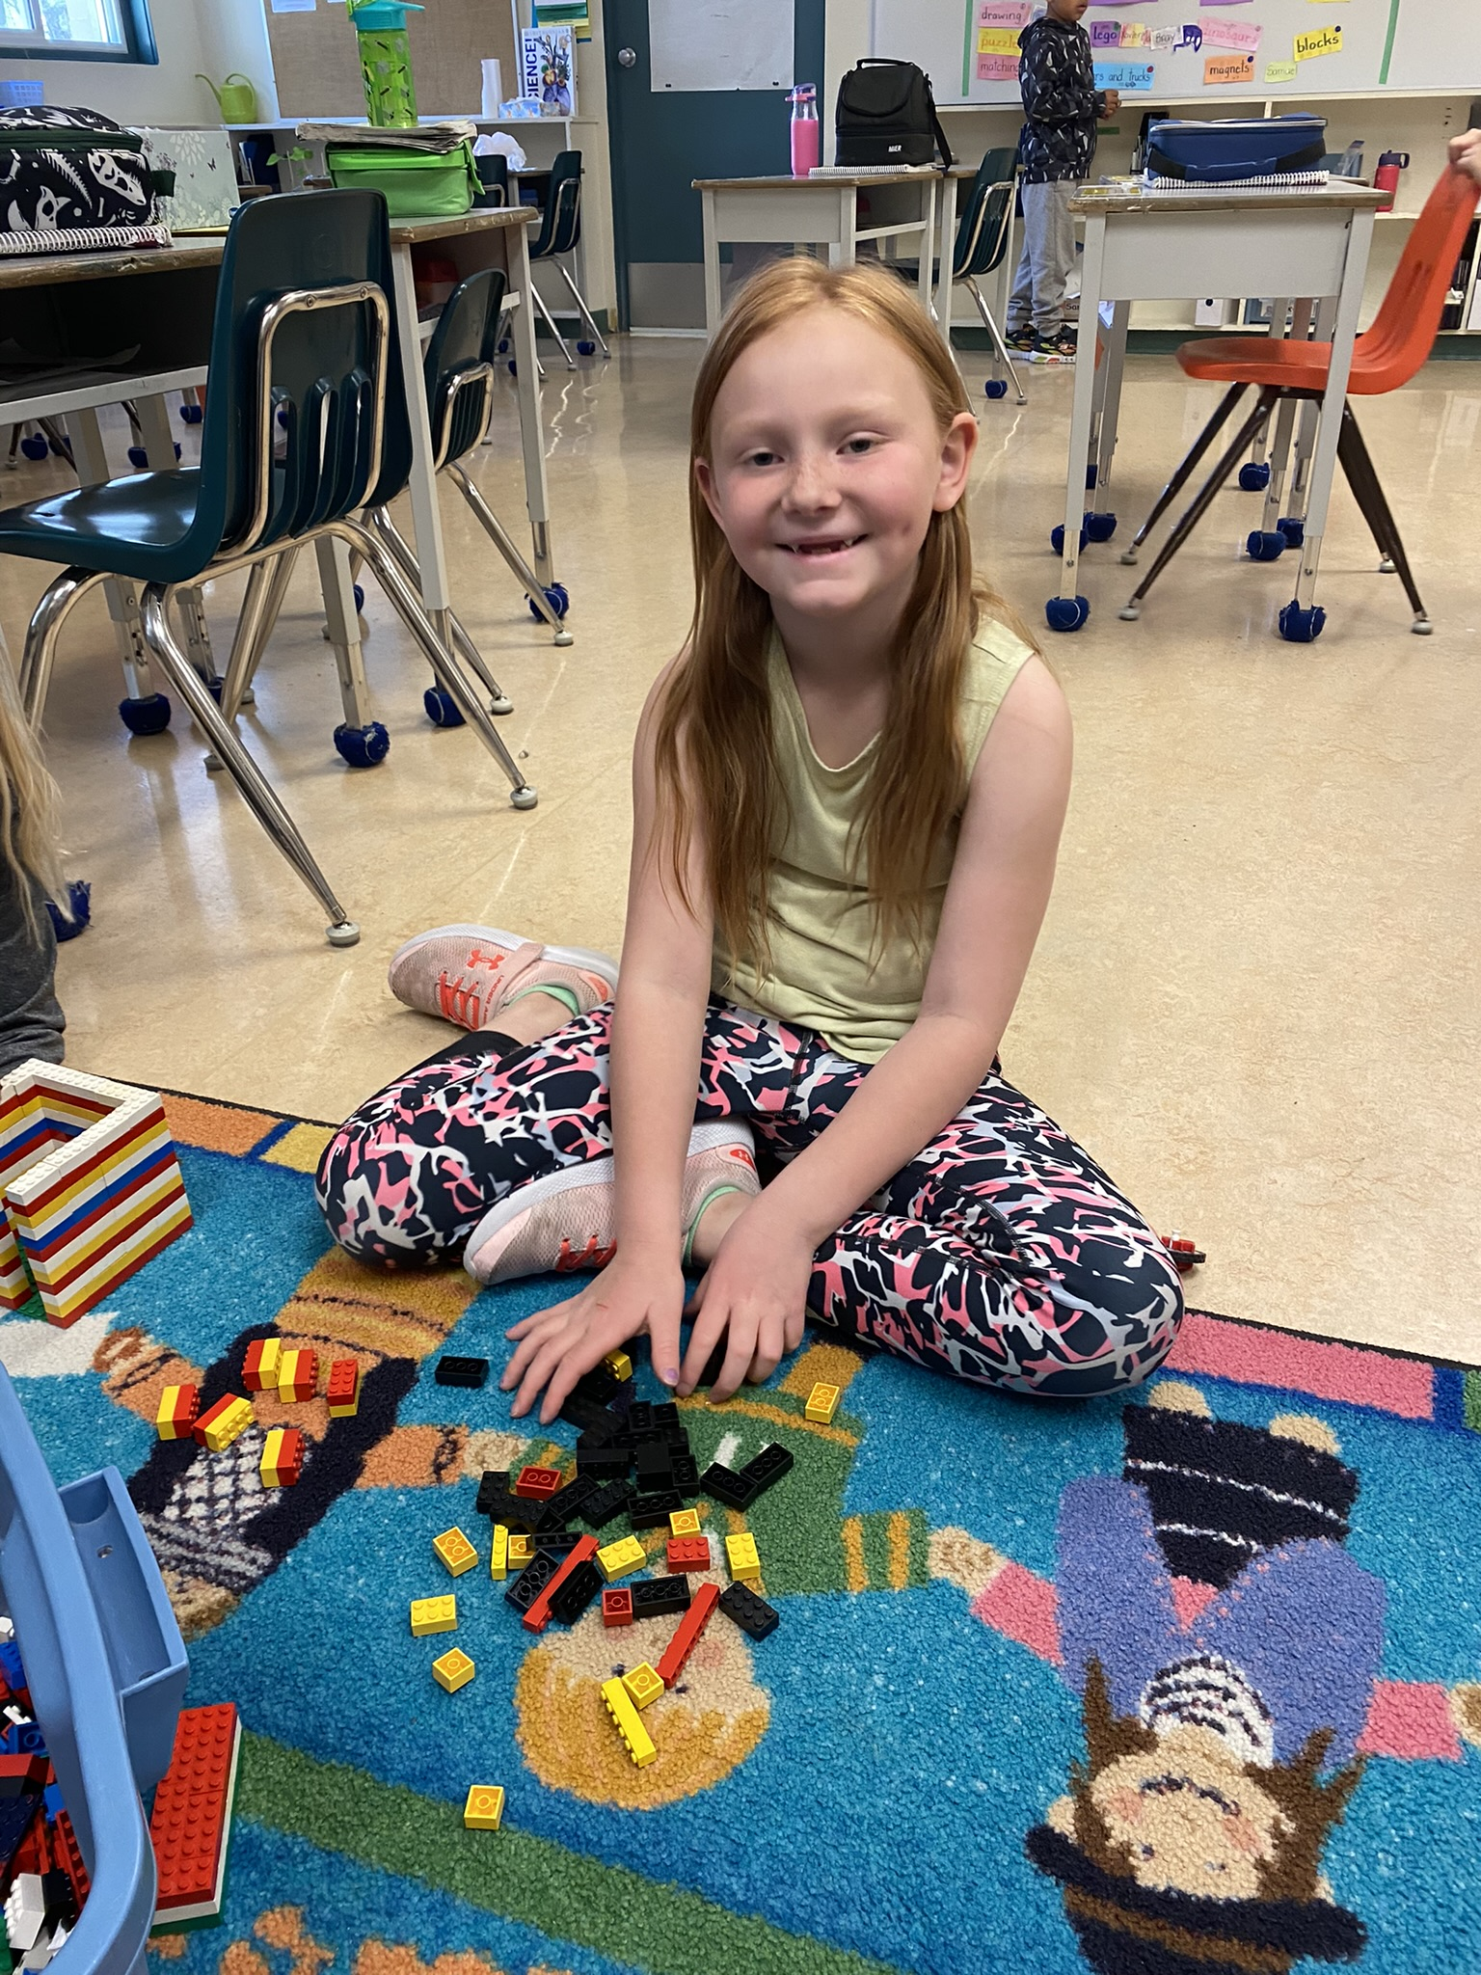
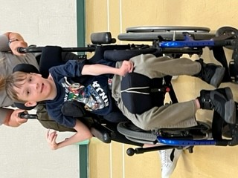
Strategic Priority One
Equity and Inclusion
To Increase student understanding of Social Emotional Learning (SEL)

Slide 6
Percentage of June Participants Identifying 4 or more ways to show Care
56% Take Care of Myself
including physical care, staying on task, making good choices, using regulation tools, asking for help, and being aware of physical limitations.
50% Take care of others
39% Take care of this place
All of these areas showed room to grow so we will continue to focus on all three Pillars of Care.

Slide 7
Student Learning Survey: My Choices Affect Others
A: Martin Morigeau
B: Province
The evidence of students thinking of others aligns with similar provincial measures for our school

Slide 8
Staff noticed that students came with a broad range of skill levels in self-regulation, interpersonal relations, conflict resolution, and contributing as a community member in the larger school environment. Introducing the common language of the 3 Pillars of Care (At MMES We Take Care of Ourselves, We Take Care of Each Other and We Take Care of This Place), in September allowed students brainstorm to create and post visible ways to participate. After class reviews were done in February it was identified that students were still struggling to independently identify
more than 3 examples of the 3 Pillars. We adjusted our strategy and as a school, focused on one pillar per month. Based on end of year data, this remains a focus for the upcoming year.
Developing healthy relationships helps us feel connected, supported and valued at MMES. We can do this through Identifying and incorporating a variety of ways to Take Care of Self, Others and This Place through social emotional learning.
If all staff use common "3 Pillars of Care" language while teaching Social Emotional Learning (SEL) skills, will students ability to demonstrate actions of each pillar increase?

Slide 9
3 Pillars of Care survey
Sept, Dec, March, May
Bimonthly review of each pillar at staff meeting
Province SLS in April gr 4-7
Review attendance at School Based Teams
Early Sept: Student Pillar pre-survey
Sept, Jan, March: Teacher data review, adjustment Teacher goal setting for school wide instructional focus
Dec, Mar, May: Student Pillar survey 2
Mid May: Student Pillar post-survey and data
Explore + incorporate Mind Up Curriculum as common SEL across grades .
Work with school counsellor to supplement Mind Up Curriculum with elementary Mental Health Literacy
Data analysis and application process
Common PD days to focus on SEL for Equity and Inclusion
School Data from "Wolf Recognition"
IESW Cultural Literacy
Scheduled staff meeting time for data review and adjustment cycle
https://mindup.org/
https://mentalhealthliteracy.org/
Teachers These Days: Stories and Strategies for Reconnection-Jody Carrington
80% or more of MMES students can demonstrate the ability to identify and demonstrate 4 or more actions of each of the Three Pillars of Care

Slide 10
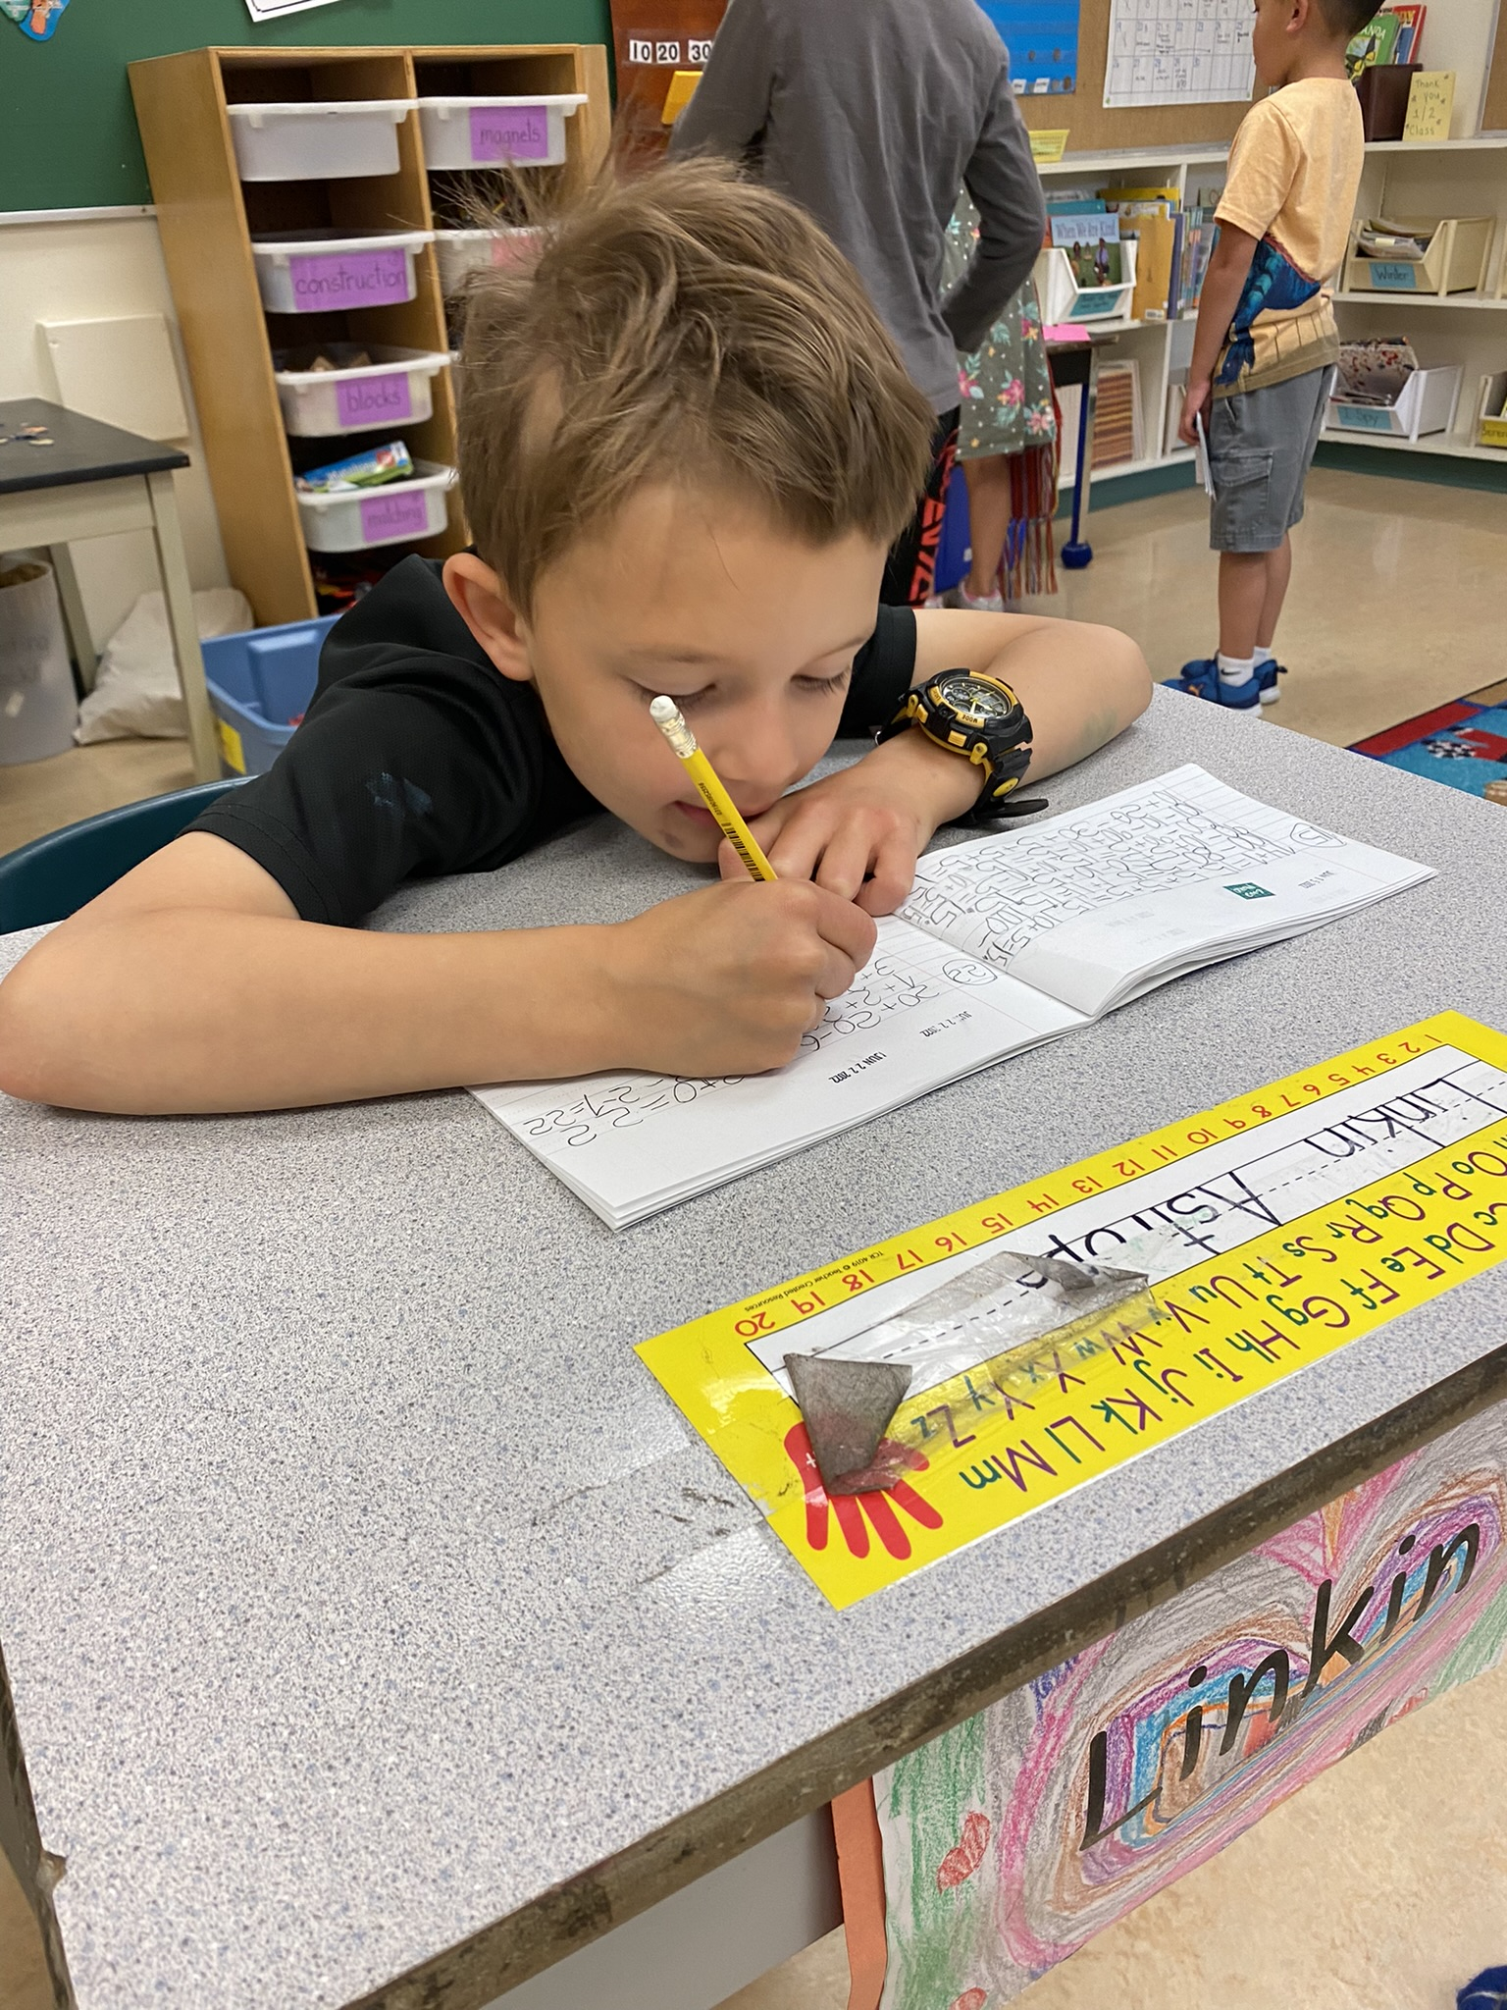
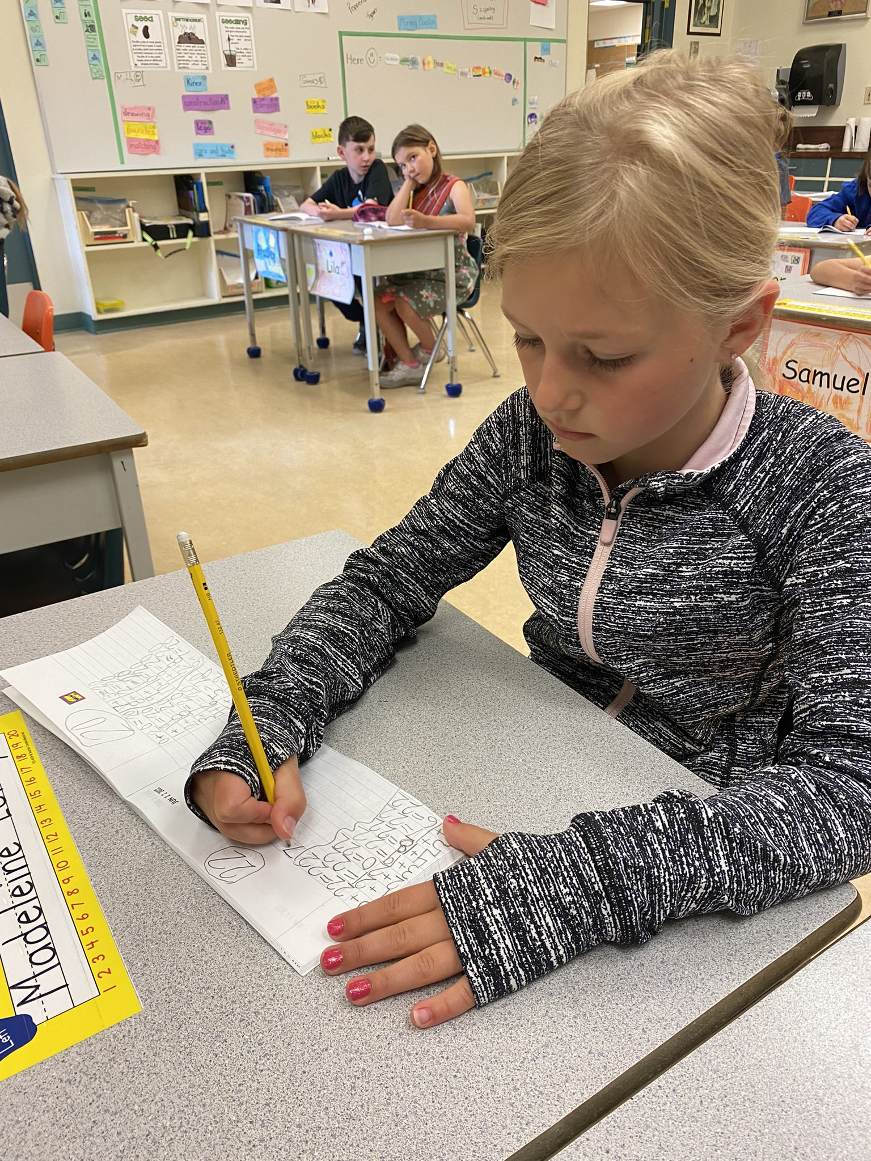
Strategic Priority Two
Success for all learners
Improve student Reading Achievement

Slide 11
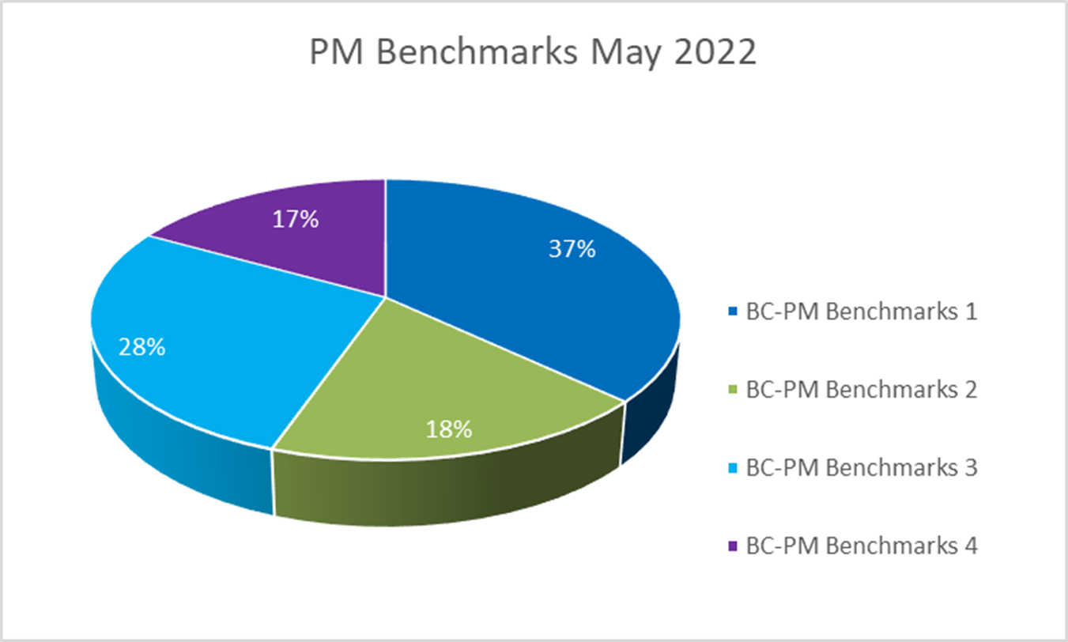
The dark blue and green area represents 55% of primary students who are not yet where expected in May 2022

Slide 12
The dark blue and green area represents 57% of intermediate students who are not yet where expected in May 2022.

Slide 13
Staff reviewed reading results for the 2021-2022 school year. While growth was noted for all students, it was not to the extent expected, as shown in the previous data slides. Therefore staff have continued to identify reading as an area of focus for next year.
Exploring stories and other texts help us connect to and understand ourselves, others and the world. Ensuring students are able to decode words at their grade level helps them actively engage with a variety of texts.
To what extent will staff focusing on daily decoding strategies impact student reading progress?

Slide 14
Review student samples monthly at staff meetings
Sept , Nov, Feb, April assess, program, review progress
Dec + March assess students of concern, adjust programming
April – May review progress, adjust programming, begin Spring assessments for all students emerging to proficient
75% of Spring PM Benchmark results will be on track at a 3 or 4
Fall PM Benchmark/F&P assessment
6-8 week program reviews (student need dependent)
Mid year re-assessment of students of concern
Spring PM Benchmark/F&P assessments
Designing effective Literacy blocks to allow for simultaneous independent and 1-1 student learning
Review a variety of current professional articles on research-based scaffolded decoding strategies
Analyzing PM Benchmarks and F&P assessments for personalized programming
District Literacy VP support
Commitment to training staff for consistent decoding instruction
IESW engaging resources and Indigenous Learning content
Assigned EA time LIF funding
https://heggerty.org/
Internal and External Instructional Rounds
Visible Learning Feedback - Hattie & Clarke
Reading Power – Gear
This is Disciplinary Literacy – Cossett Lent

Slide 15
Strategic Priority Two
Success for all learners
Improve student numeracy achievement

Slide 16
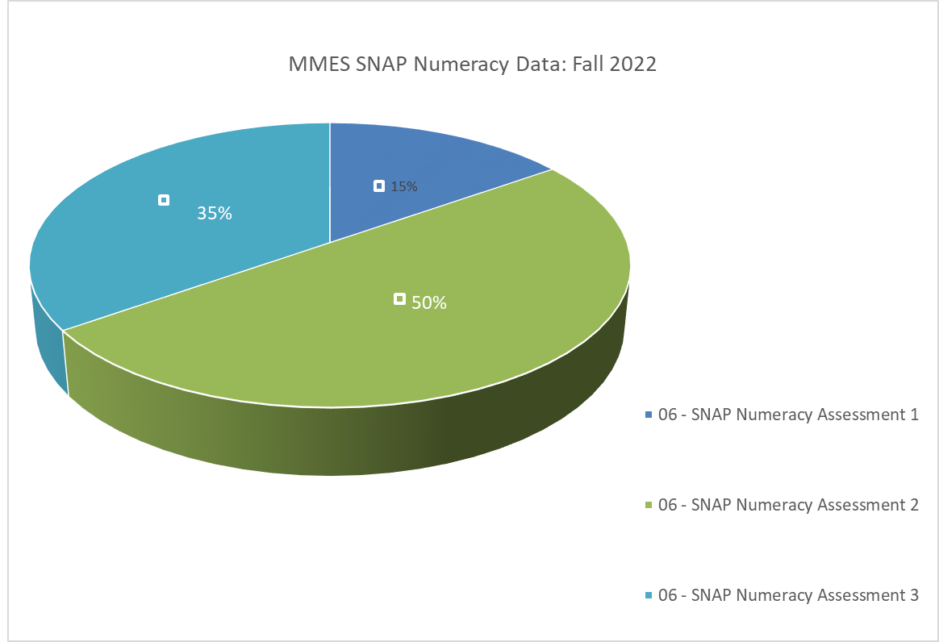
35% of MMES students who completed the assessment in May 2022 show complete proficiency as shown in light blue

Slide 17
Staff reviewed student results on the SNAP for the 2021-2022 school year and growth was not as expected. Therefore, staff have identified this as an area of continued focus with an adjustment to the strategy.
Reflecting on mathematical thinking helps students to connect numeracy concepts to each other and to other areas and personal interests.
To what extent will staff focus on intentional formative assessment during numeracy tasks impact student numeracy progress?

Slide 18
Review student math discussion feedback monthly at staff meetings
Sept , Nov, Feb, April assess, program, review progress
Dec + March assess students of concern, adjust programming
April – May review progress, adjust programming, begin Spring assessments for all students emerging to proficient
Fall SNAP assessment all students
6-8 week program reviews (student need dependent)
DEC Mid year SNAP re-assessment of students of concern
Spring SNAP assessments all students
50% or more students will meet proficiency standards in the Spring SNAP assessment
Effective Formative assessment
-Dylan Wiliam
-Hattie & Clarke
Using Numeracy journals as a feedback tool
District Numeracy VP support
IESW engaging resources and Indigenous Learning content
Instructional Rounds
Building Thinking Classrooms- Peter Liljedahl
Visible Learning Feedback - Hattie & Clarke
This is Disciplinary Literacy – Cossett Lent
Professional articles on effective numeracy journaling

Slide 19
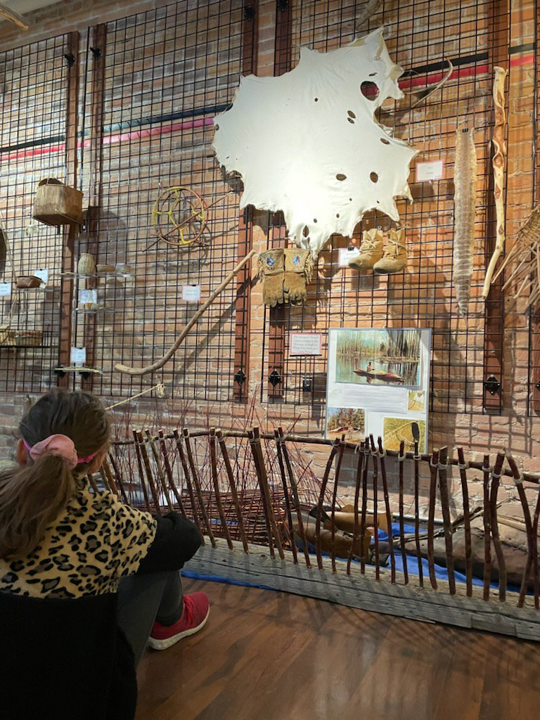
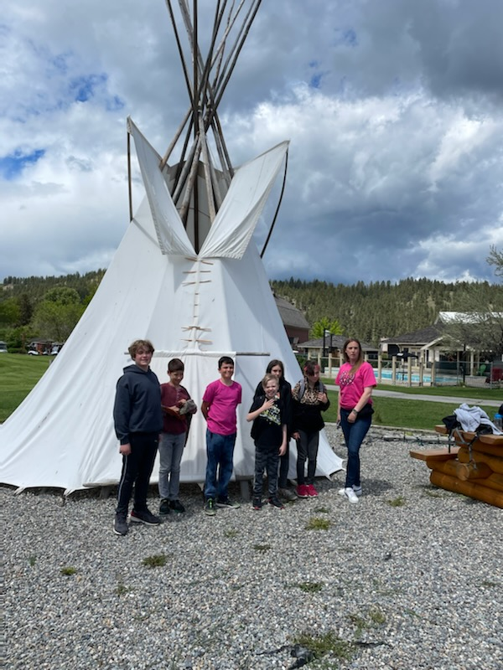
Strategic Priority Three
Excellence in Teaching and Leadership
Increase educators intentional use of formative assessment

Slide 20
Teachers identified that they would like more clarity on how to target data collection /evidence of learning to support the School Success Plan goals. Opportunities to share evidence of learning and discuss ways to actively include students in formative assessment were hindered by frequent staff and student absences making gaining traction difficult.
During the spring data analysis, teachers noticed that 2021-22 literacy and numeracy strategies did not result in expected outcomes. (See previous data slides)
Teachers wonder if there is a school wide focus on intentional use of formative assessment to identify learning needs and adjust teaching accordingly, will student achievement improve?
Research shows that "Student to teacher feedback is more important than teacher to student", and "effective feedback occurs when it is received and acted upon". Teachers will research and practice teaching themselves and students to "receive, interpret and use feedback" (Hattie & Clarke, 2019) through formative assessment across targeted subject areas to inform their day-to-day instructional programming.
If teachers participate in monthly learning about and practice of formative assessment, will they report feeling more confident in interpreting feedback to inform programming?

Slide 21
Teacher reflective question pre-survey
Monthly reflective questions
August - late Sept research and collaborative planning
Oct-June Every second or third week, teacher connect time at staff meeting to evaluate process
Research and identify elements of effective feedback culture
Research through professional literature to identify areas to adjust formative assessment feedback for optimum results
PD opportunities to review student assessment opportunities and identify evidence of learning
-Monthly staff meetings -District Literacy & Numeracy VPs
Instructional Rounds
https://www.dylanwiliam.org/Dylan_Wiliams_website/Welcome.html
Visible Learning Feedback - Hattie & Clarke
This is Disciplinary Literacy – Cossett Lent
Building Thinking Classrooms in Mathematics--Liljedahl
All teachers report using formative assessment feedback routinely every day on teacher survey
Aug PD days for research and first strategy for implementation
Every 6-8 weeks share, review, research, adjust
Fall and Spring district and provincial assessments

