Slide 1


September 2022
J. Alfred Laird Elementary School

Slide 2


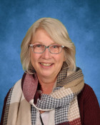
Weytk Ki?suk Kyukyit Tawnshi Welcome Bienvenue
It is an honour and a privilege to work, learn and play on the traditional, shared, unceded territory of the Secwepemc and Ktunaxa people, and the land the Métis people of BC have chosen as their home.
As a staff, we continue to build our skills to ensure that we are addressing the needs of all students in a way that is respectful and compassionate. This School Success Plan outlines some of the areas we will be focusing on in this school year as we seek to support all students to feel welcome, cared for and successful at school.
We are proud to be a Leader in Me™ school. Leader in Me™ is an evidence-based, comprehensive model that builds leadership and life skills in students, creates a high-trust school culture, and lays the foundation for sustained academic achievement. We invite our families to be partners in our Leader in Me™ journey.
Terri Ann Hayes
Principal,
J. Alfred Laird Elementary

Slide 3
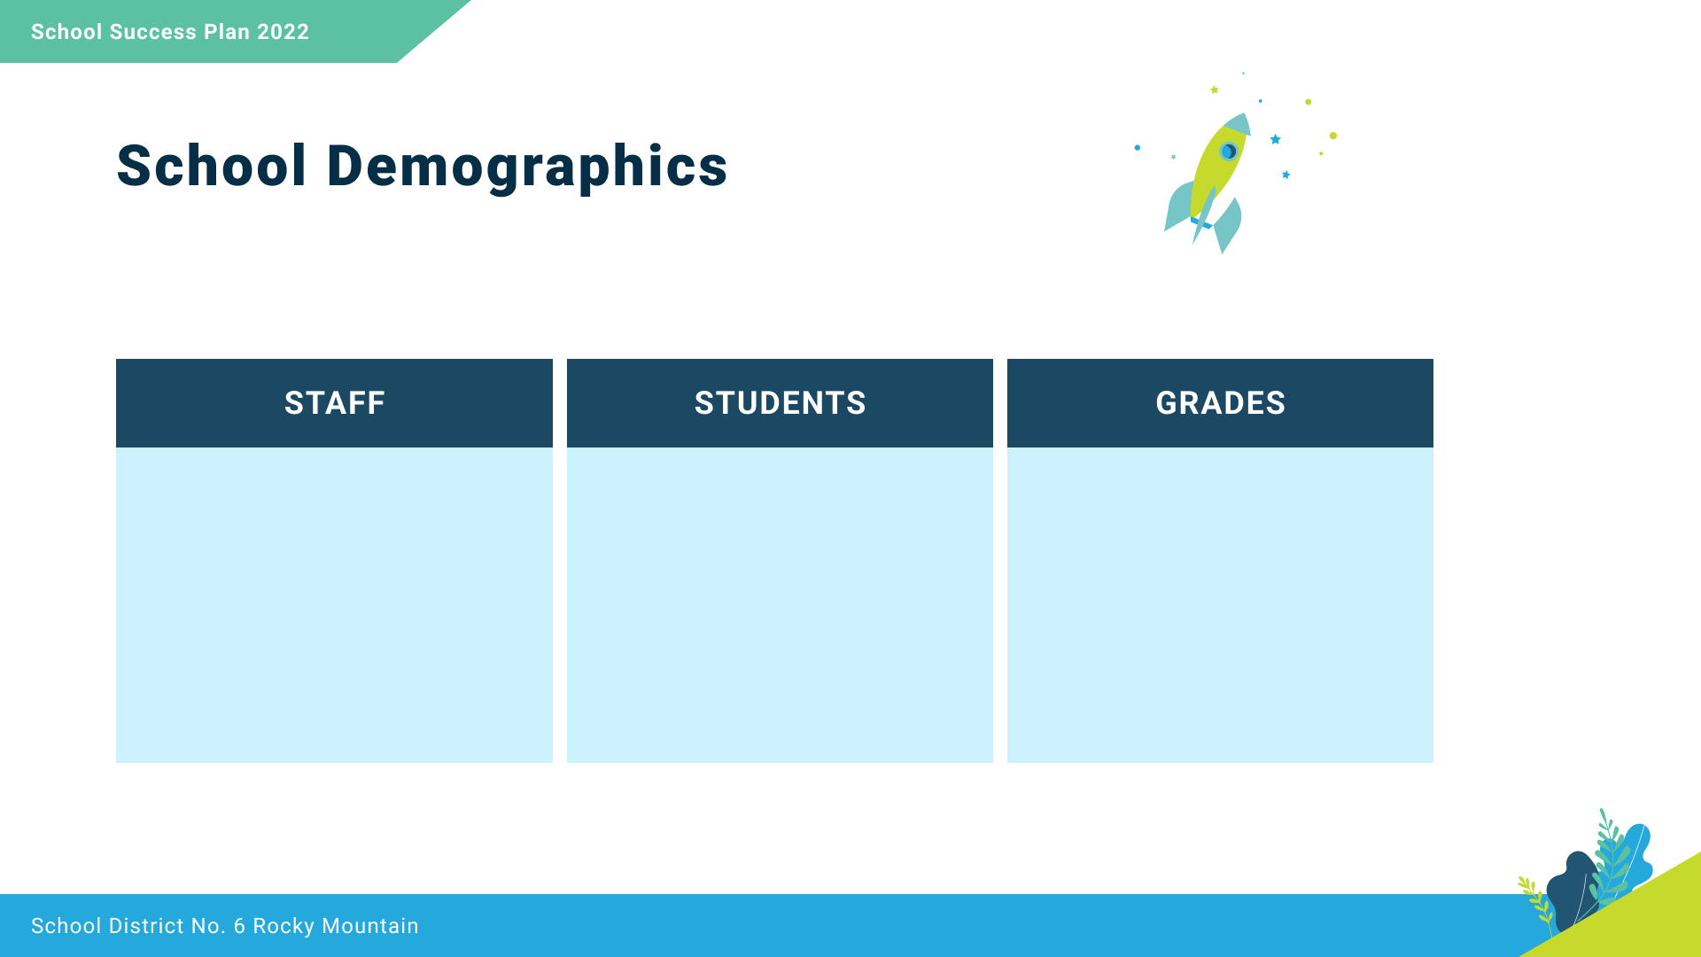
11 Teachers
7 Education Assistants
1 Administrative Assistant
1 School Counsellor
1 Youth Care Support Worker
1 Community Link Worker
1 Indigenous Education Support Worker
1 Vice Principal & 1 Principal
248 Students
55 students with Indigenous ancestry
4-7
and
Intensive French 6 and 7

Slide 4

We collaborate in the pursuit of each student’s success as knowledgeable, caring, resilient, and contributing members of a global community.
Respect
We foster respectful relationships
that build trust, safety and well-being
Equity
We strive to build learning environments that are equitable, honor diversity and inclusion, are safe, caring and healthy places to work and learn.
well-being.
Integrity
We nurture a sense of self-awareness, responsibility and honesty to become environmental stewards and morally upright global citizens.
Accountability
We are accountable for ourselves, our students and our communities for professionalism, transparency and quality results.
Innovation
We create learning opportunities that are high quality, place-based, creative, and that encourage students to reach their full potential.
Opportunity, equity,
and success for ALL learners

Slide 5

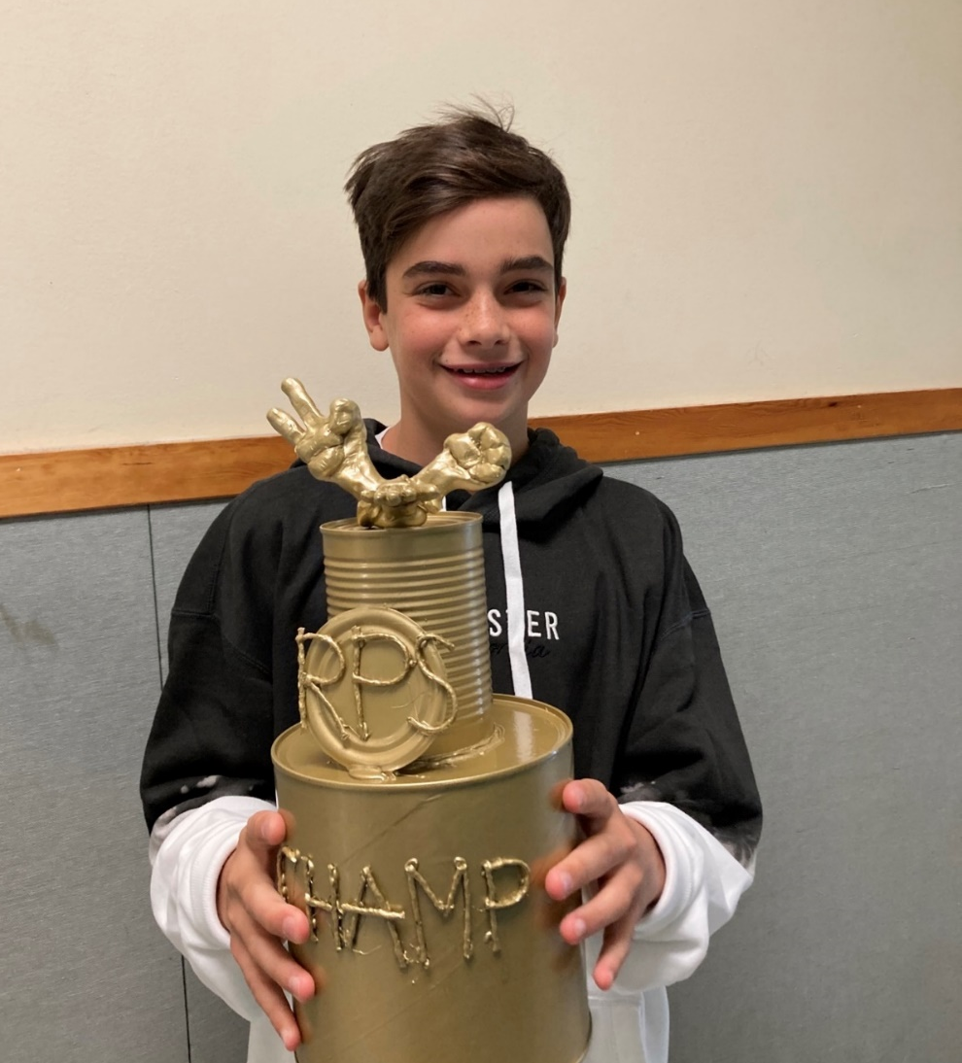
Equity & Inclusion
To increase students’ sense of connectedness at school.
Leader in Me™ focus:
Put first things first;
Begin with the end in mind;
Synergize;
Be proactive.

Slide 6


Slide 7
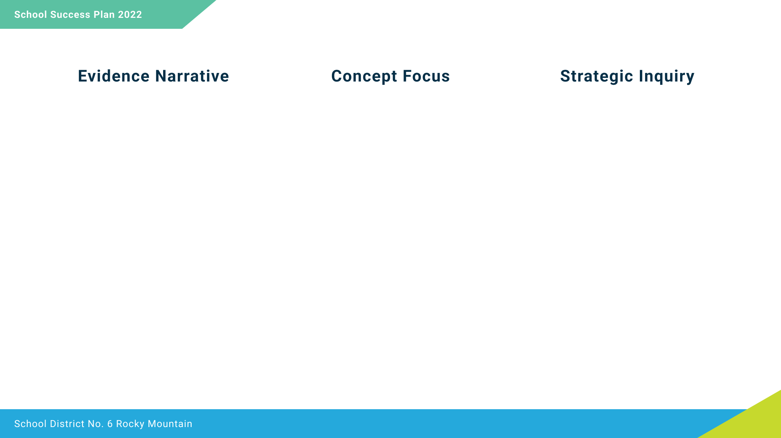
The evidence reveals that we continue to have work to do to ensure students feel that they belong at school, and that adults are here to help them when they have a problem.
The Leader in Me classroom-based Morning Meeting is designed to:
Set the tone for respectful learning;
Establish a climate of trust;
Motivate students to feel significant;
Create empathy and encourage collaboration;
Support social, emotional and academic learning.
If we set aside 15 minutes each morning in the classroom to hold a Leader in Me™ Morning Meeting with students, will students report feeling a greater sense of belonging and support from adults?

Slide 8
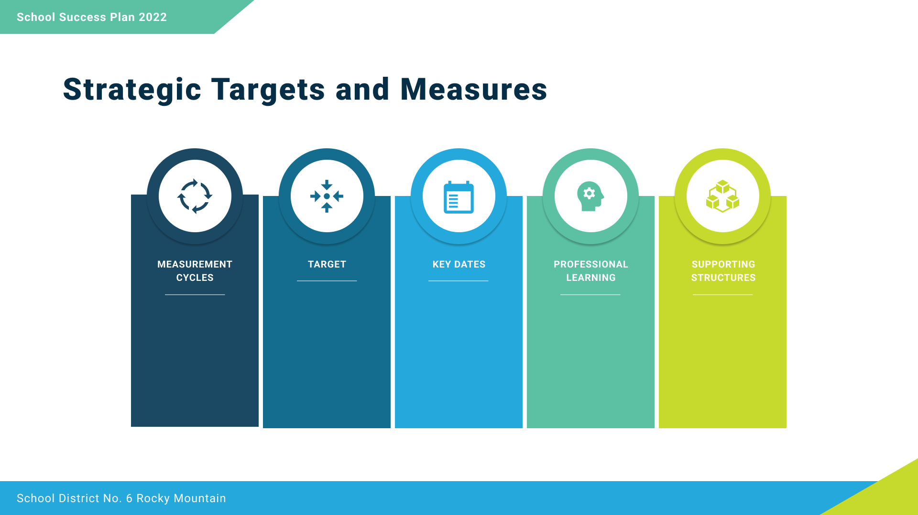
September 2022 and May 2023: Leader in Me student survey
April 2023 Student Learning Survey
Student Learning Survey 1X/year
Leader in Me student survey 2X/year
That 75% of students will report a sense of belonging most or all of the time on the Student Learning Survey in April 2023.
Monthly staff meeting focused on Leader in Me
September: all staff take day-long on-demand 7 Habits training
Teacher-led Lighthouse Team
7 Habits Teacher Training
Monthly Instructional Rounds focused on morning meeting

Slide 9
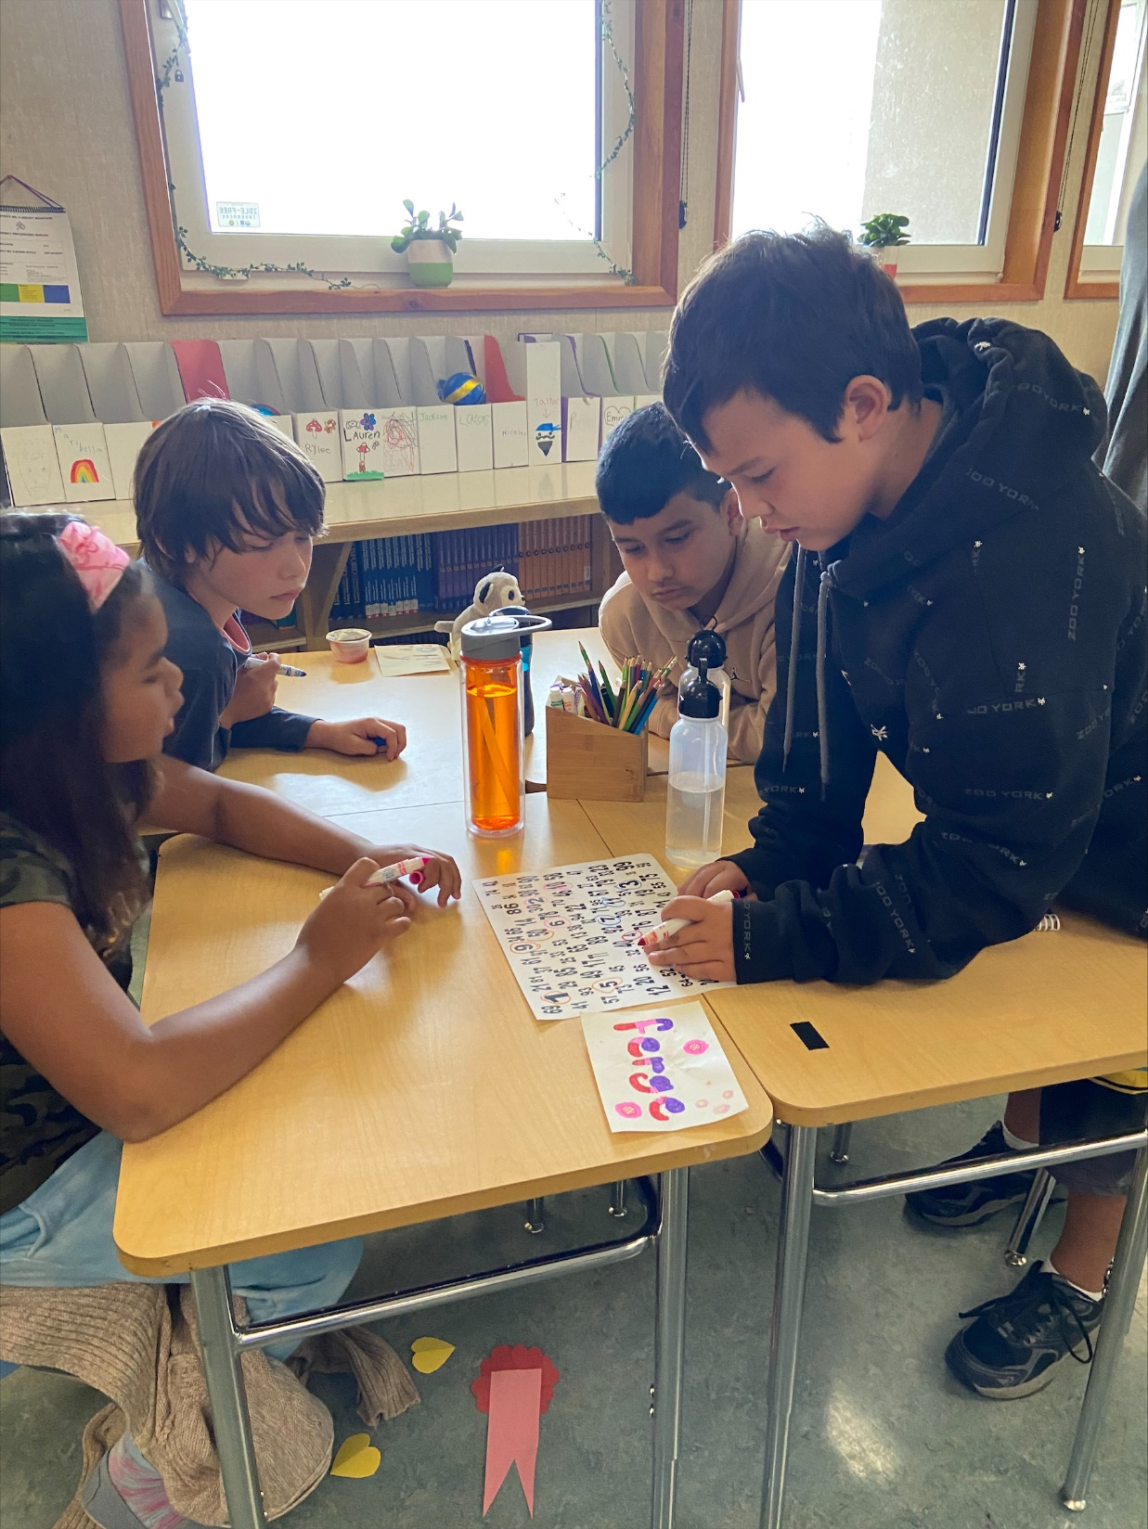
Success for all Learners
That all students will experience self-awareness that they are improving in Math.
Leader in Me™ focus:
Think win-win;
Begin with the end in mind;
Be proactive.

Slide 11
Survey results indicate that 31% of Grade 4 students, and 27% of Grade 7 students either feel they are not improving in math, or are unaware of their improvement in math. If students cannot see their growth and improvement, they are less likely to persevere and put forth their best effort. We want to create classroom environments where every child feels successful, and knows that they are improving.
Differentiated Numeracy instruction.
If we improve in our ability to differentiate math tasks, to meet the needs of the varying ability levels of students in our classroom, will students develop a greater sense of confidence and continuous improvement in math?

Slide 12
By April 2023, 10%
increase in the number of students who respond to the Student Learning Survey that they agree or strongly agree that they are getting better at math.
April 2023: Student Learning Survey
October 2022 and May 2023: SNAP assessments
1X/year
Student Learning Survey Results
2X/year SNAP assessments
Report card results 3X/year
Weekly student exit slips
Professional development days with the district vice-principal: numeracy
Monthly Staff Meetings focused on rich tasks and differentiation
Monthly Instructional Rounds
Good Questions: Great Ways to Differentiate Mathematics by Marian Small

Slide 13

Success for all Learners
To improve reading success for all students.
Leader in Me™ focus:
Begin with the end in mind;
Be proactive.

Slide 15
The traditional narrative is that primary students learn to read, while older students read to learn. However, our May 2022 reading scores point out that almost 1/3 of our students are reading at an emerging level. These students struggle with reading fluency in the lower levels, and with reading comprehension at the higher levels. As a result, they are not yet ready to “read to learn”, and will need focused interventions to support them to become confident, capable readers.
Smart Learning reading strategies are targeted toward setting specific goals during pre-reading, reading and post-reading.
If all staff work with children to set goals for their reading, will we see an increase in the percentage of children reading at a developing level or higher?

Slide 16
That 85% of our students will be reading at a developing level or higher by May 2023.
October 2022 and May 2023: Fountas & Pinnell Reading Assessments
January 2023: Fountas & Pinnell Reading Assessments for those students identified as emerging in their reading.
Fountas & Pinnell Reading Assessments 2X/year, plus one additional assessment for our struggling readers.
Student goal-setting portfolio
1 staff meeting/month dedicated to goal setting for pre-, during and post-reading.
Monthly Instructional Rounds dedicated to observing reading instruction and goal setting.
District vice-principal: Literacy

Slide 17
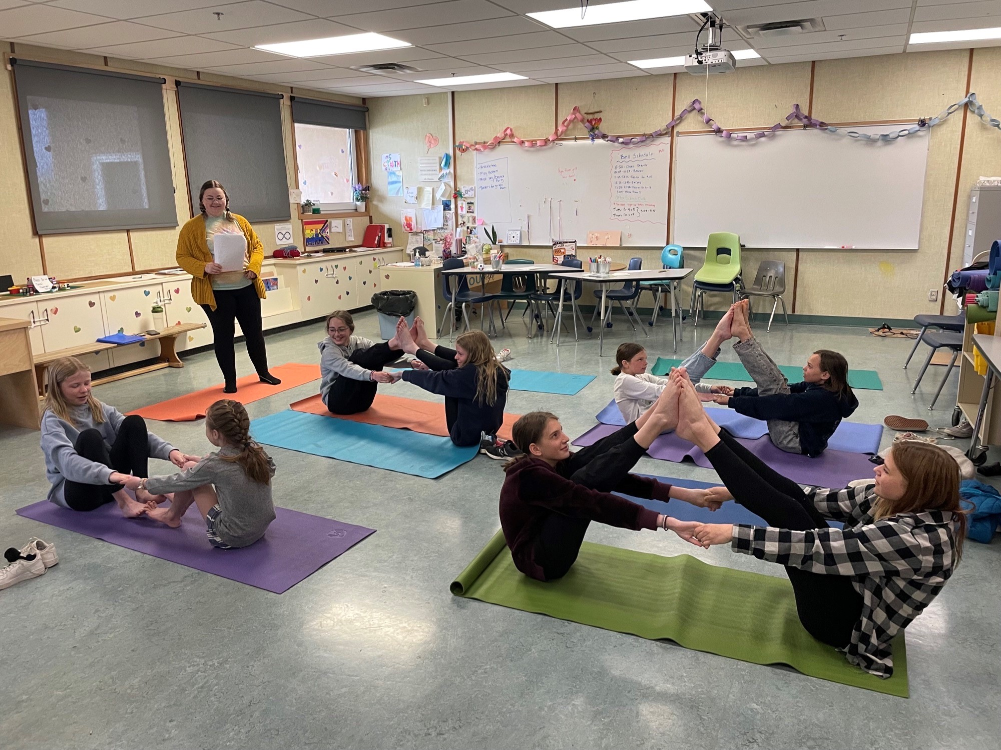
Excellence in Teaching & Leadership
To increase staff awareness and understanding of trauma-informed practice.
Leader in Me™ focus:
Seek first to understand, then to be understood;
Think win-win;
Be proactive.

Slide 18
I feel confident applying trauma-informed principles.

Slide 19
Although we have seen overall improvement in students’ sense of belonging and connectedness, we still have a small pocket of children who do not feel like they have adults (and in many cases, peers) at school who care about them. Only 20% of staff feel they have the tools and expertise to effectively support and nurture these children.
Trauma-informed, compassionate schools. Compassionate Schools benefit all students who attend but focus on students chronically exposed to stress and trauma in their lives. These schools create compassionate classrooms and foster compassionate attitudes of their school staff.
If we build our staff capacity in understanding trauma-informed practice, will our ability to teach social-emotional learning improve?

Slide 20
That all staff will indicate an increased understanding of trauma-informed practice by May 2023
September 2022, January 2023 and May 2023: Staff Questionnaire
Monthly exit slips
Staff survey 3X/year
Staff meeting exit slips
Monthly staff meetings in conjunction with staff at EMP
Book Study
District Vice Principal: Learning Support Services
What Happened to You: Conversations on trauma, resilience and healing by Dr. Bruce Perry

