Slide 1



Nicholson Elementary School
2023-2024
Nicholson Elementary School

Slide 2


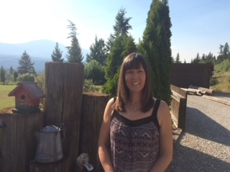
Welcome to Nicholson Elementary School, where we are a community of life-long learners who connect, synergize and positively influence each other and the world around us.
Nicholson Elementary School is a K-7 school located on the traditional unceded territories of the Ktunaxa and Secwepemc peoples and the chosen home of the Metis People of British Columbia. Nicholson Elementary is a rural school of 87 students for the 2023-2024 school year. Learn, Love, Lead communicates the values that the Nicholson Community holds for ourselves and others.
At Nicholson Elementary, the educational staff review assessment practices on an ongoing basis by participating in School Based Team Meetings, Class Profile Meetings and Staff Meetings where we look at formal and informal assessments which guides us in determining our strengths and areas that require additional focus. This information supports us in developing the goals for the School Success Plan.
Through this process we have developed goals to increase students’ sense of belonging, improvement in students reading and numeracy achievement and an increase in the quality and frequency in collaborative opportunity for the educational staff. We have developed a new goal of all Nicholson Elementary members learning some words and phrases in each of the local Indigenous Languages. Following is the plan that we have developed that specifically outlines the steps that we will use throughout the school year in order to reach the outlined goals.
Margo Reinders Principal, Nicholson Elementary
Kiʔsuk kyukyit
Weyt-kp
Tawnshi
Hello

Slide 3
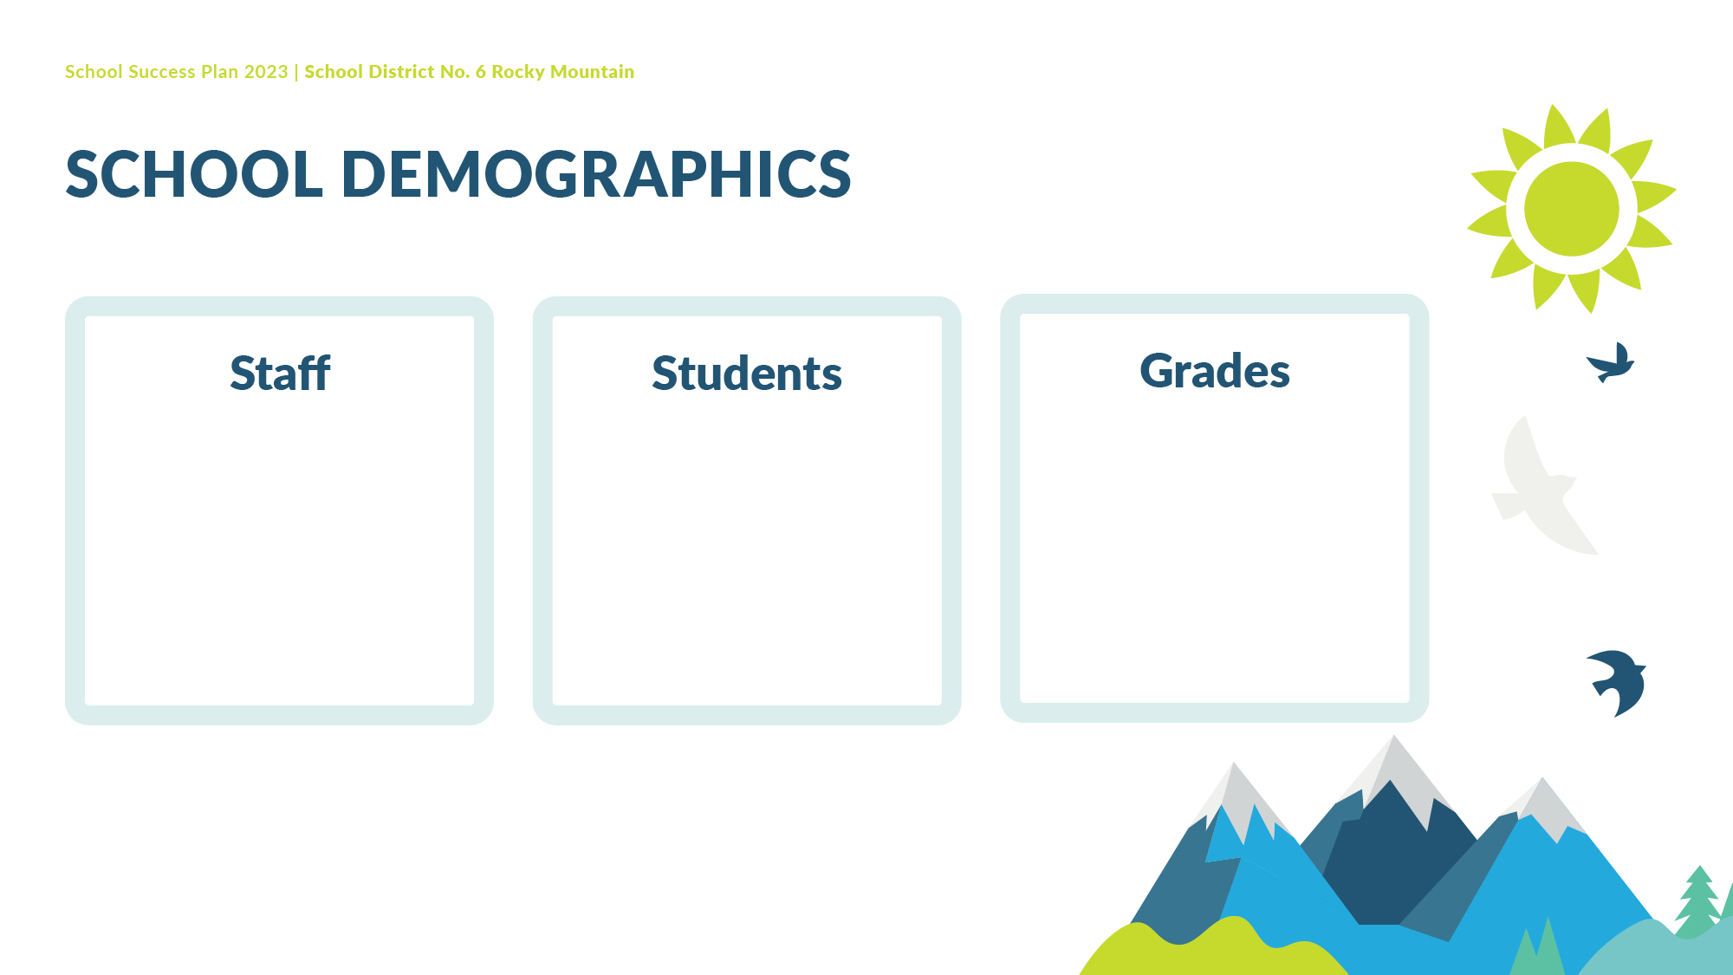
7 Teachers
6 Support Staff
2 Itinerant Staff
1 Administrator
87
K-7

Slide 4

Learn, Love, Lead
Kindness
Respect
Leadership
Belonging
Collaboration
Nicholson Elementary is a welcoming, happy place to be.
We are a community of life-long learners who connect, synergize, and positively influence each other and the world around us.
We strive for success today and prepare for success tomorrow.

Slide 5

Equity, Diversity, and Inclusion
Increase a Sense of Belonging for All Students

Slide 6
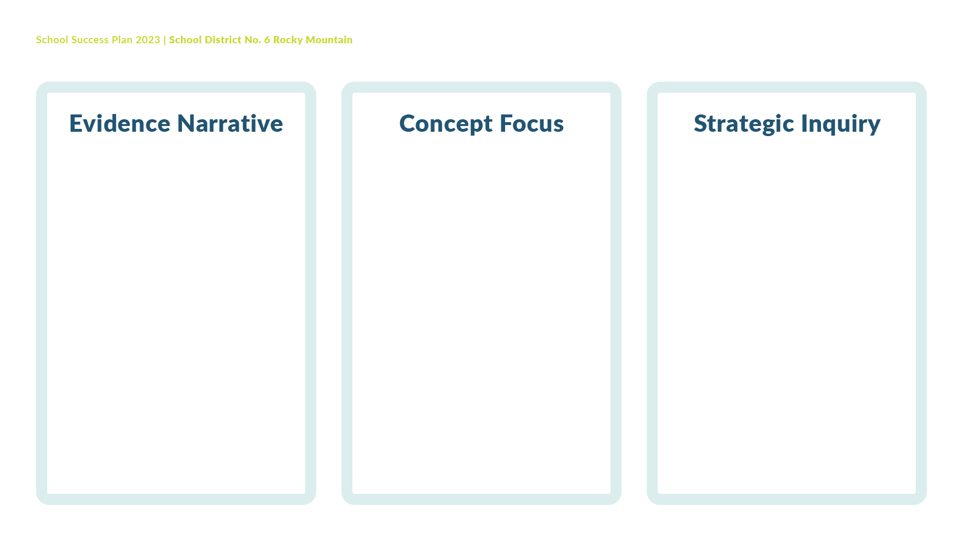
Student results on the Belonging Survey were discussed three times during the past year with staff. The team determined through this assessment that students’ feelings of belonging would continue as the strategic inquiry with a focus on Intermediate students. The percentage of students who feel they belong is lower at the Intermediate level than at the primary level.
Students identifying that they feel the school is a place where they belong is the area of focus for the school year.
To what extent will adults facilitating a classroom community circle practice, once a week, increase students' sense of belonging according to staff developed Community Circle Questions?

Slide 7


Slide 8
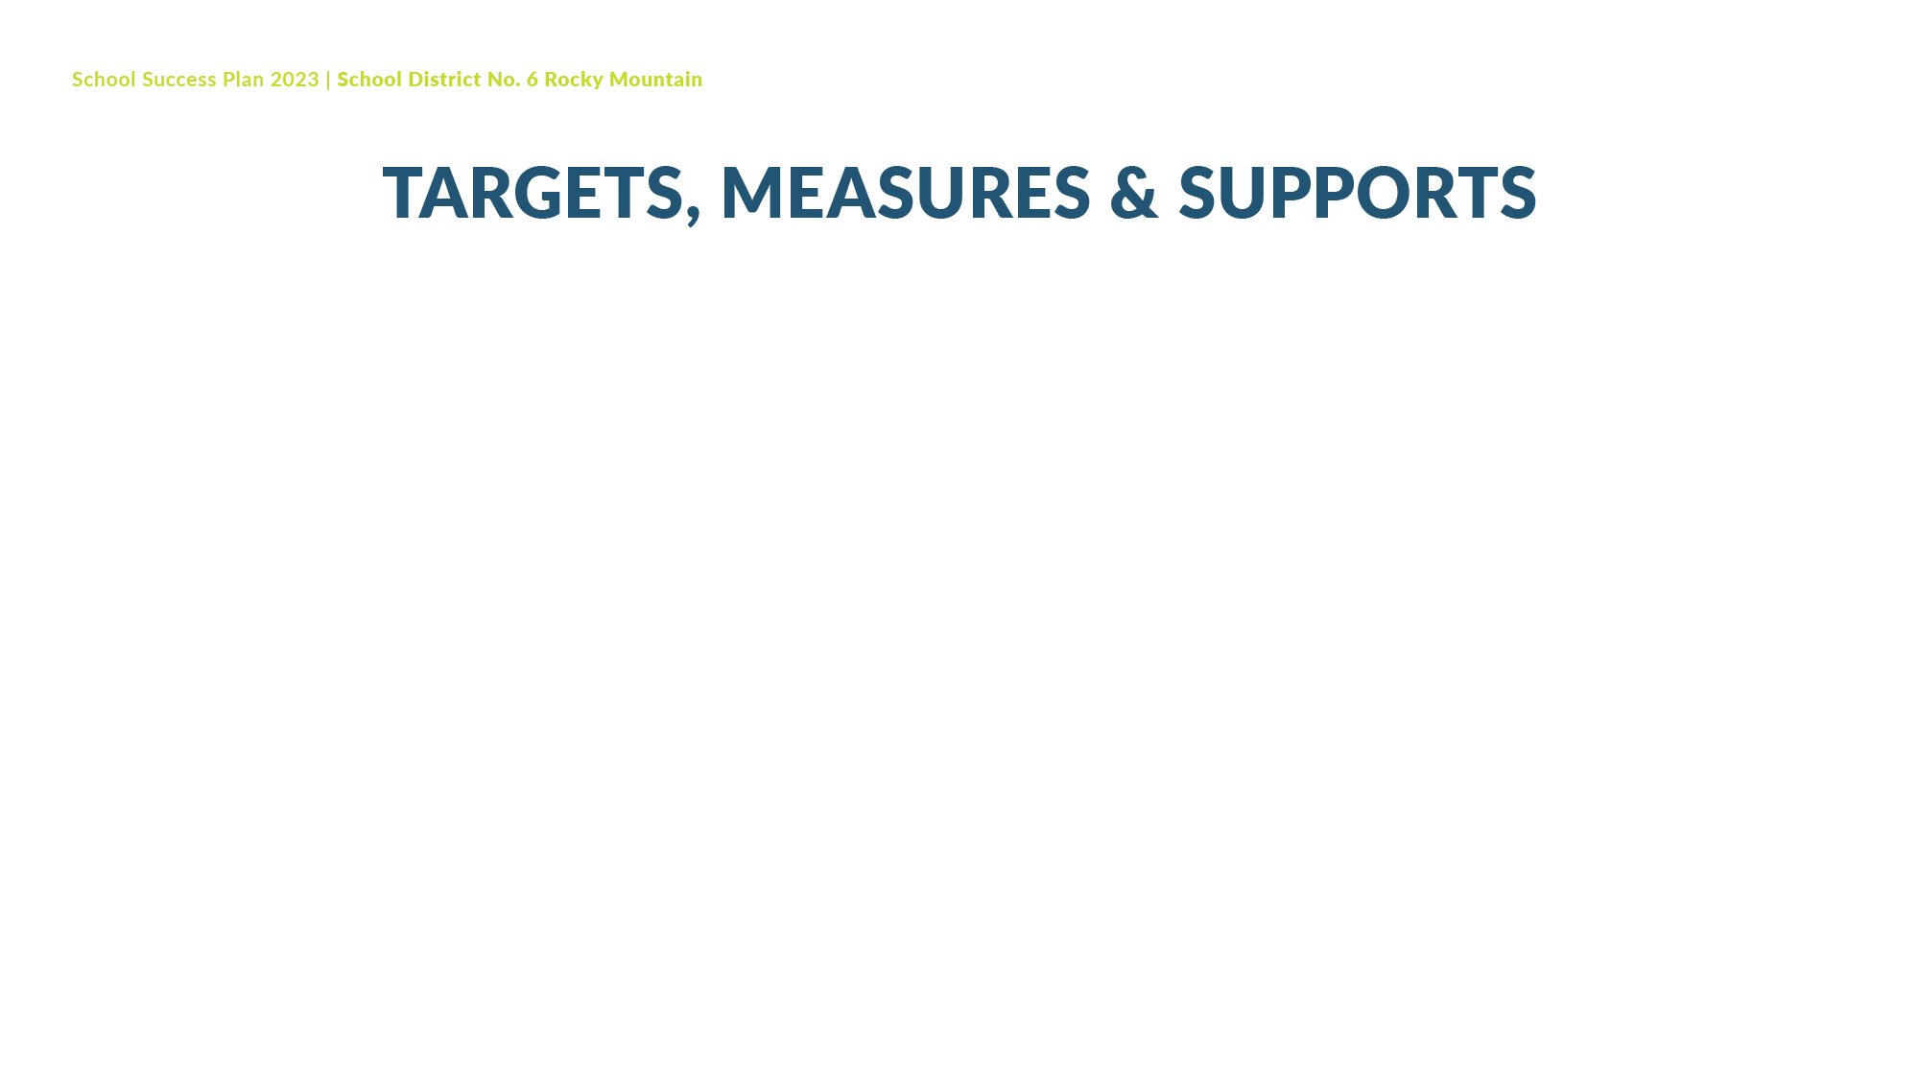
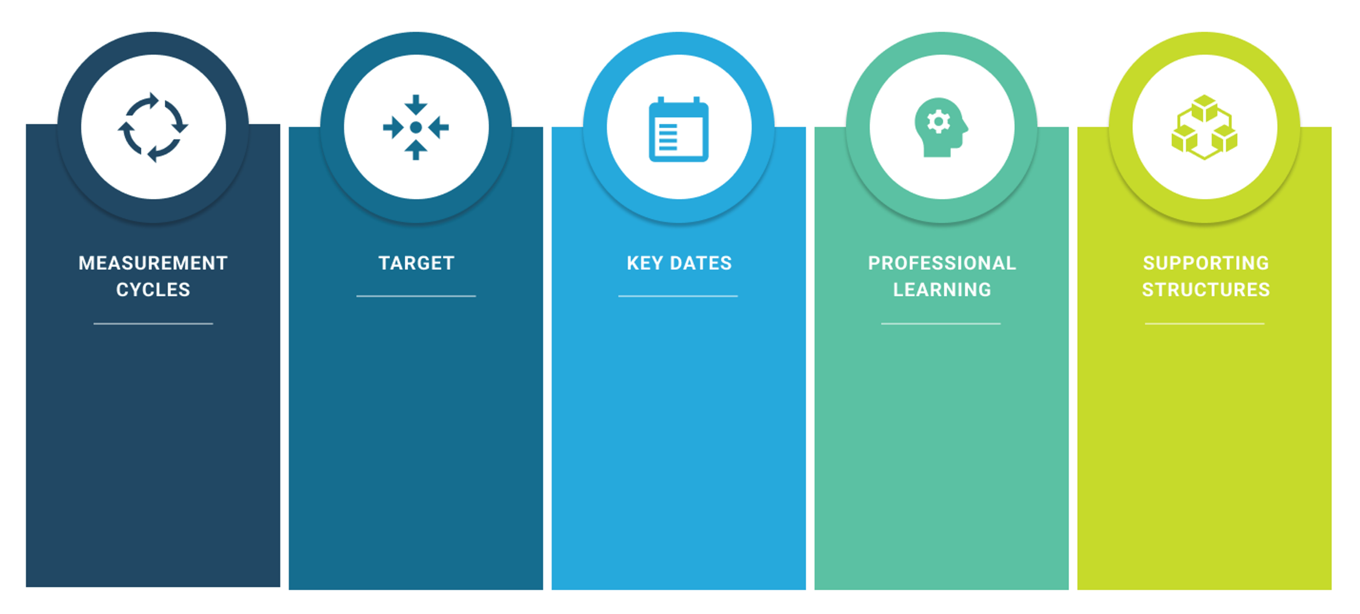
66% report a Sense of Belonging Most of the Time to 75% report a Sense of Belonging Most of the Time.
Collect Student’s response to Community Circle directed questions at the end of the month Sept-June
Collaborative Conversations on the structure and use of Community Circles
Staff Meeting time used for creating and discussing the community circle practice, developing monthly key questions and monitoring the goal
Staff Meeting discussion once a month
Sept-June

Slide 9

During the first staff meeting, we will discuss the Community Circle Practice and the important structures that we want to be in place, such as it being a safe space where all members are valued for their contributions. Teachers will initiate the practice in their classrooms at least once a week. During the second staff meeting, we will develop the specific Community Circle question for the month of September and decide how teachers would like to record these artifacts in their classroom. At the following staff meeting, the staff will discuss the artifacts they have collected and how the Community Circle practice is working in their classroom. We will cycle through this process on a monthly basis which will include an evaluation of our goal and if any revisions should be made.
The District Vice-Principal of Early Learning will support the staff in developing ways in which to record and capture artifacts that demonstrate this learning.

Slide 10

Success for Each Learner
Improve Reading Achievement for All Students

Slide 11
Student results on the Reading Benchmark Assessment were discussed three times during the previous year with staff.
We determined through this assessment that reading was the primary focus for literacy in our school. The team feels that for the students emerging or developing in reading according to the Reading Benchmarking assessment, the focus needs to be in decoding skills, specifically phonological and orthographic skills.
Decoding using Phonological Skills will be the focus. This will support the reading achievement for 37% of the students to grow from emerging or developing to proficient according to the Reading Benchmark Assessment.
To what extent will teaching specific reading strategies, focused on decoding, during small reading groups affect students’ overall achievement as measured by the Phonological Assessment?

Slide 13
All students will have developed grade specific phonological skills.
Beginning and end Phonological assessment of the 4-6 week classroom block of small reading groups
Collaborative discussions on the topic of reading, decoding skills, phonological awareness and orthographic knowledge
Staff Meeting time used for collaborative dialogue about reading, decoding skills, phonological awareness and monitoring the goal
Phonological Assessment at the beginning and end of each of the four classroom blocks of small reading groups

Slide 14
Starting the third week of September, the Teacher, the Learning Assistance Teacher and the Principal will work in one classroom for 4-6 weeks, teaching phonological skills to small groups of students. Each student will complete the pre and post phonological assessment which will be used to track the progress of the goal as well as determine which students will need further support in developing these skills to grade level. This process will take place for the four classrooms and if time permits, we will revisit a classroom that shows the most need for continued support.
The educational team would like to learn more about phonological awareness and the skills needed that support proficient reading and writing. We will continue to investigate the use of phonological and orthographic programs and resources to further our learning to support students in their reading and writing acquisition.
The District Vice-Principal of Literacy will support the educational staff is developing their skills in Phonological Awareness and Orthographic Knowledge.

Slide 15
Success for Each Learner
Improve Numeracy Achievement for All Students

Slide 16
There has been a history of focus on students being able to communicate their literacy thinking which has not transferred into numeracy. The staff would like to focus on students being able to communicate their numerate thinking using the Numeracy Communication Rubric to assess student progress.
Students being able to communicate their numerate thinking is the concept focus.
To what extent will all teachers, using the Think/Pair/Share strategy, once a month, increase student’s ability to communicate their understanding of numeracy concepts?

Slide 18
Students’ numerate communication responses at the end of the month Sept-June
Assessment of Numerate Thinking using the rubric once per term.
Collaborative time to learn how to use the Communication Skill of the Numeracy Proficiency Scale and practice using the Think/Pair/Share strategy
Staff Meeting time used to collaborate on the use of the Numeracy Proficiency Scale and using it to assess students’ numerate communication skills.
Staff Meeting discussion once a month
Sept-June
70% of students are proficient in communicating their numerate thinking

Slide 19
During a Staff Meeting in September, the staff will discuss the Think/Pair/Share strategy and how to use it in the classroom. As well, each teacher will choose a numeracy activity that they will use in class to practice the Think/Pair/Share strategy as well as choose a way in which they will record student responses. These student responses will be reviewed and using the Numeracy Proficiency Rubric focused on Communicating Thinking, will be assessed. We will cycle through this process once a term which will include an evaluation of our goal and if any revisions that should be made.
The District Vice-Principal of Numeracy will support the staff in using the Think/Pair/Strategy in the Numeracy Classroom and how to develop a rubric to assess Numerate Communication Skills.

Slide 20

Growing Capacity of Self and Others
Increase Quality and Frequency of Collaborative Opportunities

Slide 21
Staff have had opportunities to participate in a variety of collaborative opportunities with colleagues and have benefited from these discussions. The staff would like to continue this practice with further opportunities to discuss student learning.
The staff would like to focus the priority on continuing to diversify our collaborative opportunities to discuss student learning.
By participating in the collaborative practice of discussing student learning, will educational staff report greater opportunity to diversify a collaborative culture?

Slide 23
All Educational Staff have participated in a collaborative practice six times during the year.
Two collaborative practices by the end of each term November, March and June
Discussion with educational staff about what collaborative practices they would like to take part in and developing new opportunities.
Staff Meeting time used to discuss and record progress by evaluating the Collaborative Practices and monitoring the goal.
All Education Staff participate in collaborative practices twice per term.

Slide 24
The Educational Staff will review and discuss this goal on a monthly basis, sharing collaborative practices that they have been involved in and developing plans for further opportunities.
The District Vice-Principals will be asked to support these collaborative opportunities in their specific area of practice such as the Primary Teachers collaborating using the Early Learning Framework with the support of the District Vice-Principal of Early Learning.

Slide 25

Stewardship for the Future
All Members of the Nicholson School Community Learning
Local Indigenous Languages

Slide 26
A staff member had the opportunity to attend a Professional Learning opportunity where they learned words and phrases in Ktunaxa, Secwepemc and Michif. The staff would like to support the growth of the use of Local Indigenous Languages for all community members.
The concept focus is revitalizing local Indigenous languages for the future.
To what extent will teachers using Indigenous words and phrases increase the use of Indigenous Languages for the students?

Slide 27
All community members are able to identify their use of Local Indigenous Languages
Students and staff self reflection at the end of each term
November, March and June
Staff Collaboration on learning and sharing simple words and phrases in Local Indigenous Languages
Supporting Indigenous Language Teachers in coming to the school to work with students and staff.
Students and staff complete a self reflection once per term.
Staff Meeting time to discuss targeted Indigenous Language instruction and monitor the goal.

Slide 28
Staff will meet and discuss which language, Ktunaxa, Secwepemc or Michif, to start to learn some simple words and phrases. We will focus on one language per-term. We will use the Indigenous Education support worker, the District Vice-Principal of Indigenous Education and local Indigenous Language Teachers to support our goal. We will evaluate our goal at the end of each term and decide if any revision are required.

